Slide 1

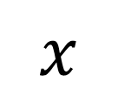









$$8$$
$$8$$
$$8$$
$$24$$
$$\frac{x}{3}$$
$$\frac{x}{3}$$
$$\frac{x}{3}$$
$$x$$
$$x$$
$$8= \frac{x}{3}$$
$$24=x$$
Multiply both sides by three.

Slide 2
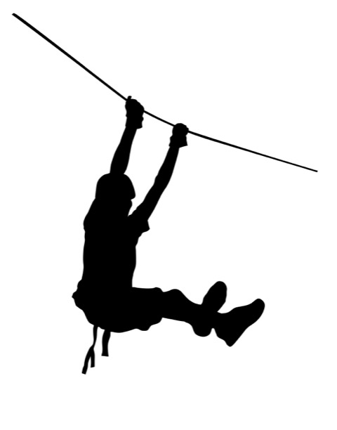

$$\sin{25.07=}\frac{h}{59}$$
Look up sin 25.07 on your calculator.
59m
h
25.07◦

Slide 3

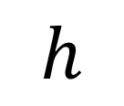





$$0.42$$
$$24.78$$
$$h$$
$$\frac{h}{59}$$
$$h$$
$$0.42= \frac{h}{59}$$
$$24.78=h$$
Multiply both sides by 59.

Slide 4


Practice Example
$$\cos{23.63=}\frac{d}{8777}$$
Look up cos 23.63 on your calculator.
8777m
23.63◦
d

Slide 5

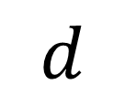

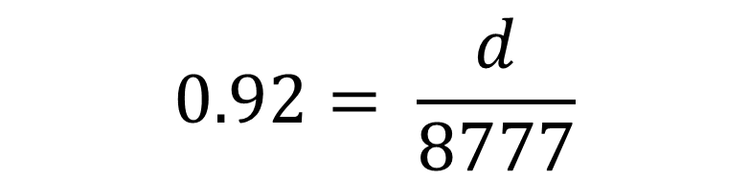


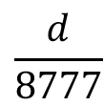
$$0.92$$
$$8074.84$$
$$d$$
$$\frac{d}{8777}$$
$$d$$
$$0.92= \frac{d}{8777}$$
$$8074.84= d$$
Multiply both sides by 8 777.

Slide 6














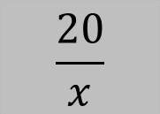
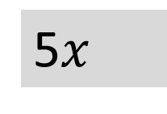

$$x$$
5$x$
$$x$$
$$x$$
$$x$$
$$x$$
$$5$$
$$\frac{20}{x}$$
4
$$20$$
$$4$$
$$4$$
$$4$$
$$4$$
$$20$$
$$5= \frac{20}{x}$$
$$5x=20$$
Multiply both sides by x.
$$x=4$$
Divide both sides by 5.

Slide 7
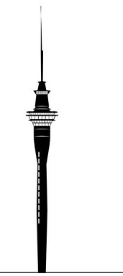

$$\tan{26=}\frac{328}{d}$$
Look up tan 26 on your calculator.
328m
26◦
d

Slide 8
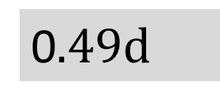









$$0.49$$
0$.49d$
$$d$$
$$\frac{328}{d}$$
$$328$$
$$669.39$$
$$328$$
$$0.49= \frac{328}{d}$$
$$0.49d=328$$
Multiply both sides by d.
$$d=669.39$$
Divide both sides by 0.49.

Slide 9

Practice Example
$$\sin{34=}\frac{66}{l}$$
l
66m
34◦

