Slide 1
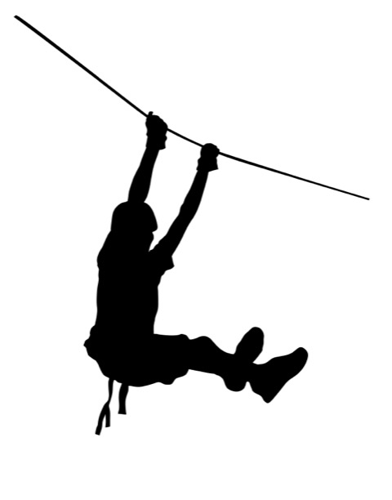

$$\sin{25.07=}\frac{h}{59}$$
59m
h
25.07◦
Imagine you know the length of the zipline and the angle of elevation.
How will you find the height (h)?

Slide 2

$$\sin{34=}\frac{66}{l}$$
l
66m
34◦
Imagine you know the height and the angle of elevation.
How will you find the length of the zipline (l)?

Slide 3
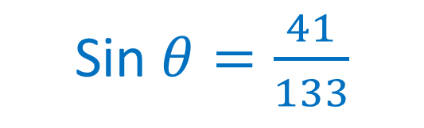
Sin $θ=\frac{41}{133}$
133m
41m
θ
Imagine you know the height and the length of the zipline.
How will you find the angle of elevation (θ)?

Slide 4


$$\cos{23.63=}\frac{d}{8777}$$
8777m
23.63◦
d
Imagine you know the length of the slope and the angle of elevation.
How will you find your horizontal distance from the summit (d)?

Slide 5

$$\cos{23.63=}\frac{8041}{l}$$
l
23.63◦
8041 m
Imagine you know your horizontal distance from the summit and the angle of elevation.
How will you find the length of the slope (l)?

Slide 6
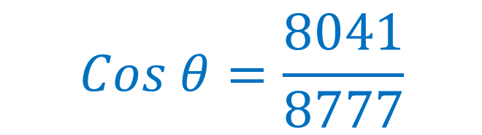
$$Cos θ=\frac{8041}{8777}$$
8777m
θ
8041 m
Imagine you know your horizontal distance from the summit and the length of the slope .
How will you find the angle of elevation (θ)?

Slide 7
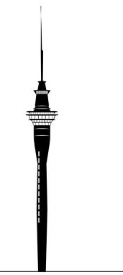

$$\tan{33=}\frac{h}{505}$$
h
33◦
505m
Imagine you know your horizontal distance from the Skytower and the angle of elevation.
How will you find the height (h) of the Skytower?

Slide 8

$$\tan{26=}\frac{328}{d}$$
328m
26◦
d
Imagine you know the height of the Skytower and the angle of elevation.
How will you find your horizontal distance (d) to the Skytower?

Slide 9
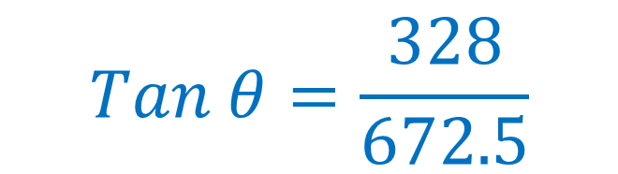
$$Tan θ=\frac{328}{672.5}$$
328m
θ
672.5m
Imagine you know the height of the Skytower and your horizontal distance from it.
How will you find the angle of elevation (θ)?

