Slide 1
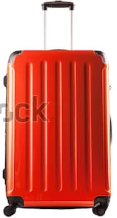
Students in Room Six chose their favourite holiday destination.
This picture graph shows their data.
Australia
Fiji
Samoa
New Zealand
Calculate the percentage of the class that chose each country.

Slide 2



Australia
0 %
0 %
$$37.5\%$$
rate
$$12.5\%$$
25 %
50 %
100%
$0.00
24
base
0
3
6
9
12
amount
$$\frac{}{100}×24=9$$

Slide 3

Fiji
0 %
0 %
rate
25 %
50 %
100%
$0.00
24
base
0
6
12
amount
$$\frac{}{100}×24=6$$

Slide 4


Samoa
0 %
0 %
rate
25 %
$$33.\dot{3}\%$$
50 %
100%
$0.00
24
base
0
6
8
12
amount
$$\frac{}{100}×24=8$$

Slide 5



New Zealand
0 %
$$4.1\dot{6}\%$$
0 %
$$8.\dot{3}\%$$
25 %
100%
rate
50 %
$0.00
24
base
0
2
6
12
1
amount
$$\frac{}{100}×24=1$$

Slide 6
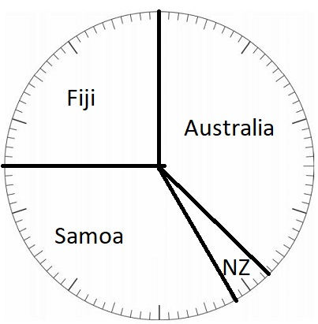

Slide 7
