Slide 1
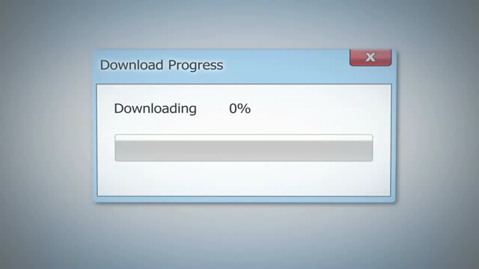

Slide 2
Kelvin downloads a film with a file size of 32 gigabytes.
How many gigabytes are downloaded as this point?
75%
0 GB
32 GB
Downloading …

Slide 3

rate
0 %
25 %
50 %
75 %
100%
0 GB
8 GB
16 GB
24 GB
32 GB
amount
base
$$\frac{75}{100}×32=24$$

Slide 4
Tania downloads a file .
It takes 24 seconds to download the whole file.
How many seconds have passed at this point?
33%
0 seconds
24 seconds
Downloading …

Slide 5

rate
0 %
33 %
100%
0 sec
≈ 8 GB
24 sec
amount
base
$$\frac{33}{100}×24=7.92$$

Slide 6
Anita downloads a file .
The total cost of the file is $35.
What has been the cost to this point?
80%
$ 0.00
$ 35.00
Downloading …

Slide 7

rate
0 %
20 %
80 %
100%
$0.00
$7.00
$28.00
$35.00
amount
base
$$\frac{80}{100}×35=28$$

Slide 8
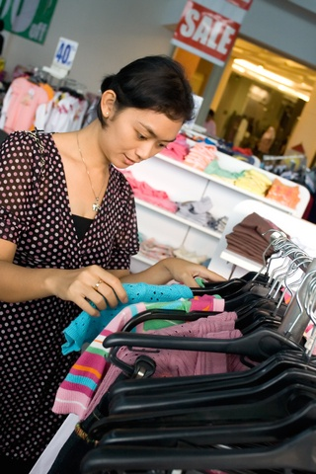
There is a 30% off sale at Katie’s favourite clothing shop. She chooses a top that normally costs $75.00.
How much will she have to pay?

Slide 9

rate
0 %
10 %
70 %
100%
0 %
$0.00
$7.50
$52.50
$75.00
$0.00
amount
base
$$\frac{70}{100}×75=52.5$$

Slide 10

Jackets are 55% off. What a saving!
How much would you pay for a jacket that normally costs $290.00?

Slide 11

rate
5 %
45 %
0 %
10 %
50 %
100%
0 %
$0.00
$29.00
$145.00
$290.00
$0.00
amount
base
$14.50
$130.50
$$\frac{45}{100}×290=130.5$$

