Slide 1

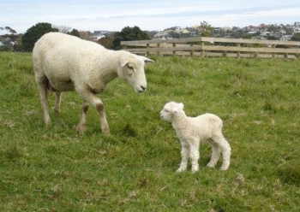
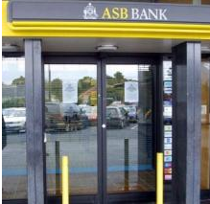


How are percentages used in these situations?
Notes:
You may find that drawing strip diagrams of the situations in copymaster 1 may help students to see the structural similarity between different problems.
Refer to the webinar of percentages to see how to do this.

Slide 2
0%
17%
31%
52%
66%
84%
100%
Downloading …
Complete

Slide 3
?
Downloading …

Slide 4
?
Downloading …

Slide 5
?
Downloading …

