Slide 1
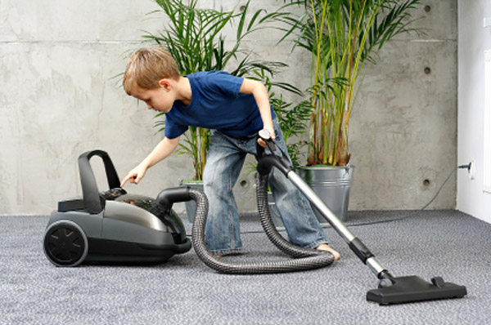
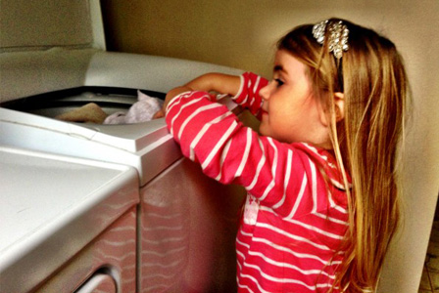
Elise and Harry
Elise and Harry both earn pocket money by doing chores around the house.
Elise spends two thirds of her pocket money each week and Harry spends three quarters of his.
Yet they spend the same amount as each other.
How much money might Elisa and Harry earn each week for this to be true?
How many different answers are possible?
What is true about all of the answers?

Slide 2
One way to see three quarters of 12 is like this:
Find one quarter of 12 first by dividing by four.
Then find three quarters of 12 by multiplying one quarter by three.

Slide 3
One way to see two thirds of 12 is like this:
Find one third of 12 first by dividing by three.
Then find two thirds of 12 by multiplying one third by two.

Slide 4
How would you find four fifths of 15?
Find one fifth of 15 first by dividing by five.
Then find four fifths of 15 by multiplying one fifth by four.

Slide 5
How would you find five sevenths of 21?
Find one seventh of 21 first by dividing by seven.
Then find five sevenths of 21 by multiplying one seventh by five.

Slide 6
Challenge 1 (easy)
You need to cut a strip that is a certain number of centimetres long.
You must be able to cut the strip into thirds and eighths using whole numbers of centimetres.
How many centimetres long could you make the strip? Give three possible answers.
Challenge 2 (medium)
Make a strip that is 36 cm long.
Put marks on your strip to show:
$\frac{2}{3}×36$ $\frac{3}{9}×36$ $\frac{3}{4}×36$ $\frac{2}{3}×36$ $\frac{5}{6}×36$ $\frac{1}{3}×36$ $\frac{13}{36}×36$ $\frac{9}{12}×36$
Are any marks in the same place? Why?
Challenge 3 (hard)
A fraction of a paper strip is marked at 18 cm from the left end.
The whole strip has a maximum length of one metre.
What is the fraction and how long is the whole strip?
How can someone systematically find all solutions to this problem?

