Slide 1
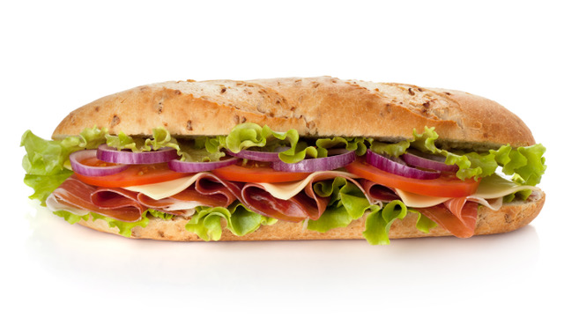
Which is more? One third or one half of the same submarine sandwich?
How much more?

Slide 2
1
$$\frac{1}{2}$$
$$\frac{1}{12}$$
$$\frac{1}{3}$$
$$\frac{1}{6}$$
$$\frac{1}{12}$$

Slide 3
$$\frac{1}{3}+\frac{}{}=\frac{1}{2}$$
$$\frac{1}{2}−\frac{1}{3}=\frac{}{}$$

Slide 4
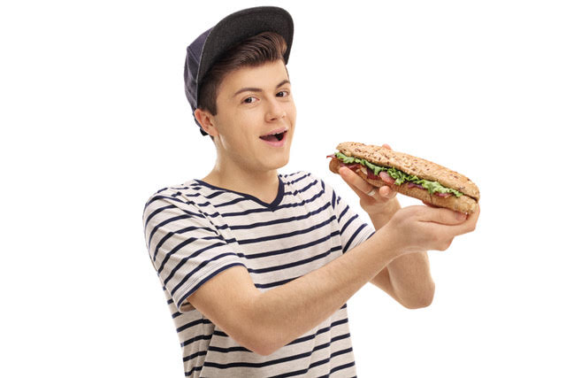
Which is more? Five eighths or three quarters of the same sized submarine sandwich?
How much more?

Slide 5
1
$$\frac{1}{8}$$
$$\frac{1}{8}$$
$$\frac{1}{8}$$
$$\frac{1}{8}$$
$$\frac{1}{8}$$
$$\frac{1}{8}$$
$$\frac{1}{4}$$
$$\frac{1}{4}$$
$$\frac{1}{4}$$

Slide 6
$$\frac{5}{8}+\frac{}{}=\frac{3}{4}$$
$$\frac{3}{4}−\frac{5}{8}=\frac{}{}$$

Slide 7
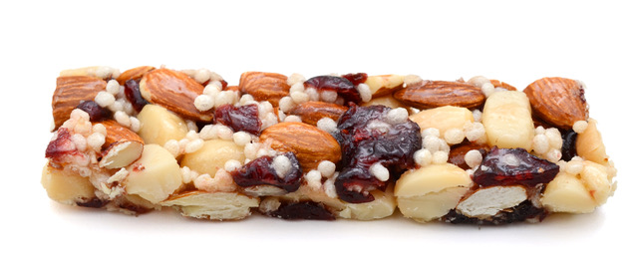
Which is more? Three fifths or one half of the same sized muesli bar?
How much more?

Slide 8
1
$$\frac{1}{5}$$
$$\frac{1}{5}$$
$$\frac{1}{5}$$
$$\frac{1}{2}$$
$$\frac{1}{10}$$

Slide 9
$$\frac{1}{2}+\frac{}{}=\frac{3}{5}$$
$$\frac{3}{5}−\frac{1}{2}=\frac{}{}$$

Slide 10
Which is more? Four fifths or two thirds of the same sized muesli bar?
How much more?

Slide 11
1
$$\frac{1}{5}$$
$$\frac{1}{5}$$
$$\frac{1}{5}$$
$$\frac{1}{5}$$
$$\frac{1}{3}$$
$$\frac{1}{3}$$
$$\frac{1}{15}$$
$$\frac{1}{15}$$

Slide 12
$$\frac{2}{3}+\frac{}{}=\frac{4}{5}$$
$$\frac{4}{5}−\frac{2}{3}=\frac{}{}$$

