Slide 1
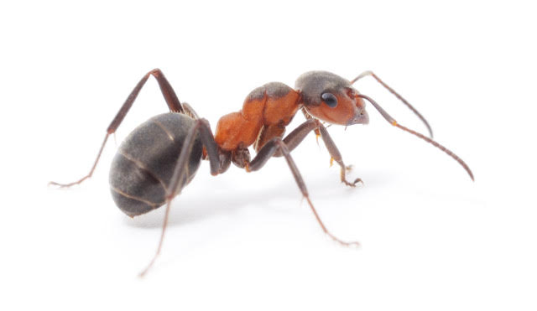
0cm
1cm
2cm
3cm

Slide 2

0cm
1cm
2cm
3cm

Slide 3
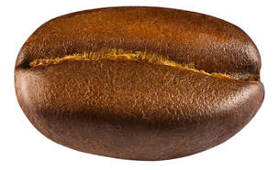
0cm
1cm
2cm
3cm

Slide 4
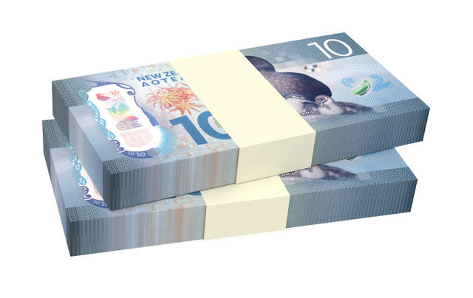
$1500
$1500
0cm
1cm
2cm
3cm

Slide 5
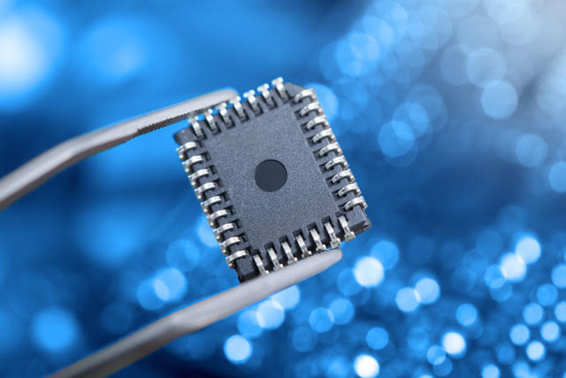
0cm
1cm
2cm
3cm
A computer chip from the early 2000s. How small are computer chips now?

