Slide 1
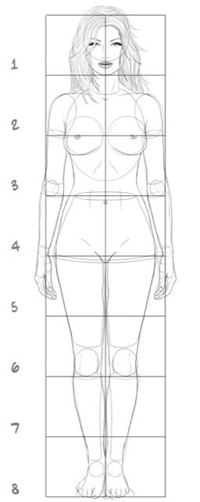

Slide 2
1.76m
0.9m
How long is the rest of Aisla?

Slide 3
1.76m
1.04m
How long is the rest of Barbie?

Slide 4
0.27m
1.76m
How long is the rest of Aisla?

Slide 5
0.34m
1.76m
How long is the rest of Barbie?

Slide 6
0.74m
0.62m
1.92m
1.7m

