Slide 1
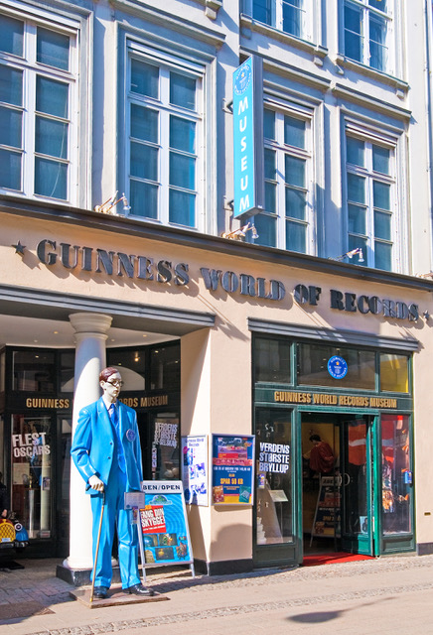
Here is a life-sized statue of Robert Wadlow, who is thought to be the tallest person ever.
Estimate his height from the picture.

Slide 2

2.72
0.72
2.0
1.98
0.02
Metres
Robert
2.72m
Scott
1.98m

Slide 3

What is the combined height of Rufus and Barbara?
1.8 + 1.57 = 2.65m, because 8 + 57 = 65.
Rufus
1.8m
Barbara
1.57m
That can’t be right, Rufus.
Our combined height must be more than 3 metres.

Slide 4
What is the combined height of Rufus and Barbara?
Rufus
1.8m
Barbara
1.57m
1.8
2.8
3.0
3.3
Metres
3.37
0.07
1.0
0.2
0.3

Slide 5
Ones
Tenths
Hundredths
Rufus
1.8m
Barbara
1.57m
3
.
3
7

Slide 6


What is the combined height of Suzanne and Tony?
That can’t be right, Suzanne.
Our combined height must be more than 3 metres.
1.72 + 1.79 = 2.151m, because 72 + 79 = 151.
Suzanne
1.72m
Tony
1.79m

Slide 7
What is the combined height of Suzanne and Tony?
Suzanne
1.72m
Tony
1.79m
1.72
2.72
3.0
3.51
Metres
1.0
0.28
0.51

Slide 8
Ones
Tenths
Hundredths
Suzanne
1.72m
Tony
1.79m
3
.
5
1

