Slide 1
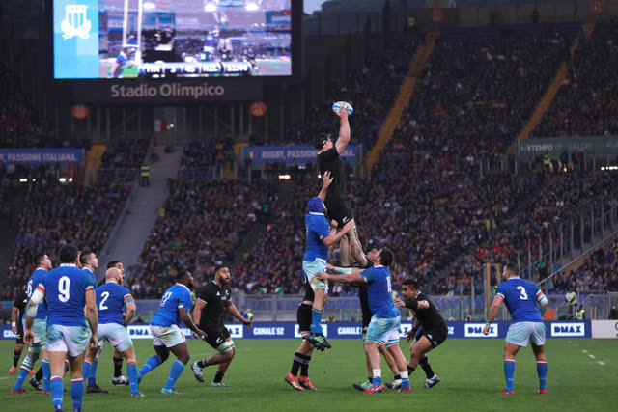
This picture shows All Black Scott Barrett catching the ball in a rugby lineout.
According to the statistics Scott is 1.98 metres tall.
What does that mean?

Slide 2
Tenths
Hundredths
Thousandths
Hundreds | Tens | Ones
 |  | 1 | 9 | 8
centimetre
millimetre
decimetre

Slide 3

Here are four young people:
Zac is 1.8 metres tall.
Gina is 1.37 metres tall.
Kane is 2.03 metres tall.
Lulu is 1.65 metres tall.
Who is who in the picture?

Slide 4
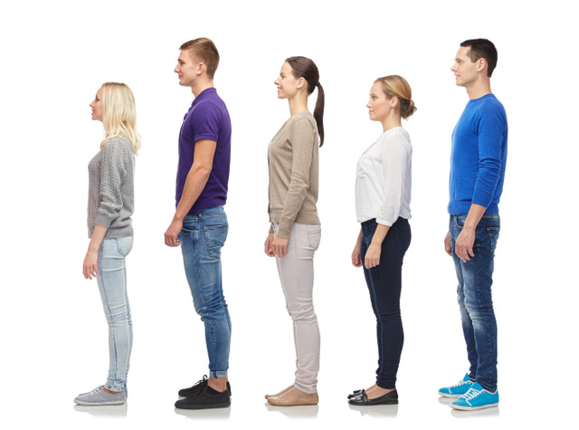
1. Which two people are 0.01m different in height?
2. Which two people are 0.03m different in height?
3. Which people need to change places for all five to be in order from shortest
to tallest?
4. Which person needs to grow 0.07m to be the tallest?
Barbara
1.57m
Rufus
1.8m
Susanne
1.72m
Zoe
1.6m
Tony
1.79m

