Slide 1
3⁰
3¹
3²
3³
3⁴
3⁵
3⁶
3⁷
3⁸
1
3
9
27
81
243
729
2 187
6 561
Calculate 81 ÷ 3 =
27
3 x 3 x 3 x 3
÷
3
=
3 x 3 x 3
This could be written as $\frac{3^{4}}{3^{1}}=3^{3}$.

Slide 2
3⁰
3¹
3²
3³
3⁴
3⁵
3⁶
3⁷
3⁸
1
3
9
27
81
243
729
2 187
6 561
Calculate 729 ÷ 9 =
81
3 x 3 x 3 x 3 x 3 x 3
÷
3 x 3
=
3 x 3 x 3 x 3
This could be written as $\frac{3^{6}}{3^{2}}=3^{4}$.

Slide 3
3⁰
3¹
3²
3³
3⁴
3⁵
3⁶
3⁷
3⁸
1
3
9
27
81
243
729
2 187
6 561
Calculate 243 ÷ 243 =
1
3 x 3 x 3 x 3 x 3
÷
3 x 3 x 3 x 3 x 3
=
3 ÷ 3
This could be written as $\frac{3^{5}}{3^{5}}=3^{0}$.

Slide 4
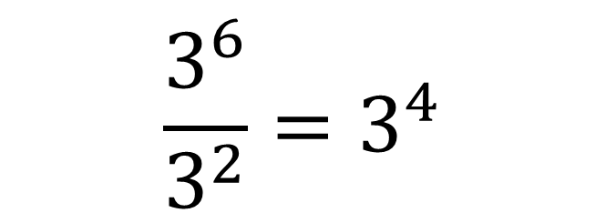
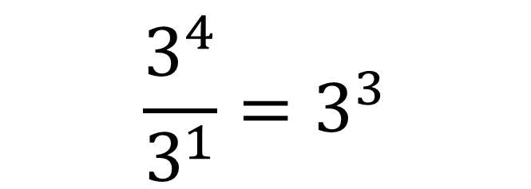
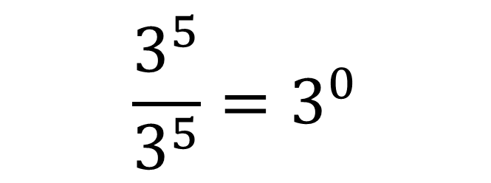
$$\frac{3^{4}}{3^{1}}=3^{3}$$
3⁴ ÷ 3¹ = 3³
$$\frac{3^{6}}{3^{2}}=3^{4}$$
3⁶ ÷ 3² = 3⁴
$$\frac{3^{5}}{3^{5}}=3^{0}$$
3⁵ ÷ 3⁵ = 3⁰

Slide 5
2⁰
2¹
2²
2³
2⁴
2⁵
2⁶
2⁷
2⁸
1
2
4
8
16
32
64
128
256
Calculate 32 ÷ 4 =
8
2 x 2 x 2 x 2 x 2
÷
2 x 2
=
2 x 2 x 2
2⁵
÷
2²
=
2³
How else could this result be written?

Slide 6
5⁰
5¹
5²
5³
5⁴
5⁵
5⁶
5⁷
5⁸
1
5
25
125
625
3125
15 625
…
…
Calculate 3 125 ÷ 25 =
125
5 x 5 x 5 x 5 x 5
÷
5 x 5
=
5 x 5 x 5
5⁵
÷
5²
=
5³
This could be written as $\frac{5^{5}}{5^{2}}=5^{}?$

