Slide 1
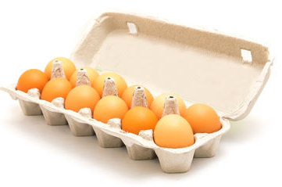
There are 12 eggs in one dozen.
How many eggs are in eight dozen?
What ways can you find to solve this problem?
Which way is the most efficient? (takes the least effort)

Slide 2
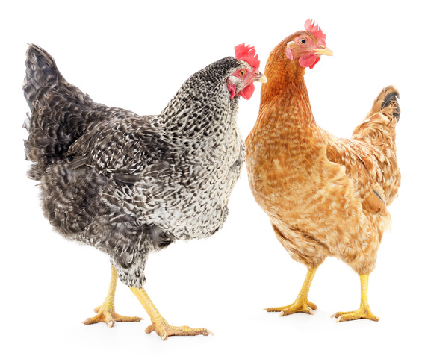
Trying different strategies means we don’t put all our eggs in one basket.
True but we are also interested in efficiency. Which strategies take the least effort to work out?

Slide 3
2 x 12 = 24
→ 4 x 12 = 48
→ 8 x 12 = 96

Slide 4
12 = 10 + 2
8 x 10 = 80
+ 8 x 2 = 16
96

Slide 5
10 x 12 = 120
- 2 x 12 = 24
8 x 12 = 96

Slide 6
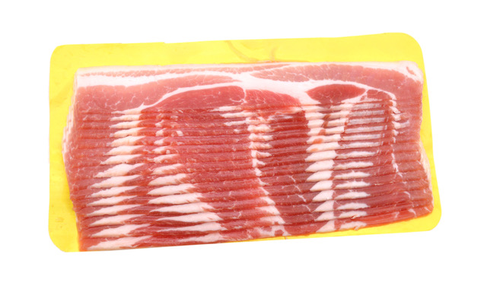
There are 15 rashers of bacon in each pack.
How many rashers are in six packs?

