Slide 1
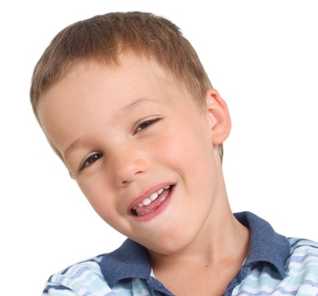
Students are earning points by caring for each other.
The student with the most points will become “Top Student” at the end of the term.
I have five times as many points as Sid.
I have four points so far.
Sid
Mia

Slide 2
Sid
Mia
0
5
10
15
20
25
30

Slide 3
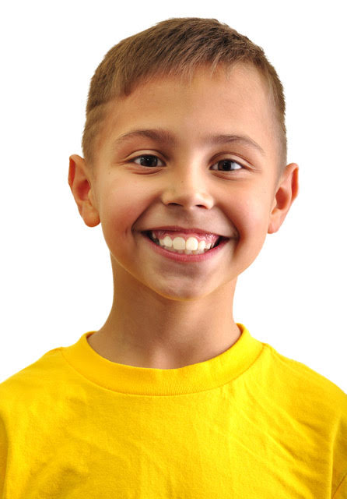
I have eight points so far.
I have three times as many points as Mel.
Sue
Carlos

Slide 4
Sue
Carlos
0
5
10
15
20
25
30

Slide 5
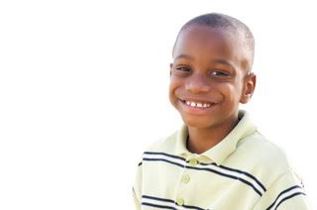
I have two and one half times as many points as Ana.
I have six points so far.
Ana
Ricky

Slide 6
Ana
Ricky
0
5
10
15
20
25
30

Slide 7
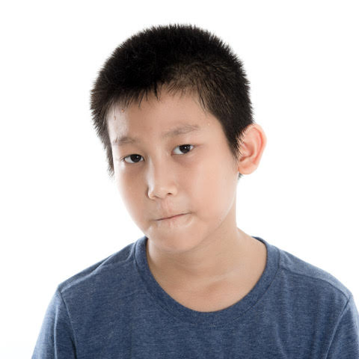
I only have three quarters as many as Due.
I have 16 points so far.
Due
Kim

Slide 8
Due
Kim
0
5
10
15
20
25
30

