Slide 1

60◦
?
60◦
60◦
60◦
Octahedron

Slide 2
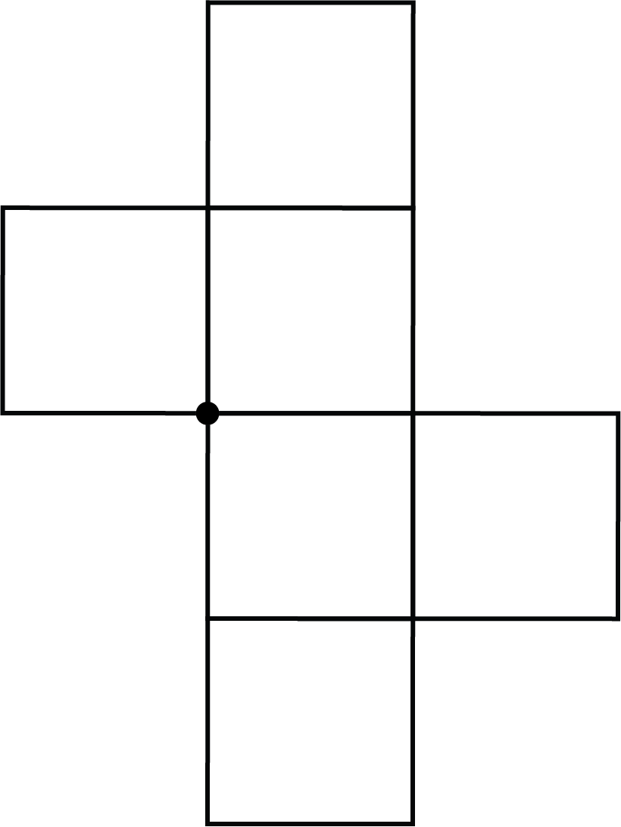
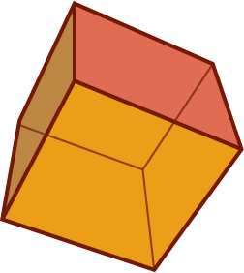
?
Hexahedron (cube)

Slide 3
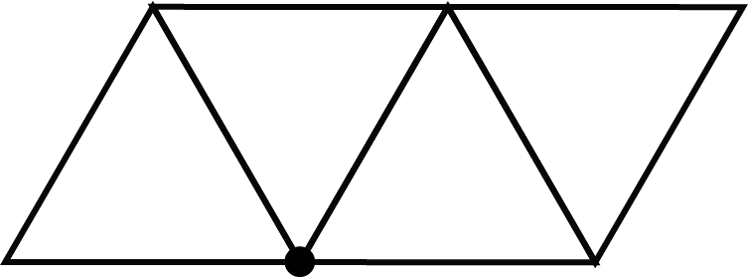
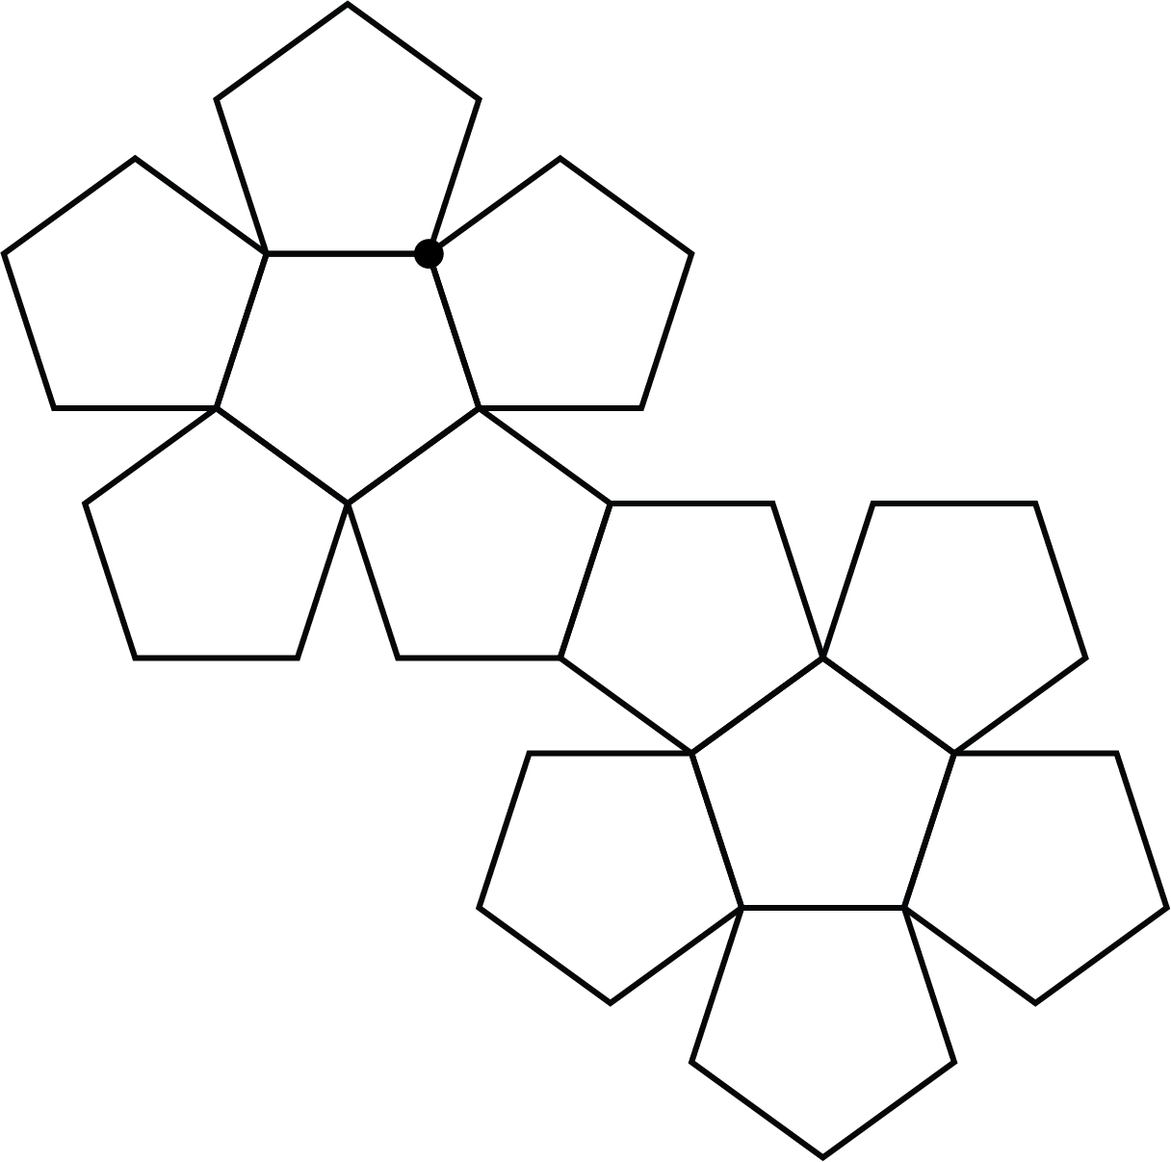
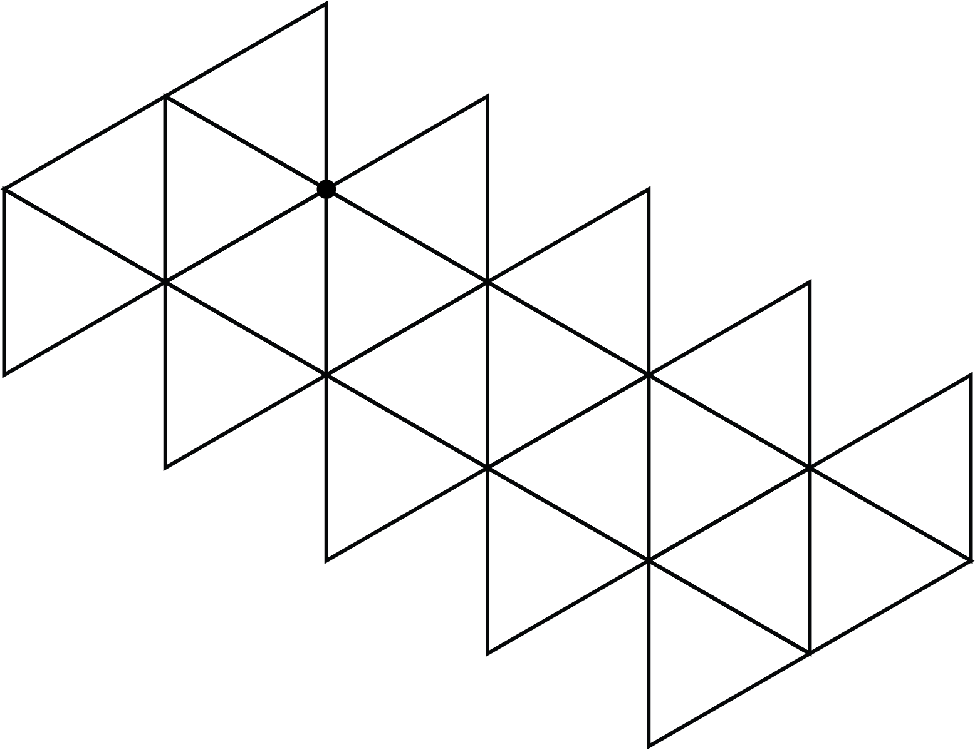
?
?
?
Angle defect = 180◦
Total of defects = 4 x 180◦
Angle defect = 36◦
Angle defect = 60◦
Total of defects = 20 x 36◦
Total of defects = 12 x 60◦

Slide 4
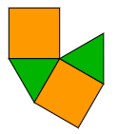
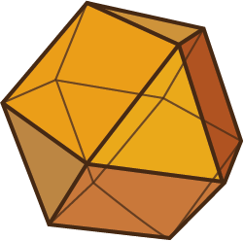
?
(4, 3, 4, 3)
(Cuboctahedron)

Slide 5
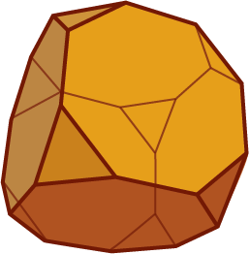
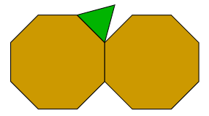
?
(8, 8, 3)
(Truncated cube)

Slide 6
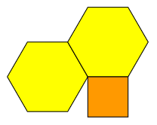
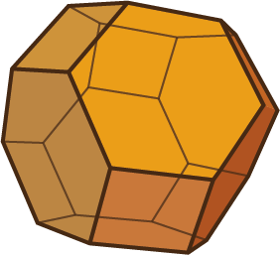
?
(6, 6, 4)
(Truncated octahedron)

Slide 7
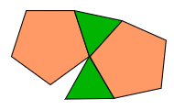
Will this arrangement of regular polygons around a vertex result in a complete polyhedron?

