Slide 1
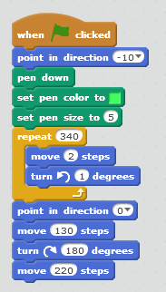
What does this event do?
Which direction is
⁻10°?
What does this pen ‘suite’ tell you about the image that will be drawn?
What shape will be drawn by this repetition?
Follow this line of code.
What shape is drawn?
What does the figure look like in total?

