Slide 1


How much taller is Jill’s apartment block than Jack’s apartment block?
Jill
Jack

Slide 2
You could say that Jill’s apartment block is 8 floors higher than Jack’s.
4 + 8 = 12
What else could you say?
Jill
Jack

Slide 3
You could say that Jill’s apartment block is three times as high as Jack’s.
3 x 4 = 12
Jill
Jack

Slide 4


How much more is Jack’s car collection than Jill’s collection?
Jill
Jack

Slide 5
You could say there are eight more cars in Jack’s car collection than Jill’s collection.
2 + 8 = 10
What else could you say?
Jill
Jack

Slide 6
You could say that Jack has five times as many cars as Jill.
5 x 2 = 10
Jill
Jack

Slide 7
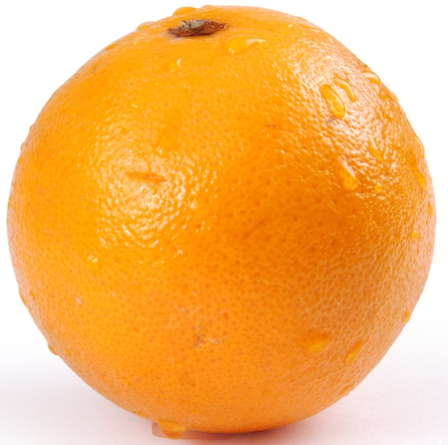
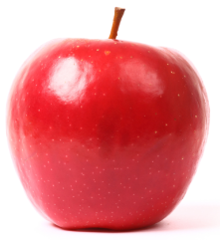
How many more apples are here than oranges?

Slide 8
You could say there are nine more apples than oranges.
3 + 9 = 12
What else could you say?

Slide 9
You could say there are four times as many apples as oranges.
4 x 3 = 12

