Slide 1
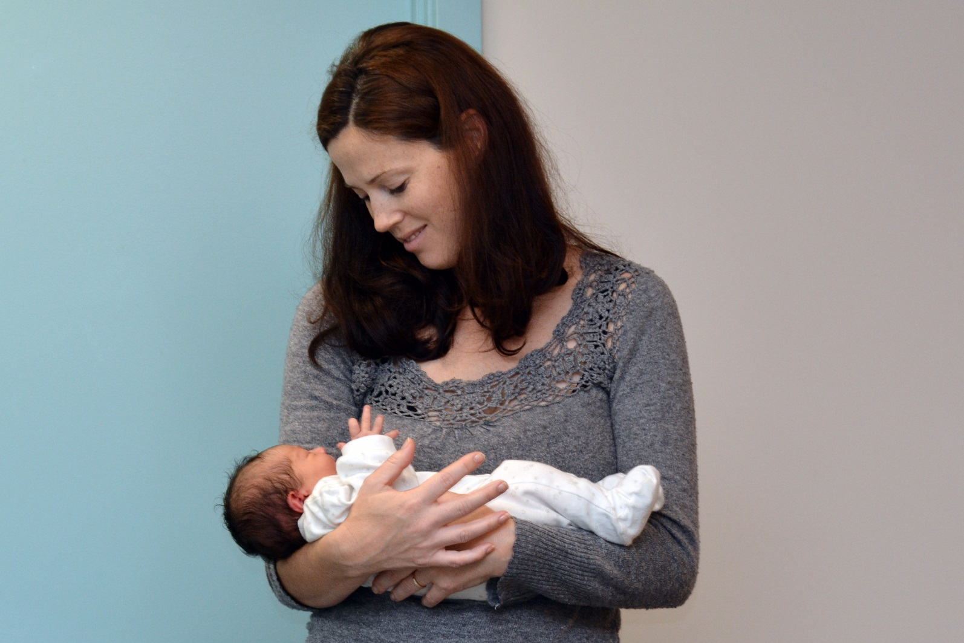
163
The average number of babies born in New Zealand each day.

Slide 2
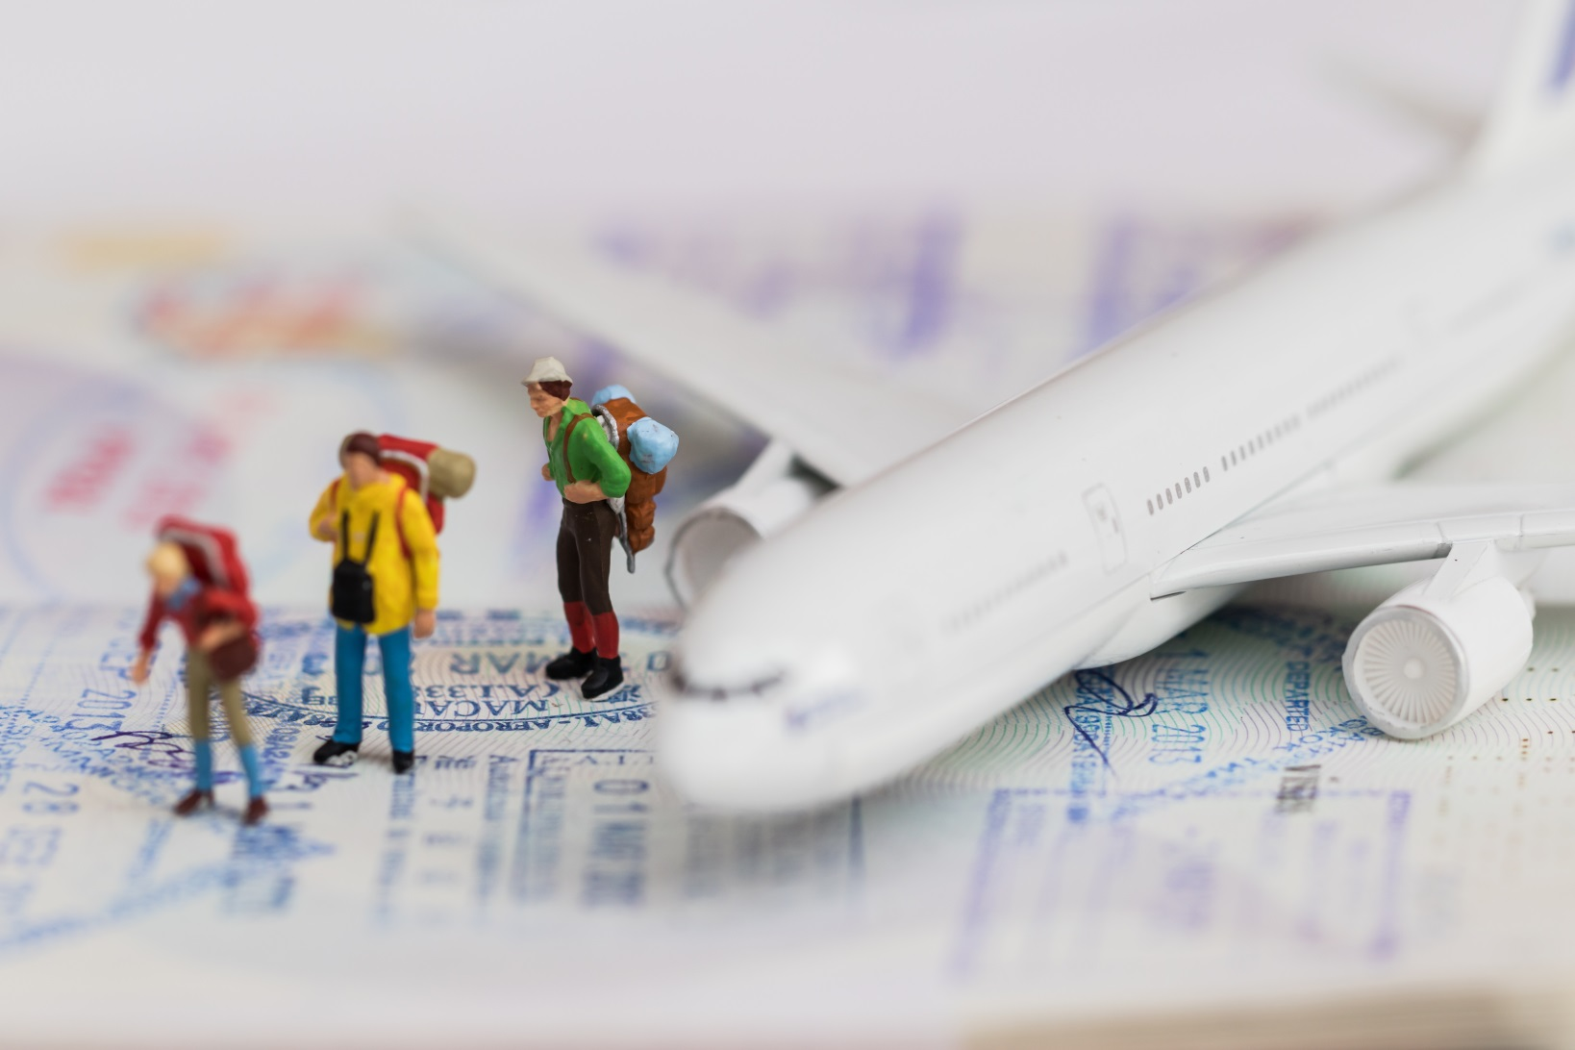
886
The average number of New Zealanders travelling overseas each day.

Slide 3
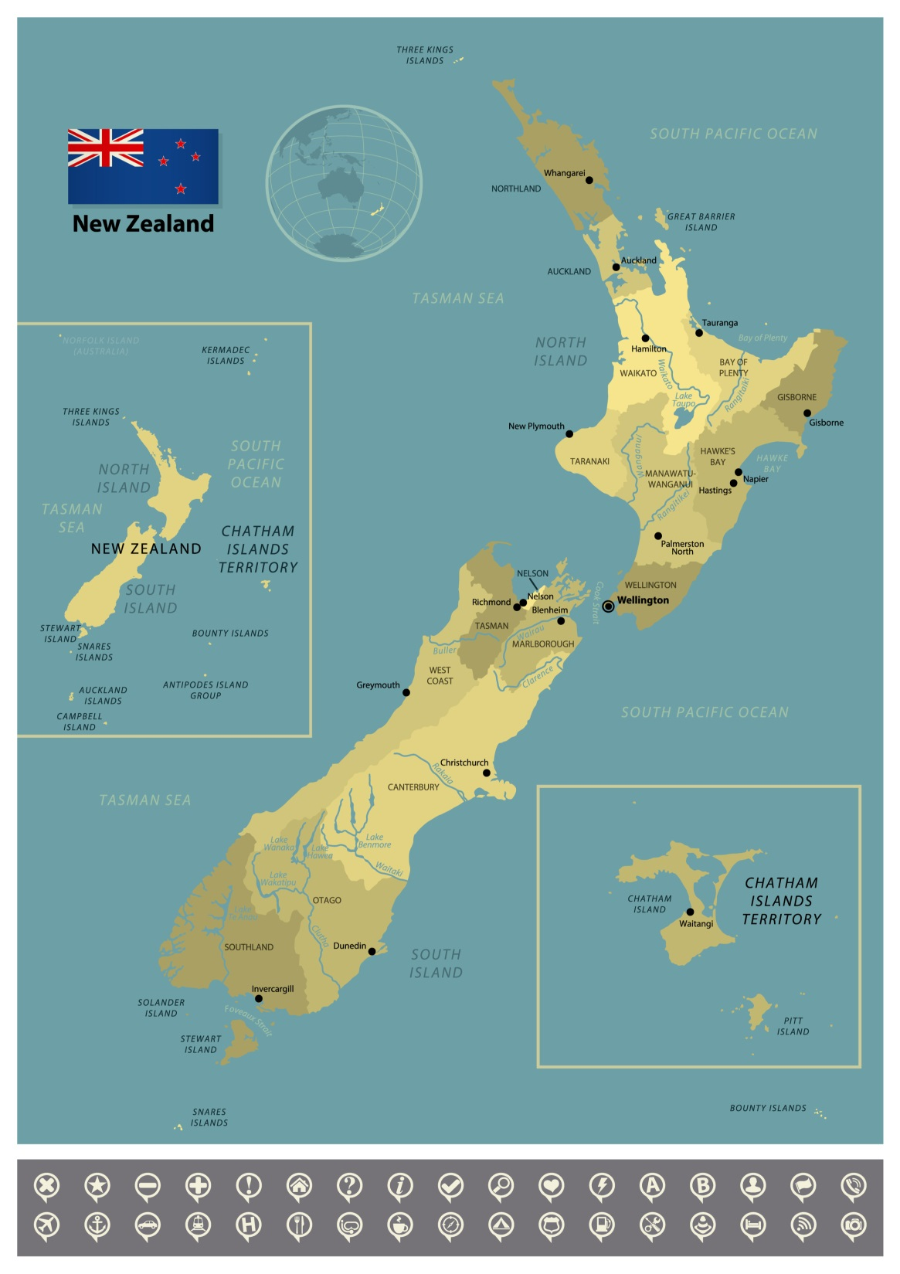
602
The number of people who live on the Chatham Islands

Slide 4
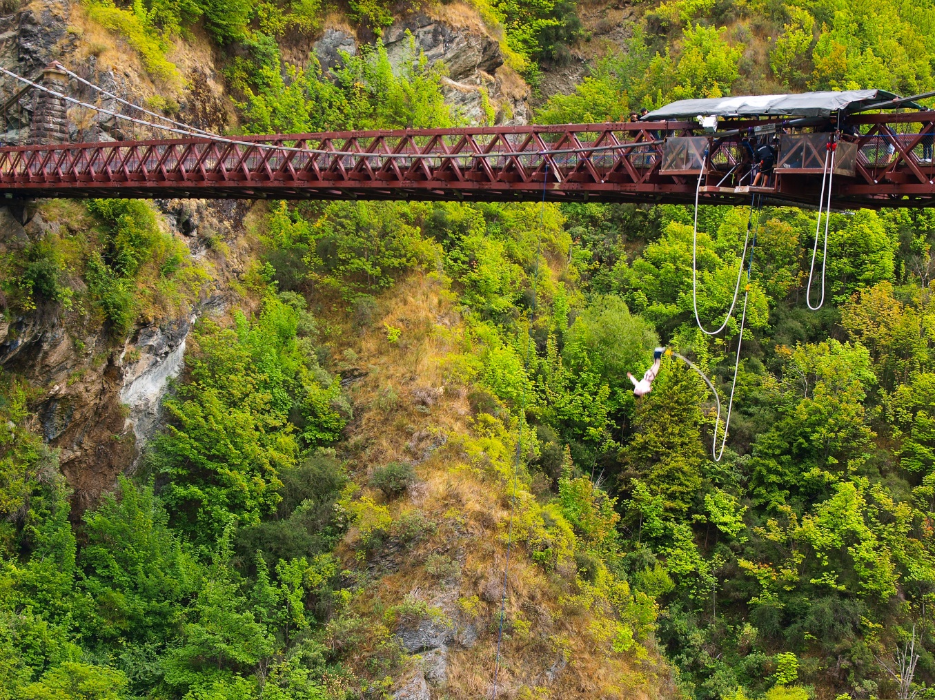
965
The number of bungee jumpers who leap from the Kawerau Gorge bridge each day

Slide 5
370
The number of New Zealanders in every 10 000 who can speak te reo Maori

Slide 6
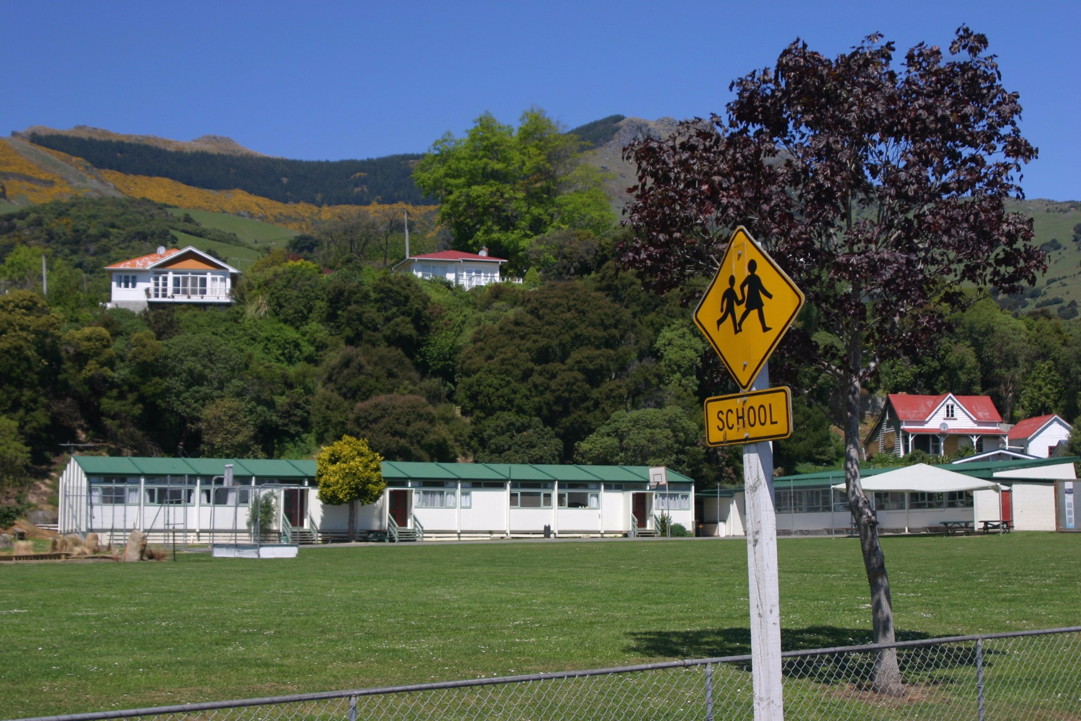
?
The number of people who attend your school.

