Slide 1
Ranginui = Papatūānuku
Tūmatauenga
Tāne-mahuta
Rongomātāne
Tāwhirimātea
Tangaroa
Haumietiketike

Slide 2
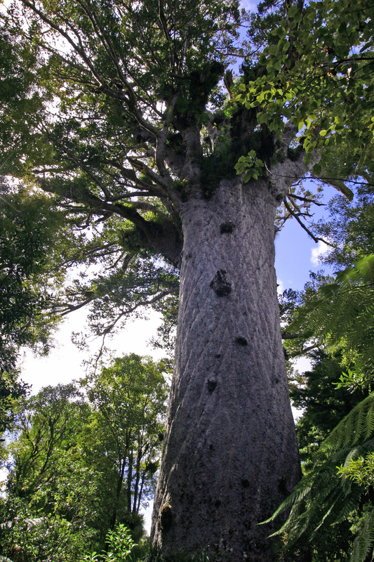
Who is this tree named after?
Where would you find it?

Slide 3
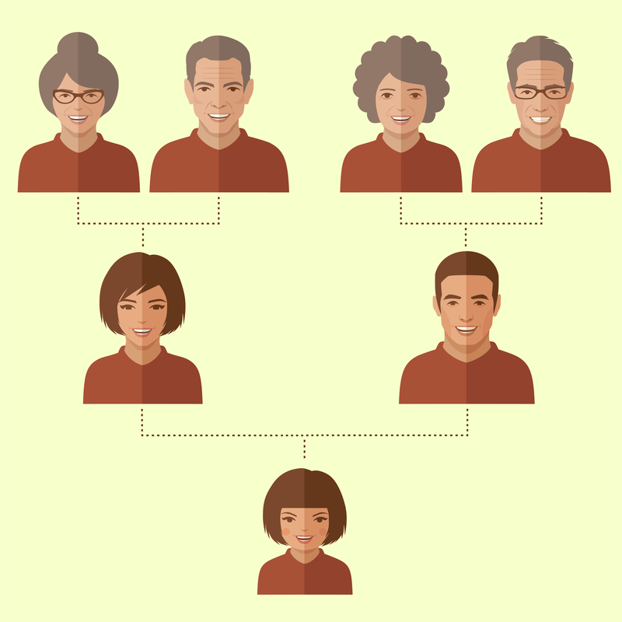
Your biological whakapapa has two parents and four grandparents.
How many great grandparents were there?
If we went back ten generations in your biological whakapapa how many ancestors would that be, including you?
In the Milky Way alone it is estimated that there are 100 billion stars.
What fraction of the stars in our galaxy will your whakapapa make?

