Slide 1
60 x 10 = 600 so I blink 600 times in one hour.
How many times do I blink in…
1 day?
1 year?
Is Toby’s strategy correct? How might his strategy be improved?

Slide 2
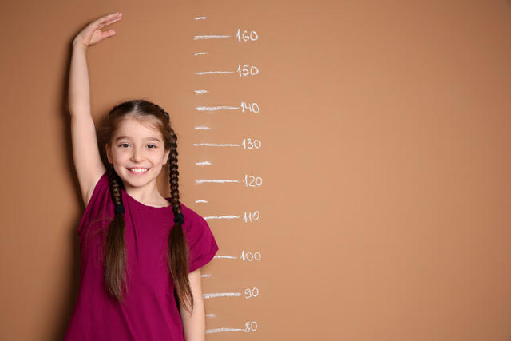
I am ten years old and measure 140cm at the start of the year.
140 ÷ 10 = 14 so I grow 14 centimetres each year.
At the end of this year I should be 154 cm tall.
Is Lena’s strategy correct? How might her strategy be improved?

Slide 3
50cm
84cm
140 ÷ 10 = 14 cm
140 – 50 = 90 cm
140 – 84 = 56 cm
90 ÷ 10 = 9 cm
56 ÷ 8 = 7 cm
Which strategy gives the most accurate estimate of gain in height each year?

