Slide 1
  There are 30 students in Room 1. Each student votes for their favourite drink for morning break.
  10 students vote for fruit juice and 20 students vote for flavoured milk.
  How can this result be expressed as a ratio?
Juice
Favoured Milk

Slide 2
  There are only 25 students in Room 2.
  10 students vote for fruit juice and 15 students vote for flavoured milk.
  How can this result be expressed as a ratio?
Juice
Favoured Milk

Slide 3

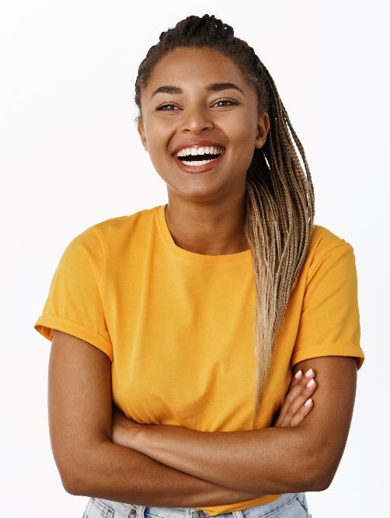
  Leila and Harry have different ideas about what happens when the two ratios are combined.
  Discuss who is right and why they are right?
If you add 1:2 to 2:3 you get 3:5.
Just add the two measures.
Easy.
If you add 10:20 to 10:15 you get 20:35.
I don’t think that is 3:5.
Not so easy.
Harry
Leila

Slide 4
Juice
Flavoured Milk
Room 1
Room 2
20
35

Slide 5
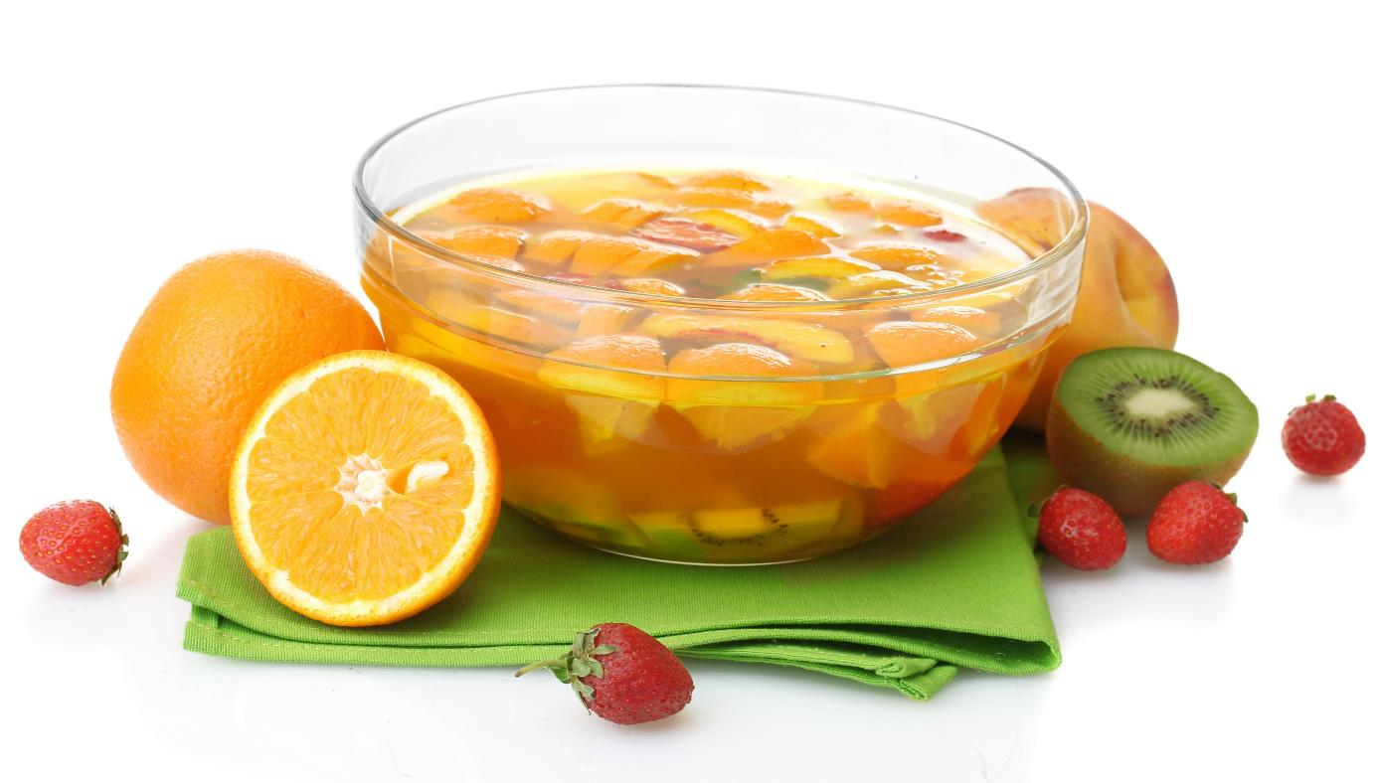
  John and Rangi bought bottles of soda water and juice for the class party.
  John bought 5 bottles, 2 bottles of soda water and 3 bottles of juice.
  Rangi bought 10 bottles of soda water and juice in the ratio of 3:2.
  If John and Rangi combined their bottles together to make punch, what is the new ratio of soda water to juice?

Slide 6
Hine made fruit punch using ginger ale and juice in the ratio of 3:2.
Amy made her fruit punch in the ratio of 2:5 but she made twice as much.
When the girls combined their punch in a bowl what is the ratio of ginger ale to juice?

Slide 7
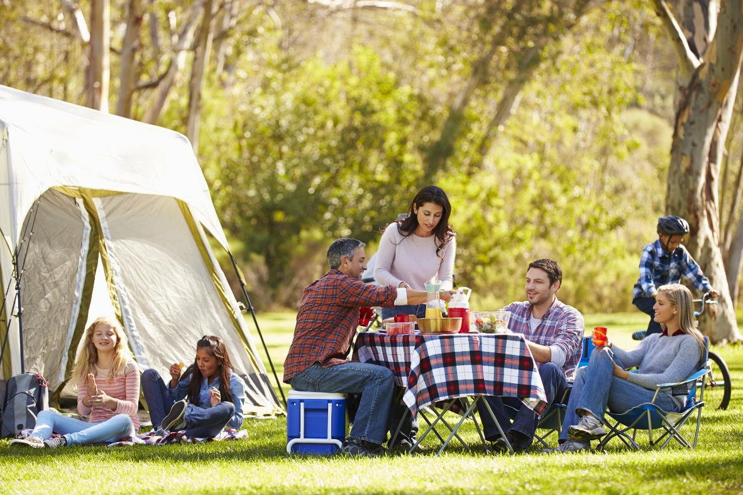
For a camping trip one family brought 8 bottles of drink, 1/4 of the bottles were apple juice and the rest were water.
The second family brought 7 bottles, 3 of them were apple juice and 4 were water.
When the two families combined all the bottle what was the ratio of apple juice to water? (Answer = 1:2)

