Slide 1
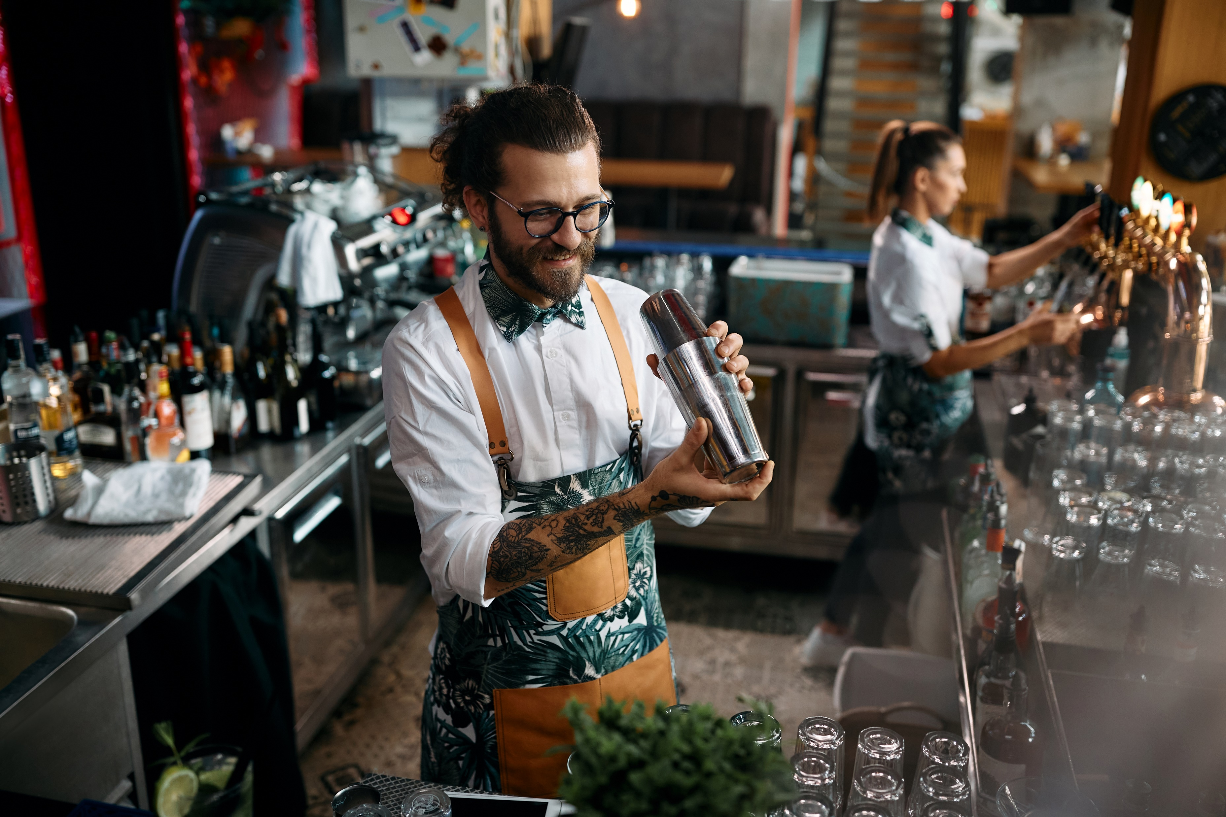
Citrus, the bartender, experimented with new mocktail recipes.
His record keeping was excellent so he could recreate each successful recipe.
However, to enter the mocktail competition he needs to record his recipes like this:
X parts ingredient A
Y parts Ingredient B
Z parts ingredient C
etc.

Slide 2



Record each of Citris’ recipes as simple ratios.
75 mL of lime juice
125 mL of cucumber juice
200 mL soda water
60 mL of pomegranate juice
90 mL of grapefruit juice
150 mL ginger ale
45 mL of lime juice
135 mL of watermelon juice
225 mL lemonade

Slide 3
75 mL of lime juice
125 mL of cucumber juice
200 mL soda water
Lime
75 mL
Cucumber
400 mL
125 mL
Soda
200 mL
Lime | Cucumber | Soda | Total
75 | 125 | 200 | 400
÷ 25
3
5
8
16

Slide 4
60 mL of pomegranate juice
90 mL of grapefruit juice
150 mL ginger ale
Pomegranate
60 mL
Grapefruit
90 mL
300 mL
Ginger ale
150 mL
Pomegranate | Grapefruit | Ginger ale | Total
60 | 90 | 150 | 300
÷ 30
2
3
5
10

Slide 5
45 mL of lime juice
135 mL of watermelon juice
225 mL lemonade
Lime
45 mL
Watermelon
405 mL
135 mL
Lemonade
225 mL
Lime | Cucumber | Soda | Total
45 | 135 | 225 | 405
÷ 15
3
9
15
27

Slide 6
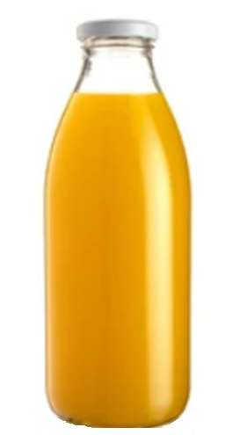
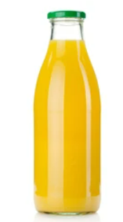
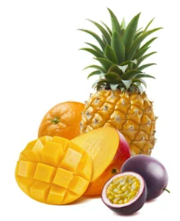
Pineapple Passion is a soft drink flavoured with pineapple and passionfruit juice.
It also contains mango juice.
Recently a new version of Pineapple Passion was released with the claim, “10% more pineapple and passion flavour.”
Is the claim correct?
250 mL Pineapple Juice
200 mL Passionfruit Juice
300 mL Mango Juice
Pineapple
Passion
275 mL Pineapple Juice
225 mL Passionfruit Juice
450 mL Mango Juice
Pineapple
Passion
Old Bottle
New Bottle

