Slide 1
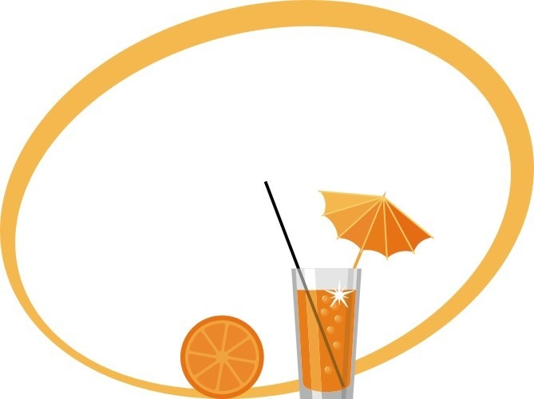
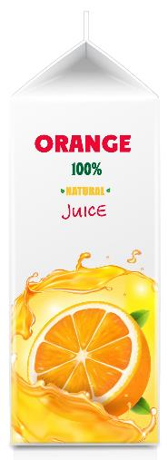
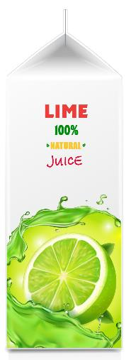
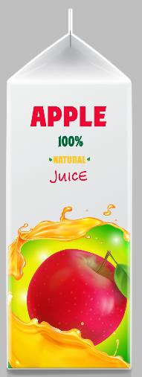
Sour Puss
5 parts orange juice
3 parts lime juice
2 parts apple juice
Makes 1 L

Slide 2
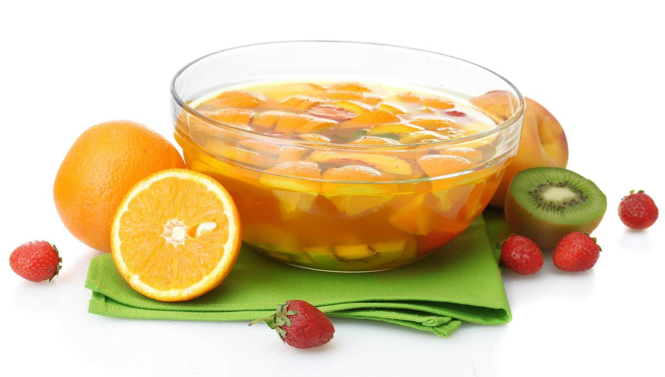
You need to mix 2 litres of orange juice using a ratio of concentrate to water of 1:4.
How much concentrate and water do you put in the bowl?

Slide 3
2 000 mL
400 mL
0 mL

Slide 4
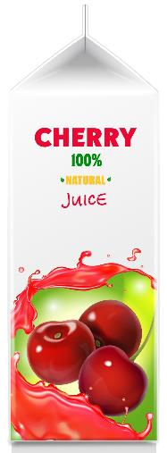
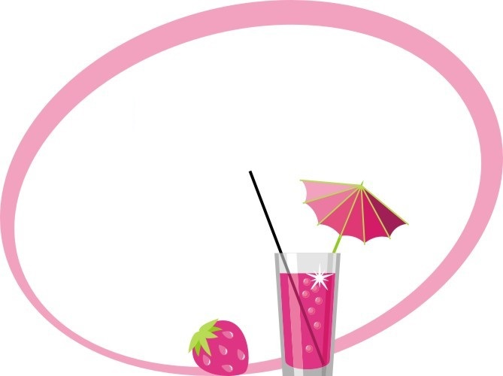
How much of each fruit juice is needed?
Red Devil
3 parts cherry juice
2 parts apple juice
Makes 600 mL

Slide 5
How much of each fruit juice is needed?
Sour Puss II
5 parts orange juice
3 parts lime juice
Makes 1 L

Slide 6
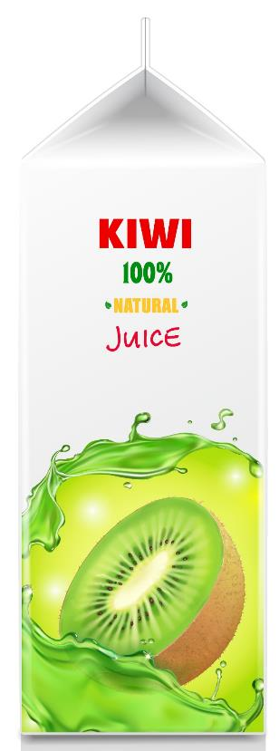
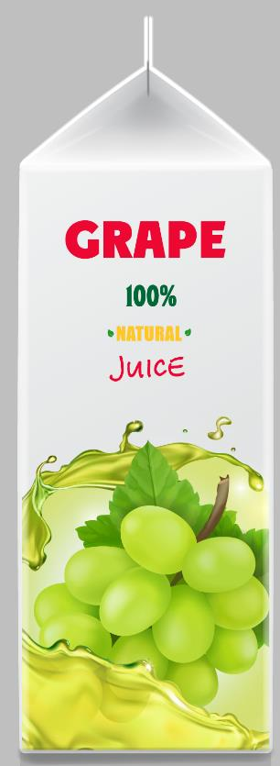
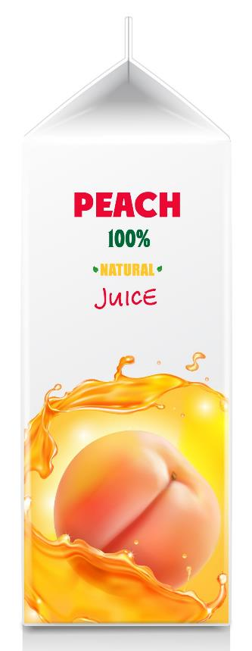
How much of each fruit juice is needed?
Green with envy
50% kiwifruit juice
30% grape juice
20% peach juice
Makes 450 mL

Slide 7
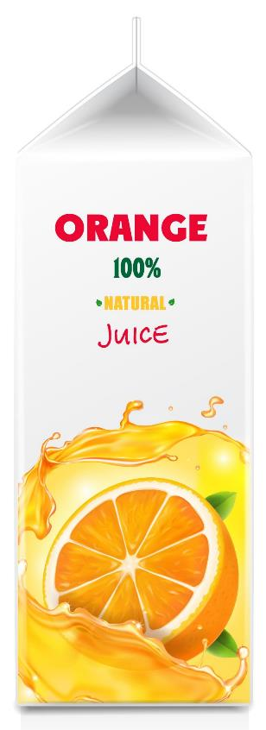
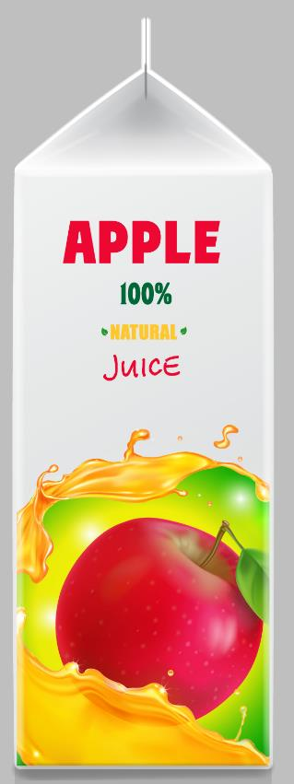
How much of each fruit juice is needed?
Traffic Light
30% kiwifruit juice
30% orange juice
40% apple juice
Makes 750 mL

Slide 8
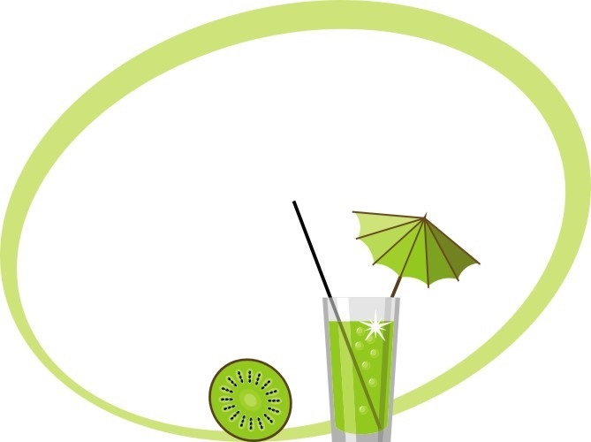
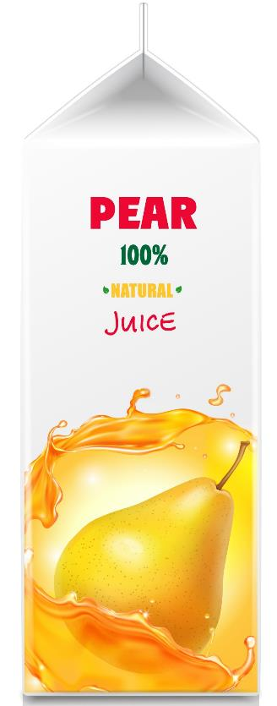
How much of each fruit juice is needed?
Pearfect
60% pear juice
30% peach juice
The rest is grape juice
1.5 litres are made.

Slide 9
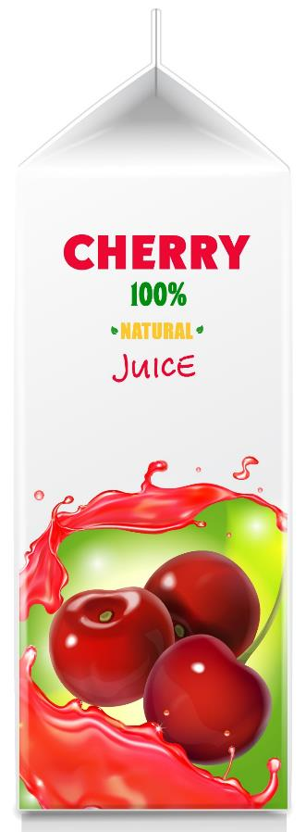

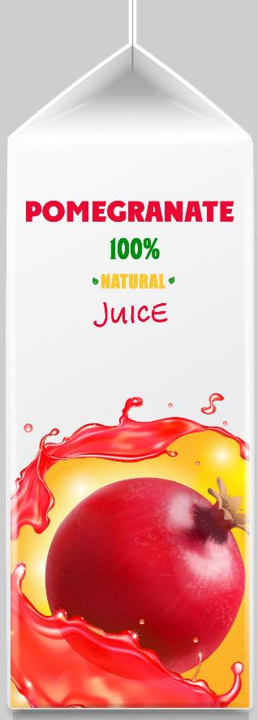
How much of each fruit juice is needed?
Pom-Bomb
50% pomegranate juice
25% cherry juice
The rest is apple juice
360 mL are made.

Slide 10
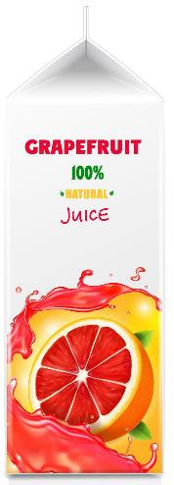
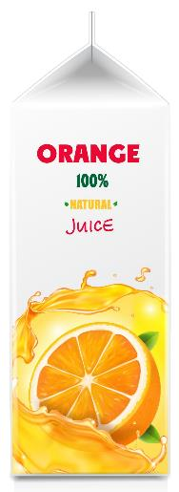

How much of each fruit juice is needed?
Bitter-Sweet
Mix grapefruit juice,
orange juice and
pear juice in a ratio
of 2:1:3.
Makes 900 mL.

Slide 11

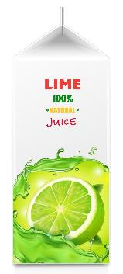
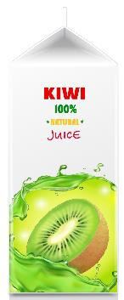
How much of each fruit juice is needed?
Kiwi Cure
Mix kiwifruit juice,
lime juice
and peach juice
in a ratio of 4:3:2.
Makes 1.8 L.

Slide 12
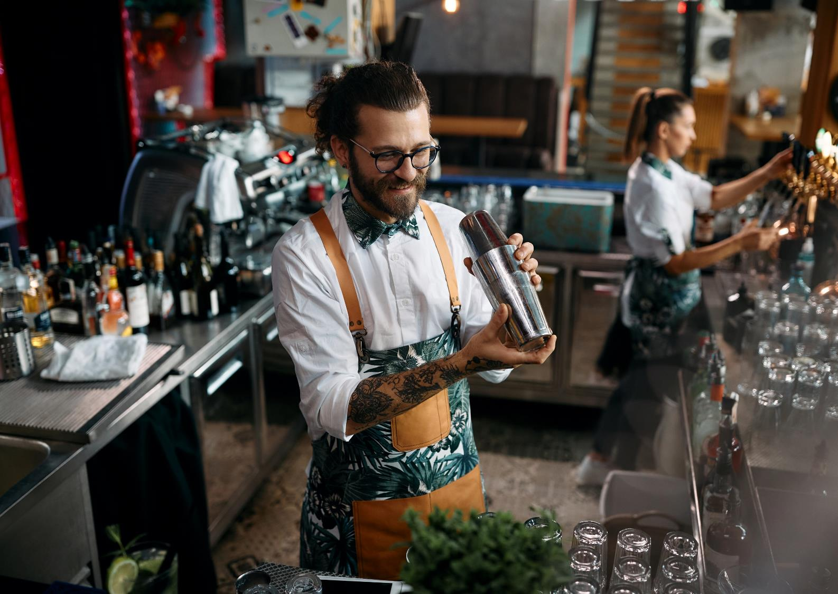
The bartender mixes 100 mL of lime juice with 400 mL of apple juice and 200 mL of grape juice.
How much mix does he make?
What percentage of the mix is each juice, lime, apple and grape?
What is the mocktail called?

