Slide 1
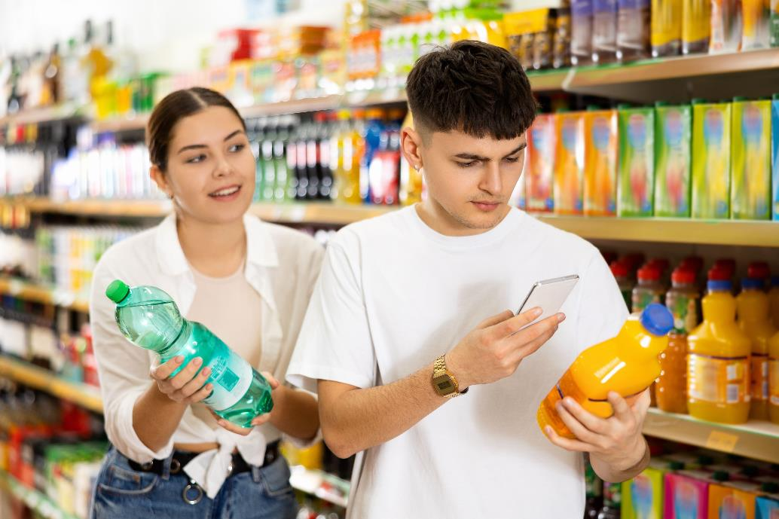
Mix 1 part concentrate to 4 parts water

Slide 2
$\frac{1}{5}$ concentrate
$\frac{4}{5}$ water
1
:
4

Slide 3
$\frac{1}{5}$ = $\frac{20}{100}$
$\frac{4}{5}$ = $\frac{80}{100}$
$20\%$concentrate
$80\%$water
1
:
4

Slide 4
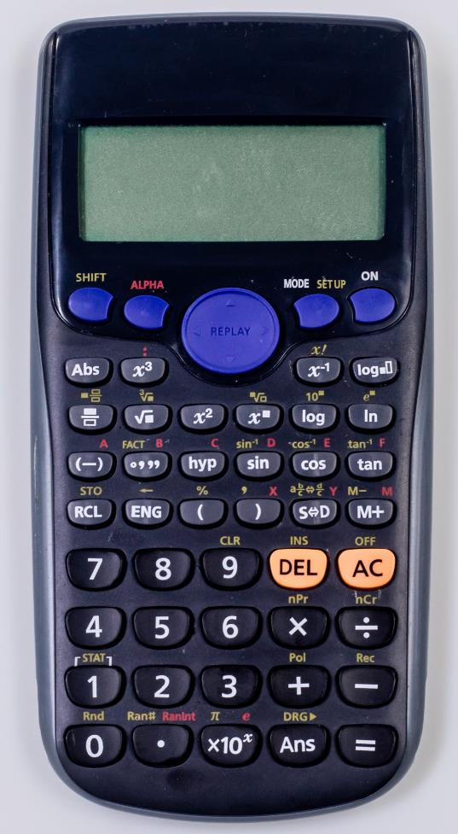
To show $\frac{3}{5}$ as a percentage key in:
3
Shift
5
Shift
%
=

Slide 5
Mix 2 parts concentrate to 8 parts water

Slide 6
$\frac{2}{10}$ concentrate
$\frac{8}{10}$ water
2
:
8

Slide 7
$\frac{2}{10}$ = $\frac{20}{100}$
$\frac{8}{10}$ = $\frac{80}{100}$
$20\%$concentrate
$80\%$water
2
:
8

Slide 8
2:3
5:9
1:2
3:5
6:11

Slide 9
Estimate the percentage of concentrate in each ratio, then work out the actual percentage with a calculator.
$\frac{2}{5}$ = 40%
$\frac{5}{14}$ = 35.7%
$\frac{1}{3}$ = 33.$\dot{3}$%
$\frac{3}{8}$ = 37.5%
$\frac{6}{17}$ = 35.3%
2:3
5:9
1:2
3:5
6:11

Slide 10
1:2
6:11
5:9
3:5
2:3
True or false?
Ratios that have the biggest number of concentrate parts taste strongest.
Ratios that have the biggest number of water parts taste weakest.
Ratios that have the biggest difference between the number of water parts and the number of concentrate parts taste weakest.
Ratios that have the biggest fraction of parts concentrate to total number of parts taste strongest.

Slide 11
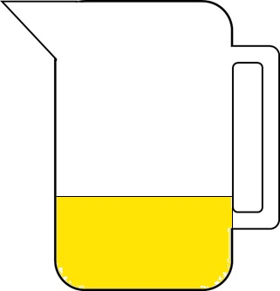
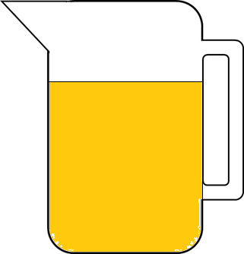
Leisel makes orange juice in two ratios of concentrate to water.
4:6
1:3
What amounts of concentrate or water can she add to make the two juices taste the same?

