Slide 1
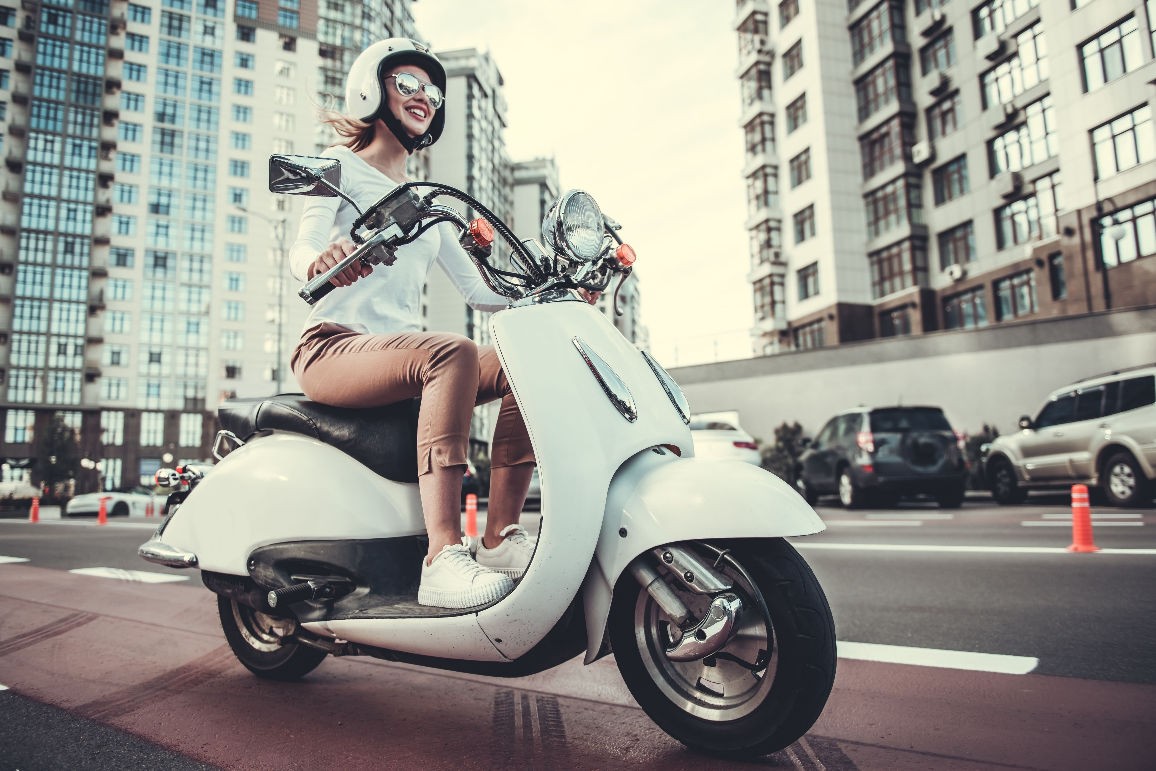
Audrey commutes to work on her scooter.
The one-way trip is 12 kilometres.
She averages a speed of 40 kilometres per hour which includes the stops she makes.
How long, in minutes, is each trip to work?

Slide 2


Number of kilometres | Time in hours
40 | 1
Number of kilometres | Time in minutes
40 | 60
1 | 1.5
12 | ?
Using a calculator
$$40÷60=0⋅\dot{6} km/min$$
÷ 40
$$12÷0⋅\dot{6}=45 min$$
÷ 40
x 12
x 12
Dividing each number in 40 km/60 mins by 10
0
4
12
40
Distance (km)
0
6
18
60
Time (mins)

Slide 3
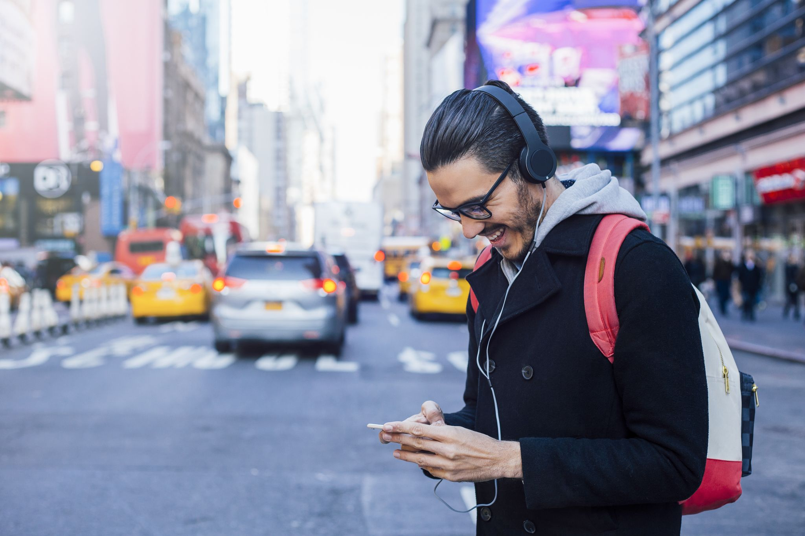
Kadijah walks to work each day.
The fitness app on his watch shows that he walks at a speed of 6.4 kilometres per hour.
If the distance from Kadijah’s home to work is 4.8 kilometres, how much time does he take to walk it?

Slide 4


Number of kilometres | Time in hours
6.4 | 1
Number of kilometres | Time in minutes
6.4 | 60
1 | 9.375
4.8 | 45
Using a calculator
$$6⋅4÷60=0⋅10\dot{6} km/min$$
$$4⋅8÷0⋅10\dot{6}=45 min$$
÷ 6.4
÷ 6.4
x 4.8
x 4.8
Dividing the double number line up into quarters
0
1.6
3.2
4.8
6.4
Distance (km)
0
15
30
45
60
Time (mins)

Slide 5
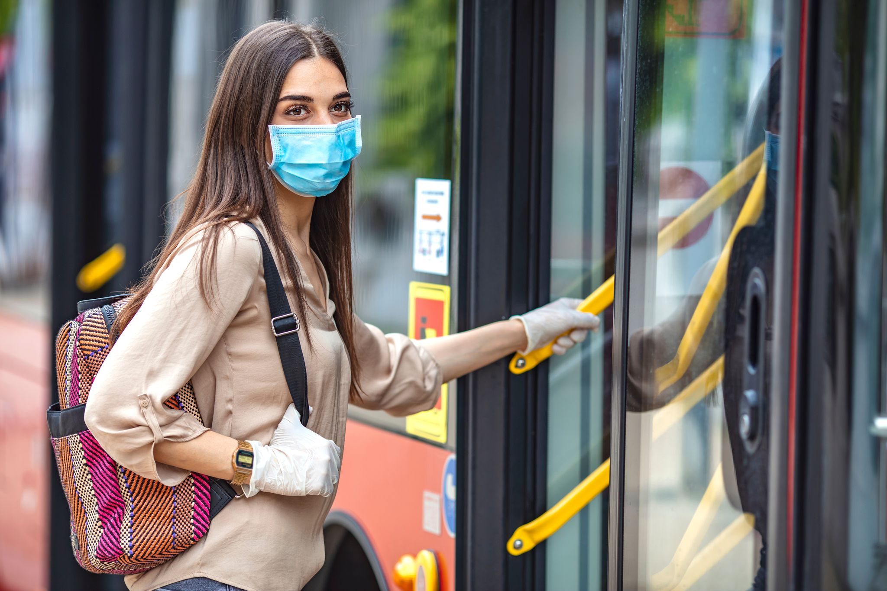
Luciana catches the bus to work each day.
On her Public Transport app the road distance of her trip shows as 7.2 kilometres.
The bus averages a speed of 24 kilometres per hour over that distance.
How long, in minutes, is the Luciana’s bus trip.

Slide 6


Number of kilometres | Time in hours
24 | 1
Number of kilometres | Time in minutes
24 | 60
1 | 2.5
7.2 | 18
Using a calculator
$$24÷60=0⋅4 km/min$$
÷ 24
$$7⋅2÷0⋅4=18 min$$
÷ 24
x 7.2
x 7.2
Dividing the double number line up into quarters first.
0
1.2
6
7.2
12
24
Distance (km)
0
3
15
18
30
60
Time (mins)

Slide 7
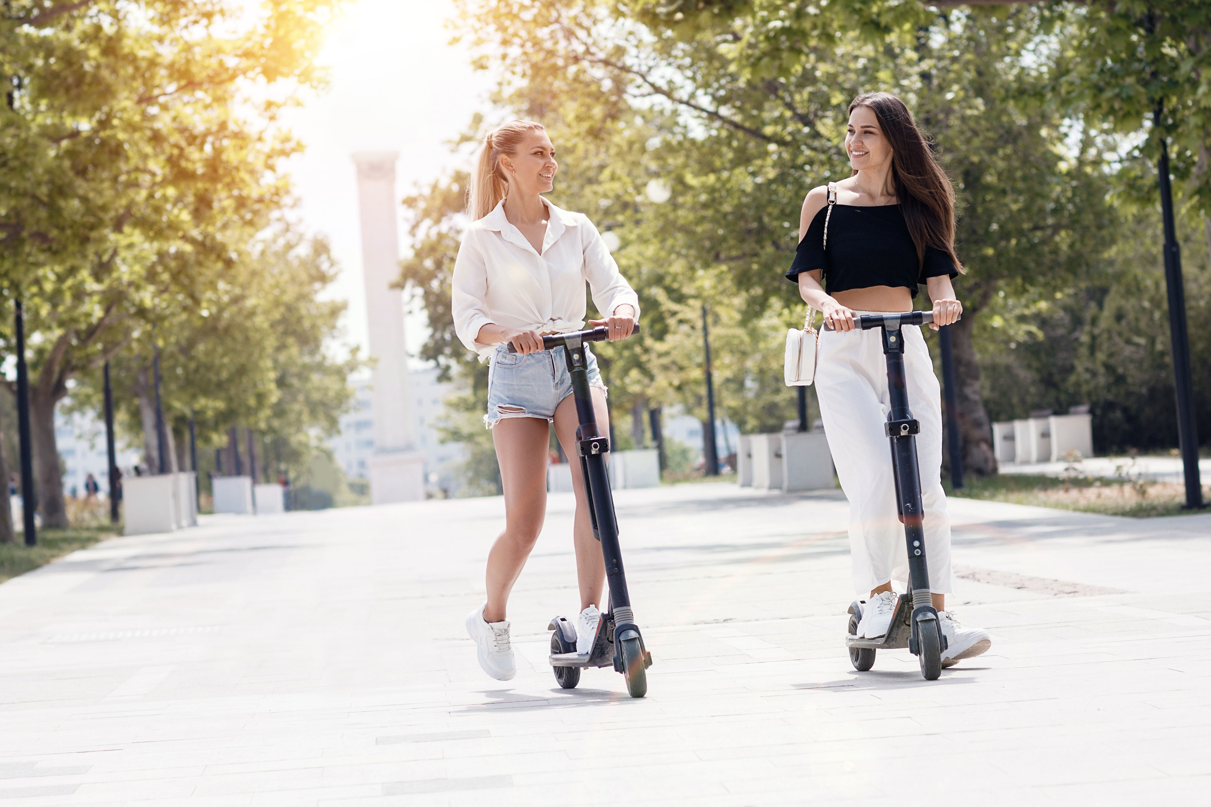
Kat and Lily complete 2 circuits of Rata Park on e-scooters.
They ride for 13 minutes and 12 seconds at a speed of 10 kilometres per hour.
What distance, in kilometres, is equal to 2 circuits?

Slide 8

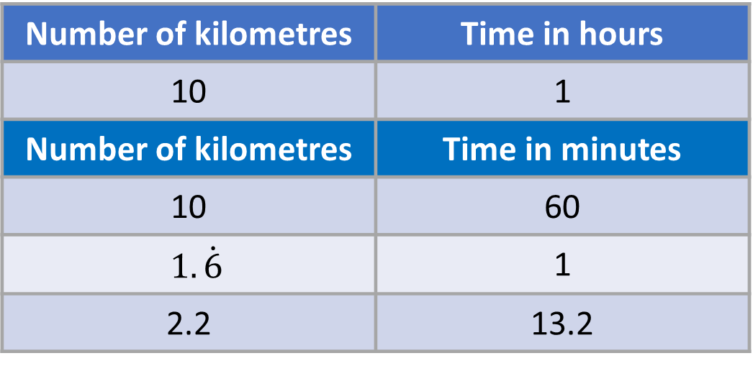

Number of kilometres | Time in hours
10 | 1
Number of kilometres | Time in minutes
10 | 60
$$1.\dot{6}$$ | 1
2.2 | 13.2
Using a calculator
$$10÷60=0⋅\dot{6} km/min$$
÷ 60
$$13⋅2×0⋅\dot{6}=2.2 km$$
÷ 60
x 13.2
x 13.2
Dividing the double number line up into tenths first.
0
1
2.2
5
10
Distance (km)
0
6
13.2
30
60
Time (mins)

Slide 9
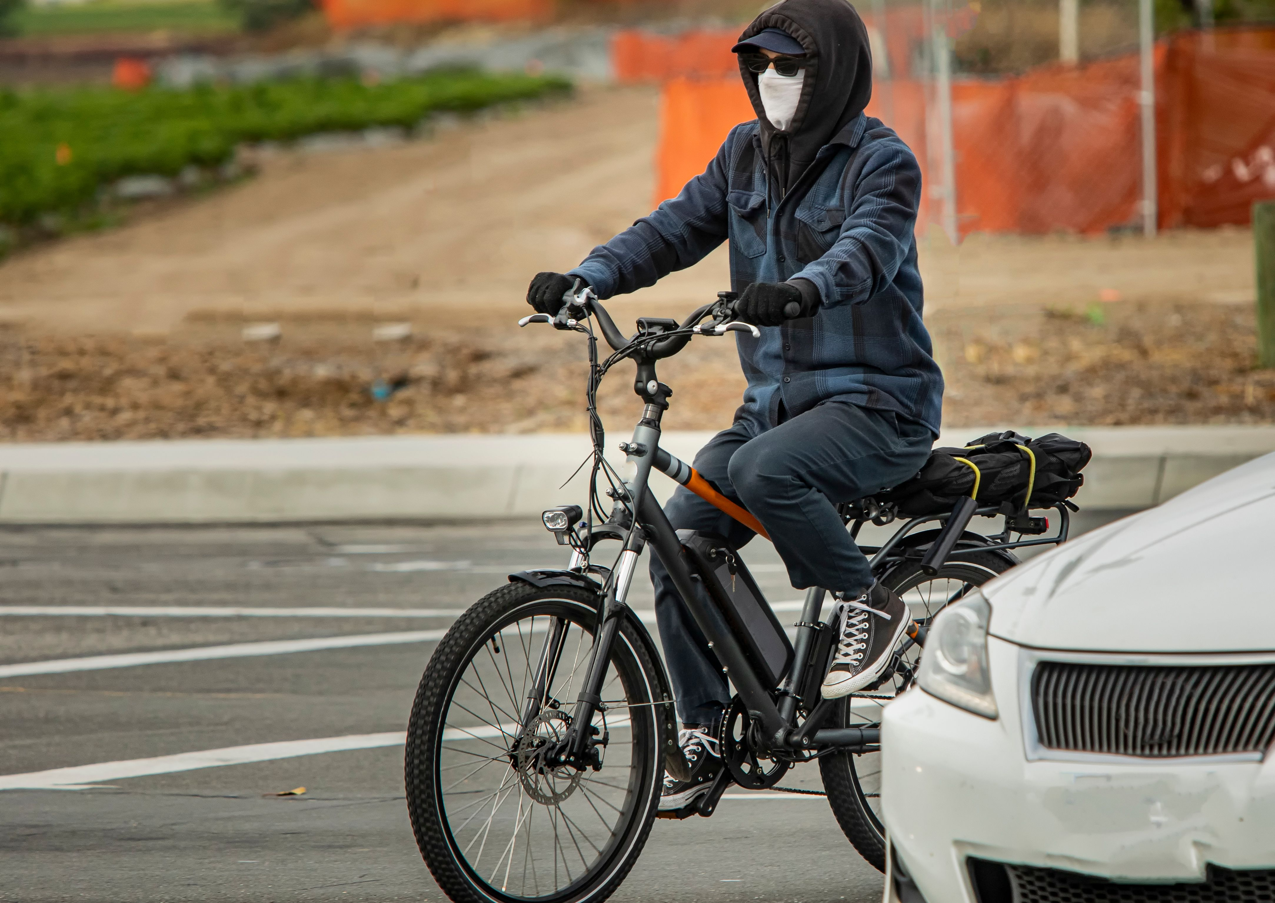
Lihn cycles to work.
She rides at an average speed of 16 kilometres per hour.
Her ride takes 36 minutes.
What distance, in kilometres, does Lihn ride to get to work?

Slide 10


Number of kilometres | Time in minutes
16 | 60
9.6 | 36
Using a calculator
$$16÷60=0⋅2\dot{6} km/min$$
X 0.6
x 0.6
$$36×0⋅2\dot{6}=9.6 km$$
Dividing the double number line up into tenths first.
0
1.6
9.6
16
Distance (km)
0
6
36
60
Time (mins)

Slide 11
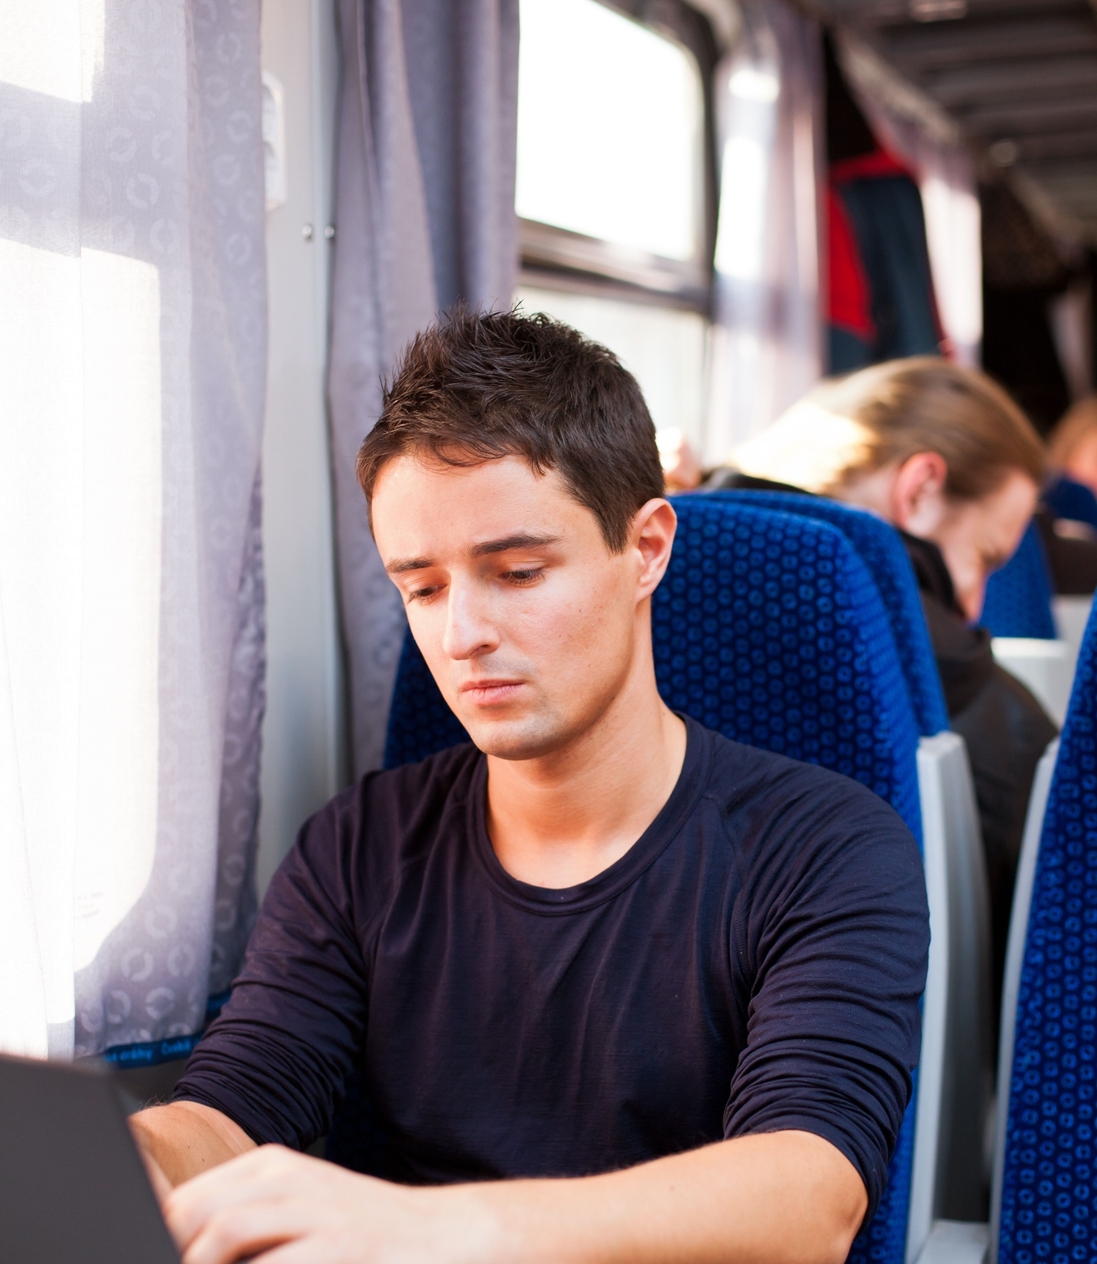
Alec catches the train to work.
The journey takes 75 minutes at an average speed of 88 kilometres per hour.
What distance, in kilometres, is Alec’s train journey?

Slide 12


Number of kilometres | Time in minutes
88 | 60
110 | 75
Using a calculator
$$88÷60=1⋅4\dot{6} km/min$$
x 1.25
x 1.25
$$75×1⋅4\dot{6}=110 km$$
Dividing the double number line up into quarters first.
0
22
88
110
Distance (km)
0
15
60
75
Time (mins)

Slide 13
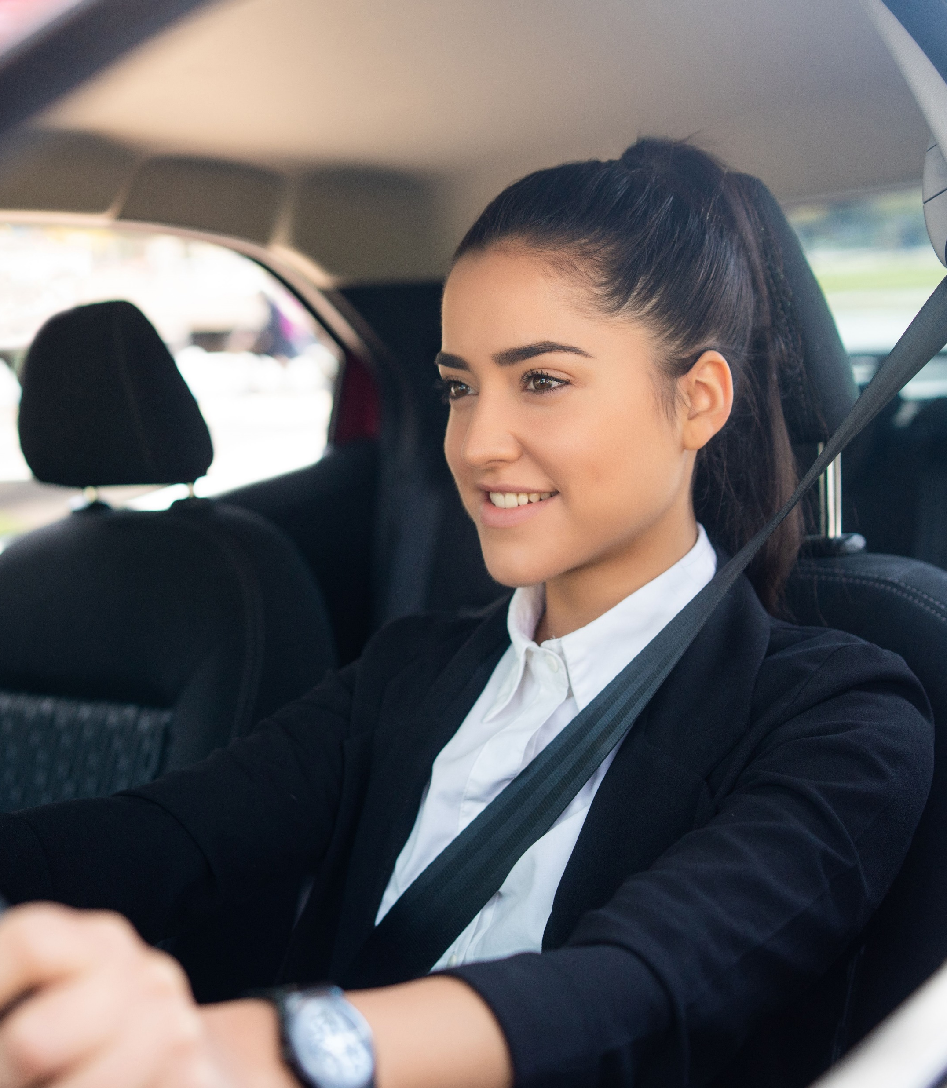
Rosalie drives to her polytechnic to study.
The drive is 24 kilometres and takes her 18 minutes.
What is Rosalie’s average speed, in kilometres per hour?

Slide 14


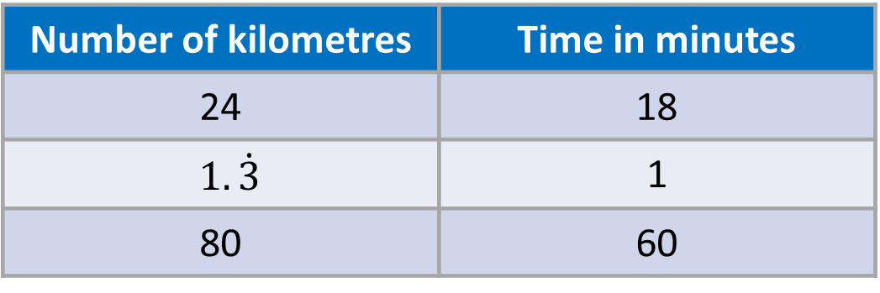
Number of kilometres | Time in minutes
24 | 18
$$1.\dot{3}$$ | 1
80 | 60
Using a calculator
÷ 18
÷ 18
$$24÷18=1⋅\dot{3}km/min$$
x 60
x 60
$$60×1⋅\dot{3}=80 km/hr$$
Dividing the double number line up into tenths first.
0
8
24
80
Distance (km)
0
6
18
60
Time (mins)

Slide 15
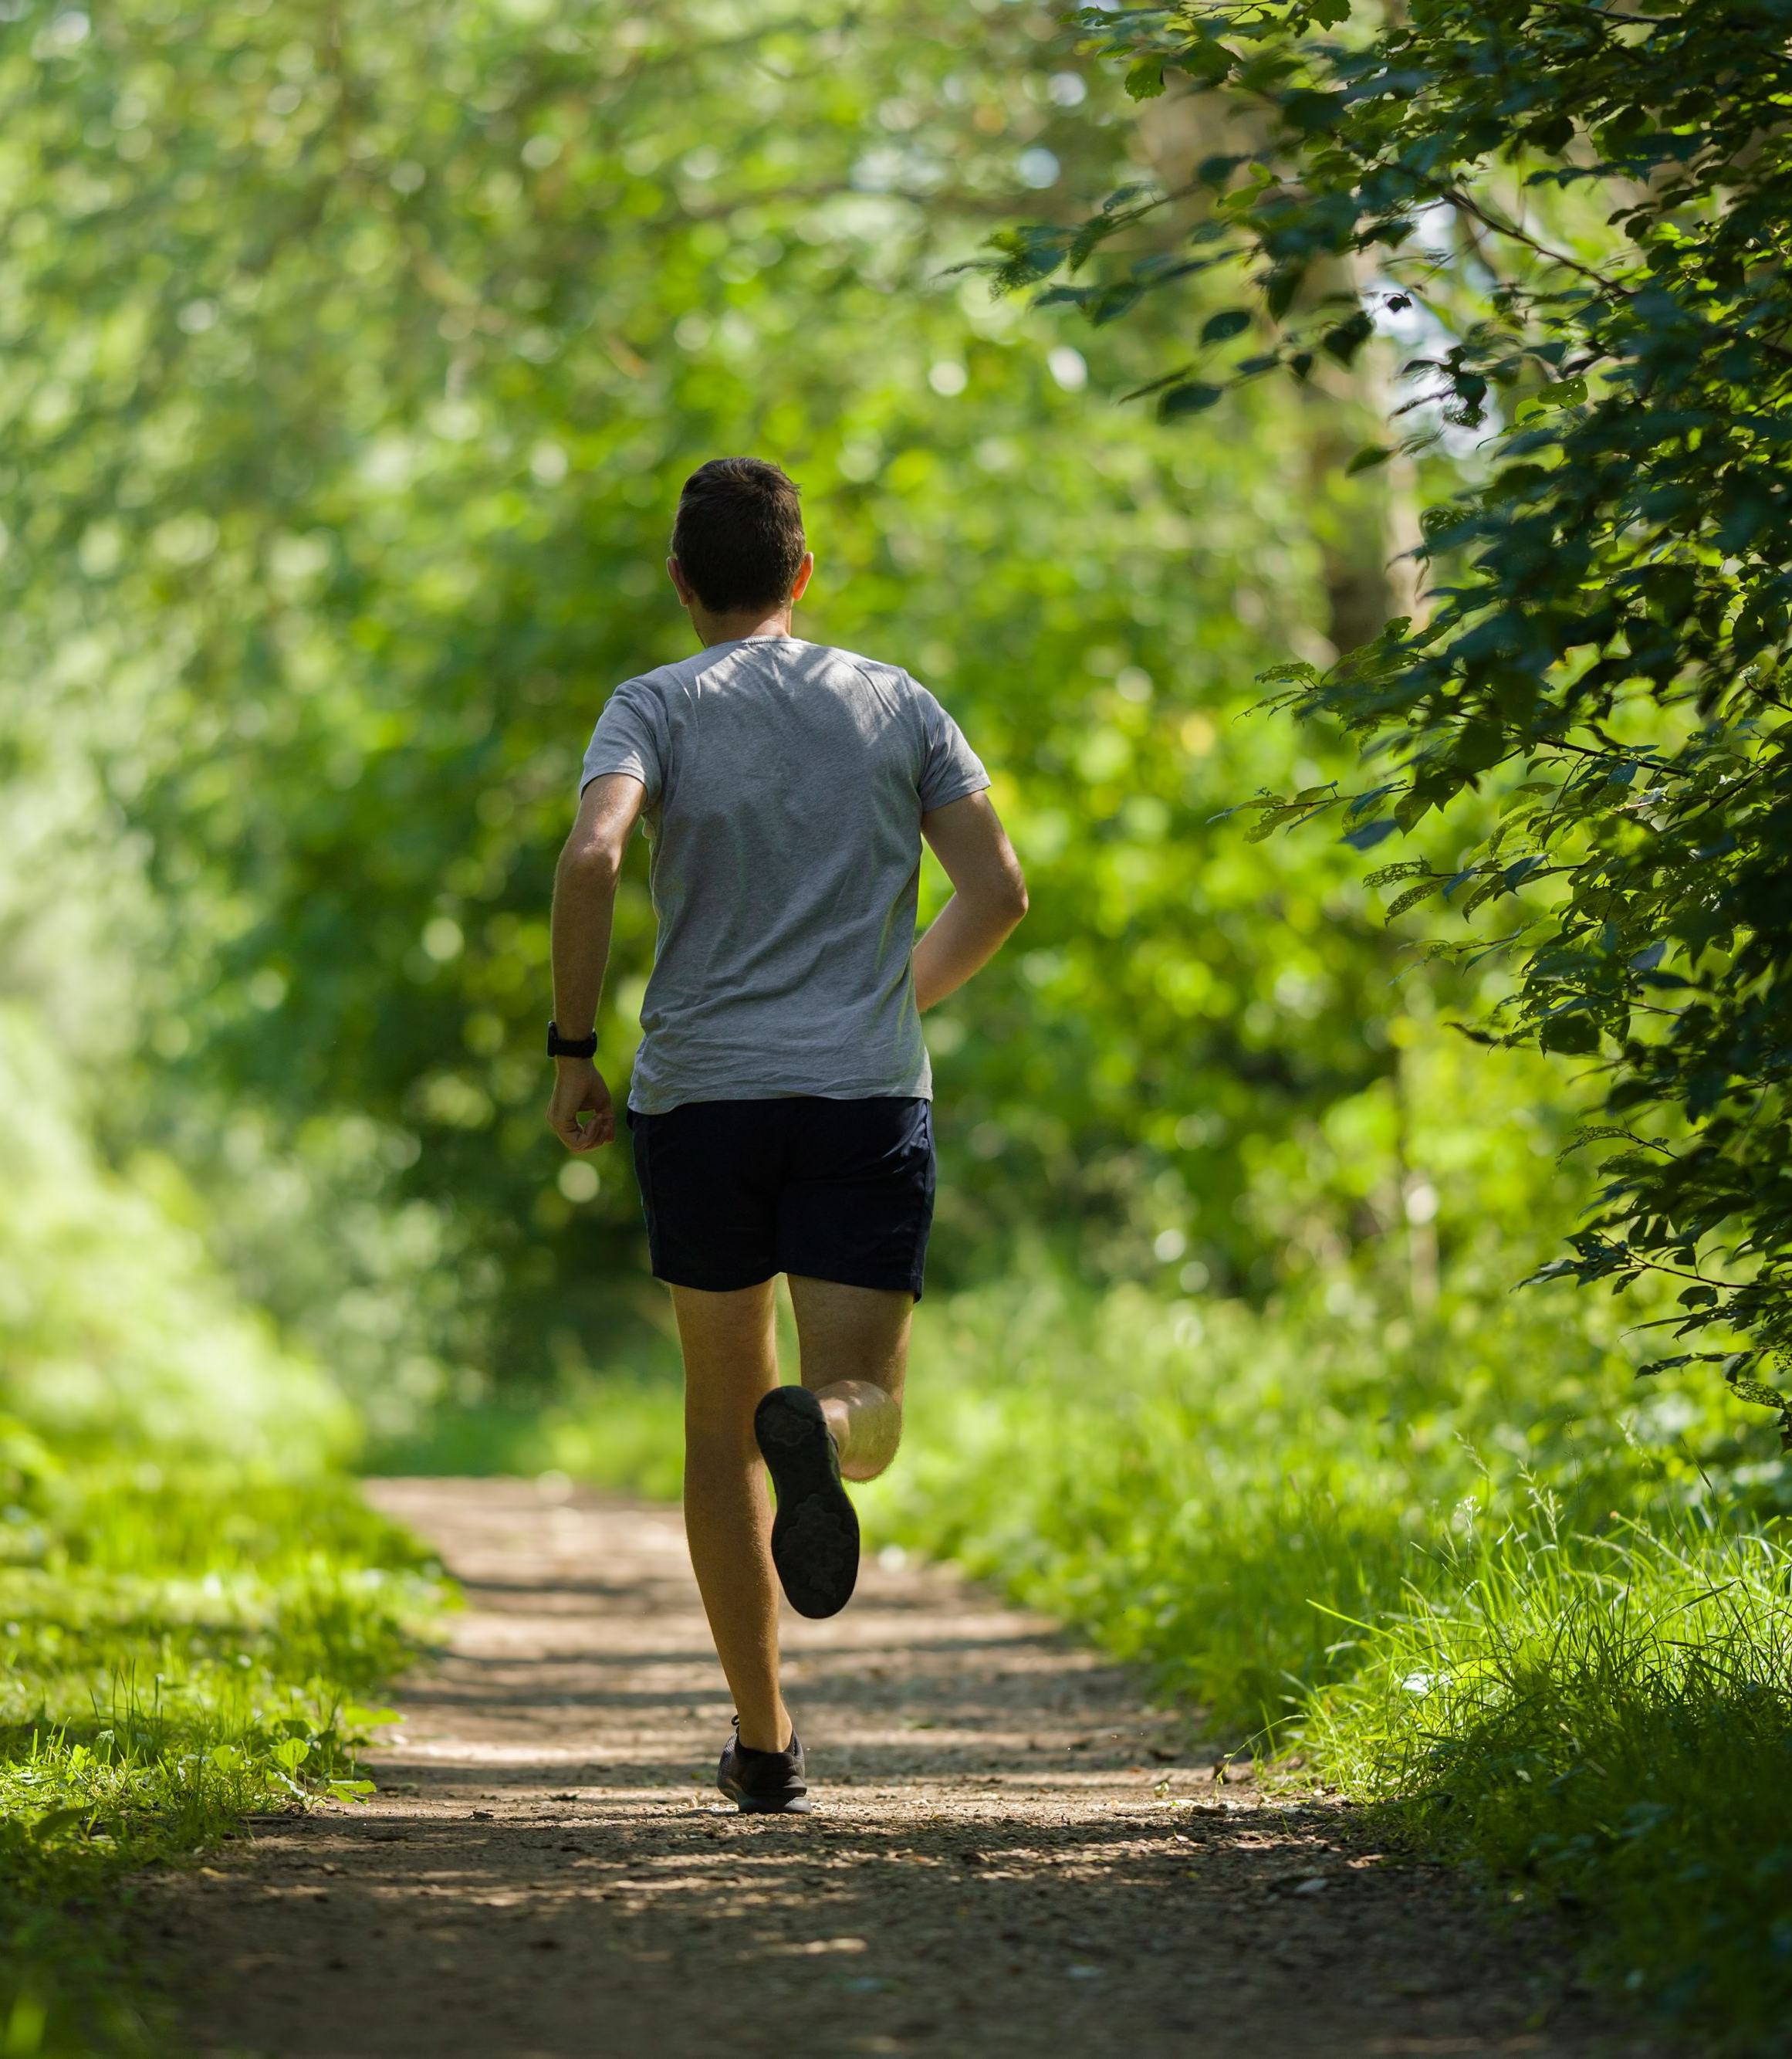
Lorenzo jogs 8.4 kilometres every lunchtime.
The run takes him 40 minutes.
What is Lorenzo’s average speed, in kilometres per hour?

Slide 16


Number of kilometres | Time in minutes
8.4 | 40
12.6 | 60
Using a calculator
$$8.4÷40=0.21 km/min$$
x 1.5
x 1.5
$$60×0.21=12 km/hr$$
Dividing the double number line up into thirds first.
0
4.2
8.4
12.6
Distance (km)
0
20
40
60
Time (mins)

Slide 17
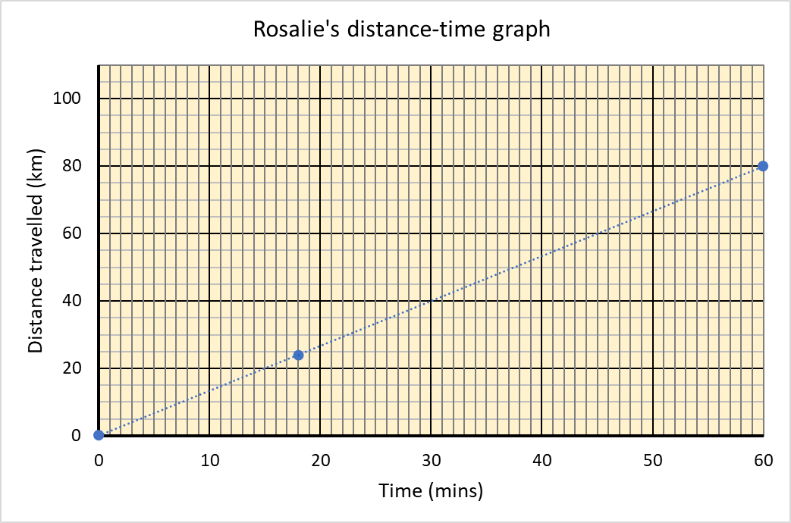

Slide 18
