Slide 1
Before changing to a hybrid or electric vehicle Mere checks out the depreciation of these three types of cars. Depreciation is the loss in sale price as the car ages.
She uses these average sale figures from the car dealers’ Red Book for 3 comparable models.
Model | 2020 (New) | 2021 | 2022 | 2023 | 2024
Petrol | 32,000.00 | 24,000.00 | 18,000.00 | 13,500.00 | 10,130.00
Hybrid | 48,900.00 | 42,500.00 | 36,100.00 | 29,500.00 | 16,700.00
Electric | 64,000.00 | 62,500.00 | 61,000.00 | 59,500.00 | 58,000.00

Slide 2
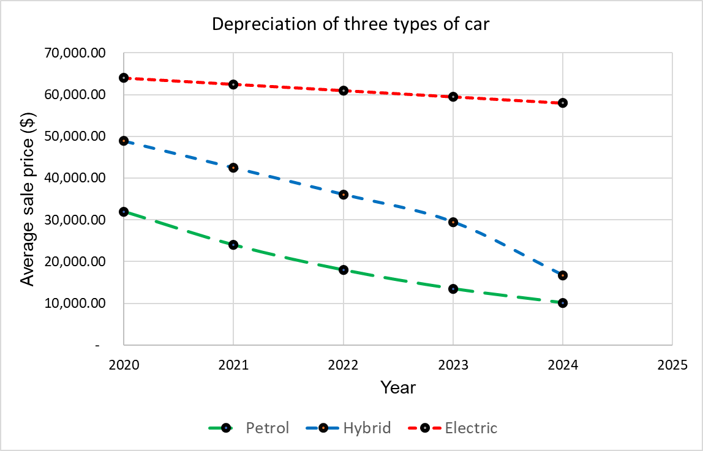

Slide 3
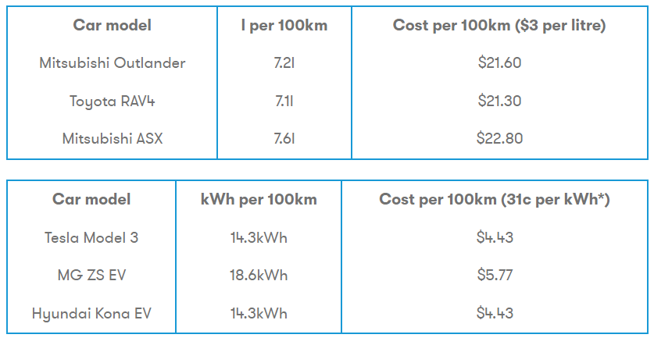
Source: https://www.canstarblue.co.nz/energy/electricity-providers/electric-cars-vs-petrol-cars-costs-and-savings/

Slide 4
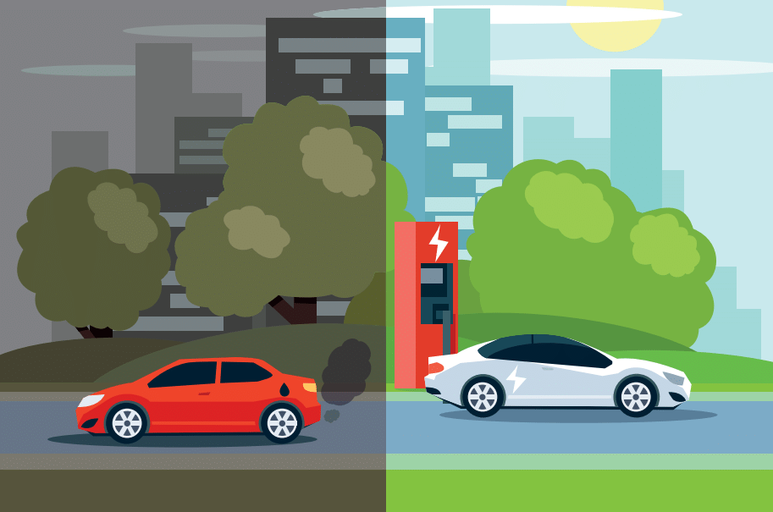
Mere expects to travel about 15 000 km per year, whatever car she gets. That includes her daily commute to work which is a big cost to her. Usually, she keeps her cars for 5 years before trading in and buying a replacement.
Mere wonders if changing her petrol car to a hybrid or an electric car is worth it.
What information will Mere need to make an informed decision?

Slide 5
