Slide 1
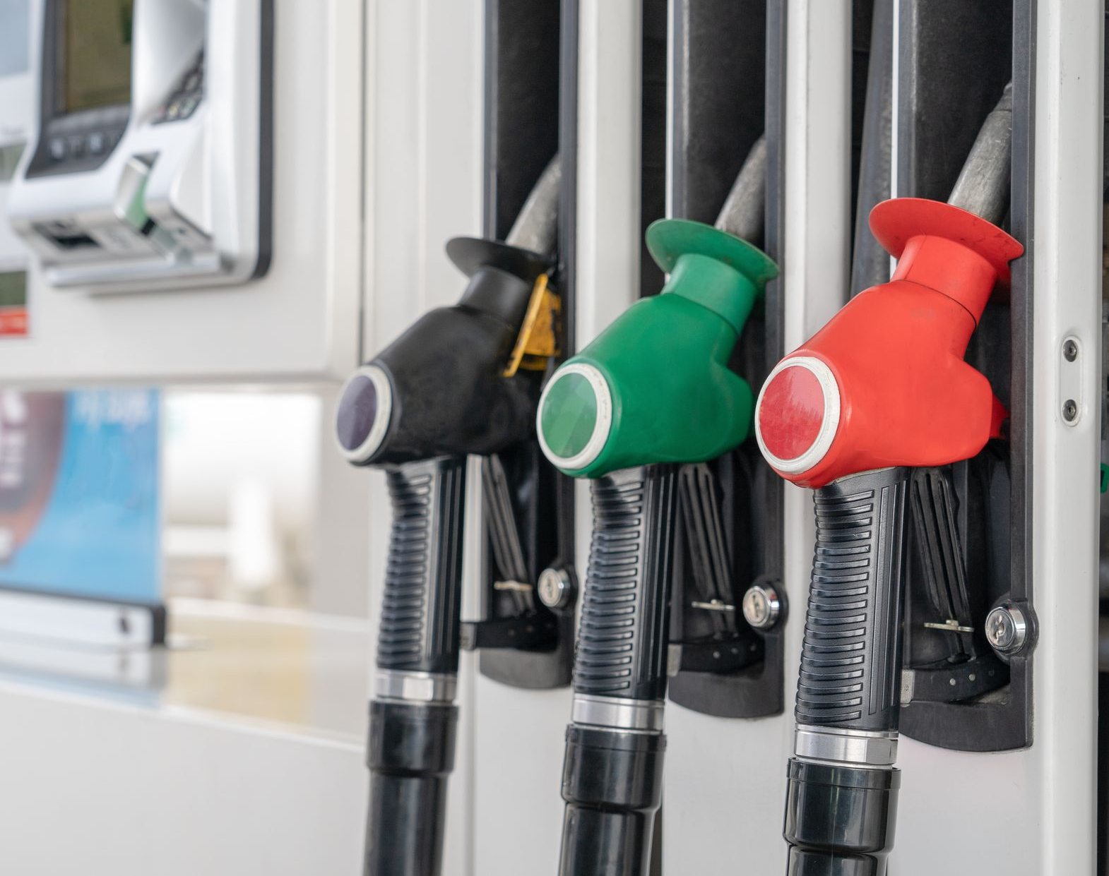
Why are there different nozzles at the petrol bowser?

Slide 2
A test was carried using the same mid-sized car, using the three percentage concentrations of octane available in New Zealand petrol stations; 91, 95, 98. The car was first tuned to the fuel concentration, then with 15 L of that fuel in the tank, the car was driven until the tank was empty. This was repeated for each of the fuels.
The results were: 91-octane: The car travelled 230 km on 15 litres of fuel. 95-octane: The car travelled 237 km on 15 litres of fuel.
98-octane: The car travelled 241 km on 15 litres of fuel.
If the relationship between amount of fuel used and distance travelled is linear, how far would the car have travelled using:
7.5 litres of 91-octane petrol?
10 litres of 95-octane petrol?
6 litres of 98-octane petrol?

Slide 3
If the relationship between amount of fuel used and distance travelled is linear, how far would the car have travelled using 7.5 litres of 91-octane petrol?
Amount of fuel (L) | Distance travelled (km)
15 | 230
7.5 | 115
÷ 2
÷ 2
0
115
230
Distance (km)
0
7.5
15
Amount of fuel (L)
$$230÷15=15⋅\dot{3} km/l$$
$$15⋅\dot{3} ×9=115km$$

Slide 4
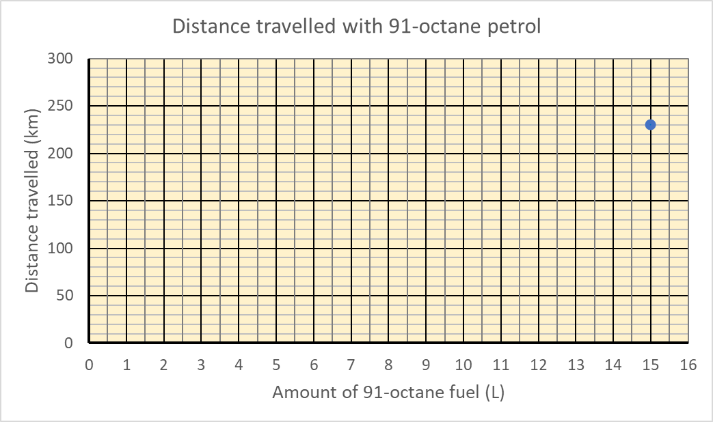
115

Slide 5
If the relationship between amount of fuel used and distance travelled is linear, how far would the car have travelled using 10 litres of 95-octane petrol?
Amount of fuel (L) | Distance travelled (km)
15 | 237
10 | 115
$$×\frac{2}{3}$$
$$×\frac{2}{3}$$
0
79
158
237
Distance (km)
0
5
10
15
Amount of fuel (L)
$$237÷15=15⋅8 km/l$$
$$15⋅8×10=158 km$$

Slide 6
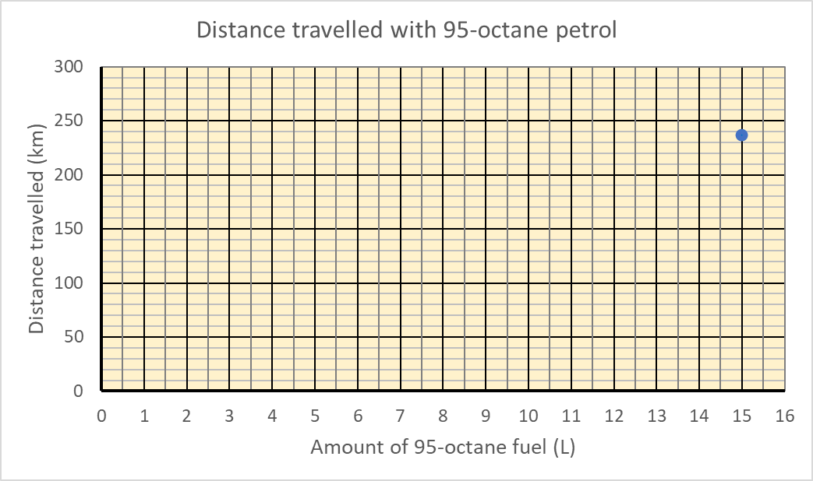
158

Slide 7
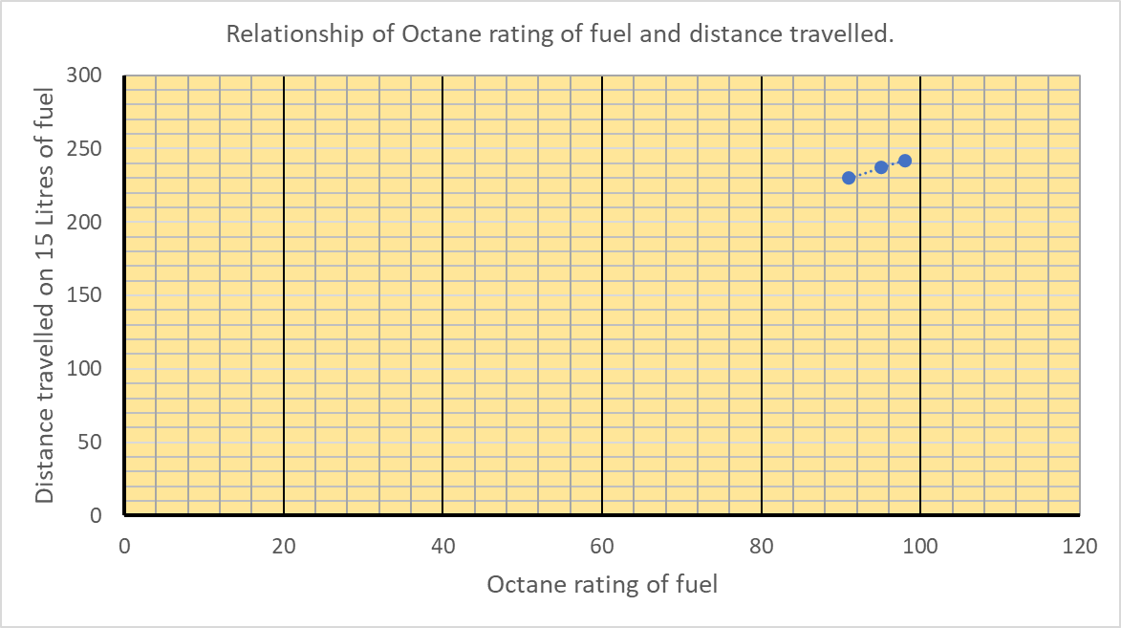

Slide 8
On the day of the test this was the price of the three types of fuel:
91-Octane cost $2.45 per litre
95-Octane cost $2.65 per litre
98-Octane cost $2.77 per litre
Assume the car can be tuned to run on any of these three fuels.
What fuel gives the best value per 100 kilometres?
91-octane: The car travelled 230 km on 15 litres of fuel.
95-octane: The car travelled 237 km on 15 litres of fuel.
98-octane: The car travelled 241 km on 15 litres of fuel.

Slide 9
For 91-Octane fuel
Amount of fuel (L) | Distance travelled (km)
15 | 230
6.52 | 100
$$÷2.3$$
$$÷2.3$$
Amount of fuel (L) | Cost ($)
1 | 2.45
6.52 | 15.98
$$×6.52$$
$$×6.52$$

Slide 10
For 95-Octane fuel
Amount of fuel (L) | Distance travelled (km)
15 | 237
6.33 | 100
$$÷2.37$$
$$÷2.37$$
Amount of fuel (L) | Cost ($)
1 | 2.65
6.33 | 16.77
$$×6.33$$
$$×6.33$$

Slide 11
For 98-Octane fuel
Amount of fuel (L) | Distance travelled (km)
15 | 241
6.22 | 100
$$÷2.41$$
$$÷2.41$$
Amount of fuel (L) | Cost ($)
1 | 2.77
6.22 | 17.24
$$×6.22$$
$$×6.22$$

