Slide 1
Halim commutes to work each weekday, driving 28 km each way. The full cost of running a medium sized car is quoted as being 89 cents per kilometre.
How much does Halim’s weekly commute cost him?

Slide 2
Working out the distance that Halim commutes each week:
There are 5 weekdays (Mon, Tues, Wed, Thurs, Fri).
Each commute is 2 x 28 = 56 km. You might calculate 10 x 28 = 280 km instead.
Commutes | Kilometres
1 | 56
5 | 280
Working out the cost each week:
280 x 0.89 = $249.20
You might work out the cost per day then multiply by 5.
Kilometres | Dollars
1 | 0.89
280 | 249.20

Slide 3
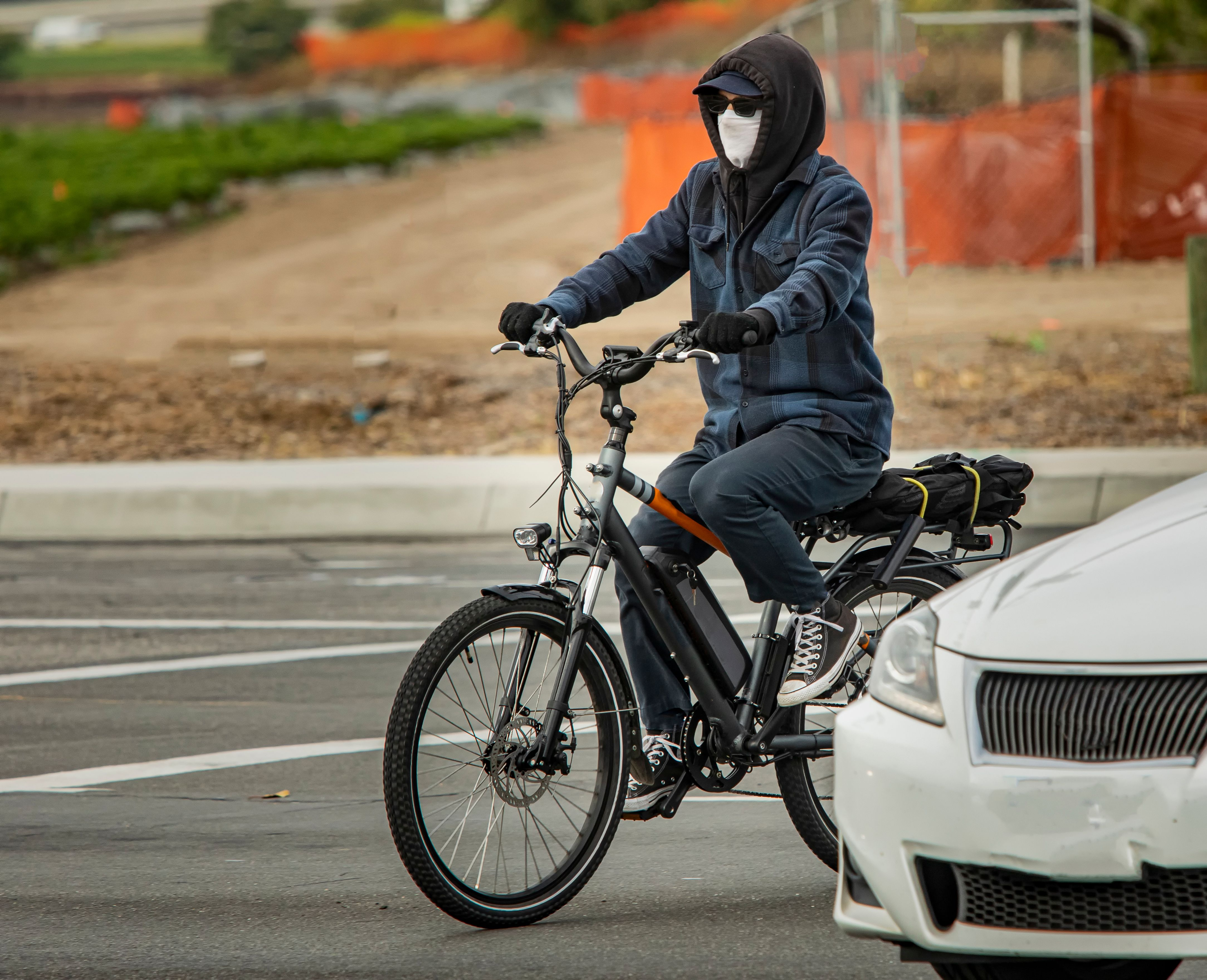
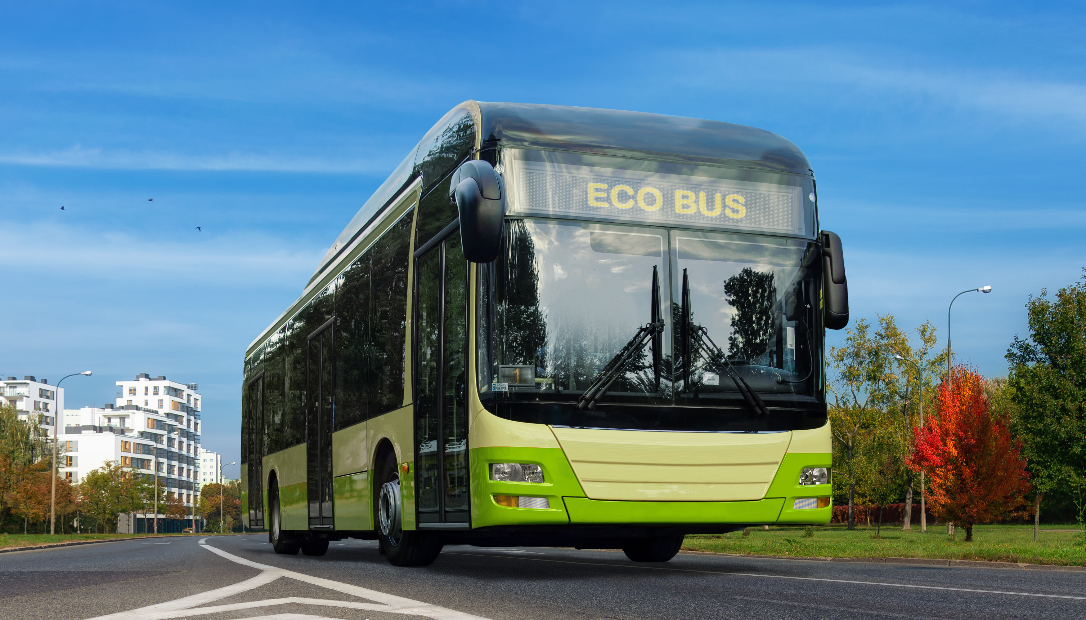
Bus
$8.90 per one way trip
Travel time (door to door) is 56 minutes each way.
Electric Bicycle
Costs $23.00 per day
Travel time (door to door) is 38 minutes each way.

