Slide 1
Estimated kiwi population over time
12,0000,000
Number of kiwi
5,0000,000
70,000
C1000 AD
Today
Year
76 Years ago
Adapted from: http://abeljulien.blogspot.com/2017/10/els-kiwis-sestan-posant-cecs.html

Slide 2
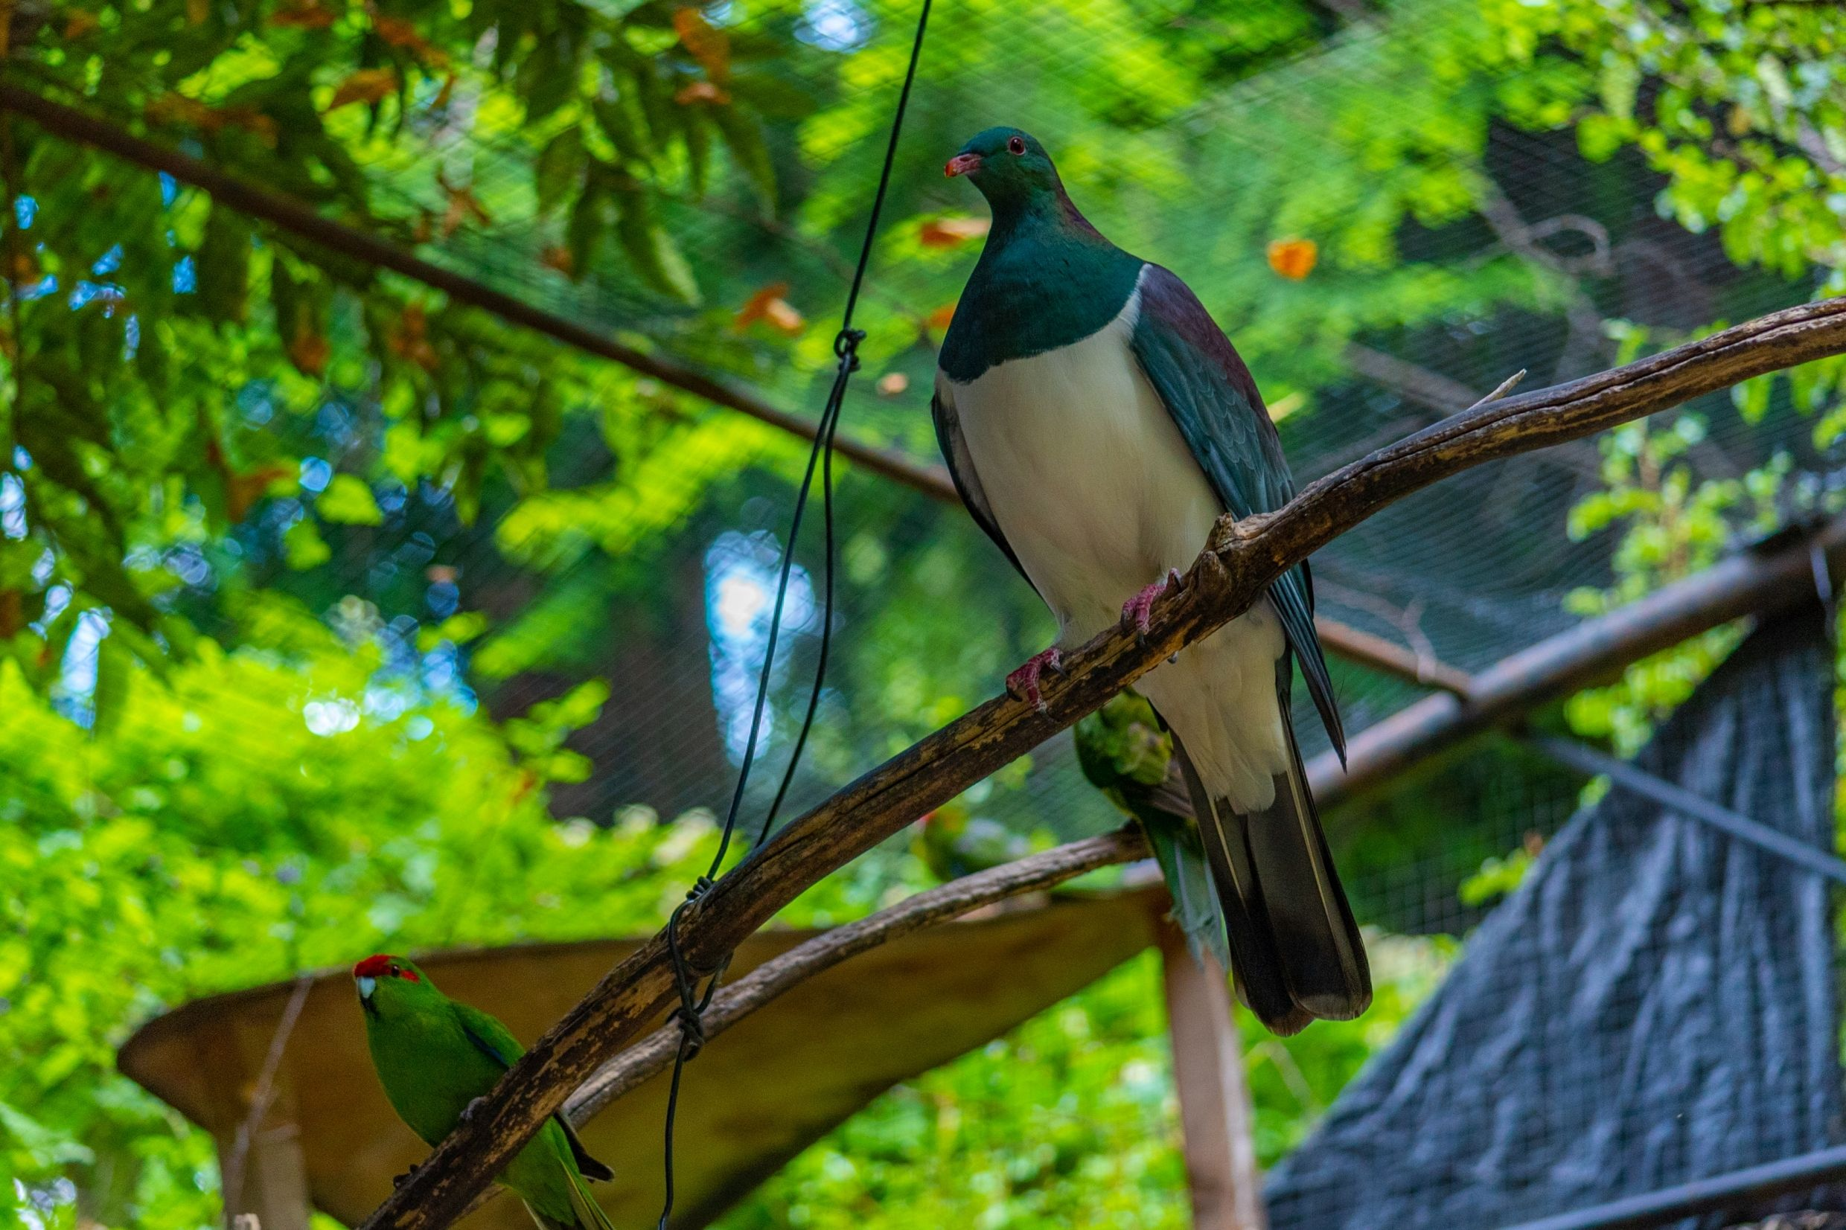
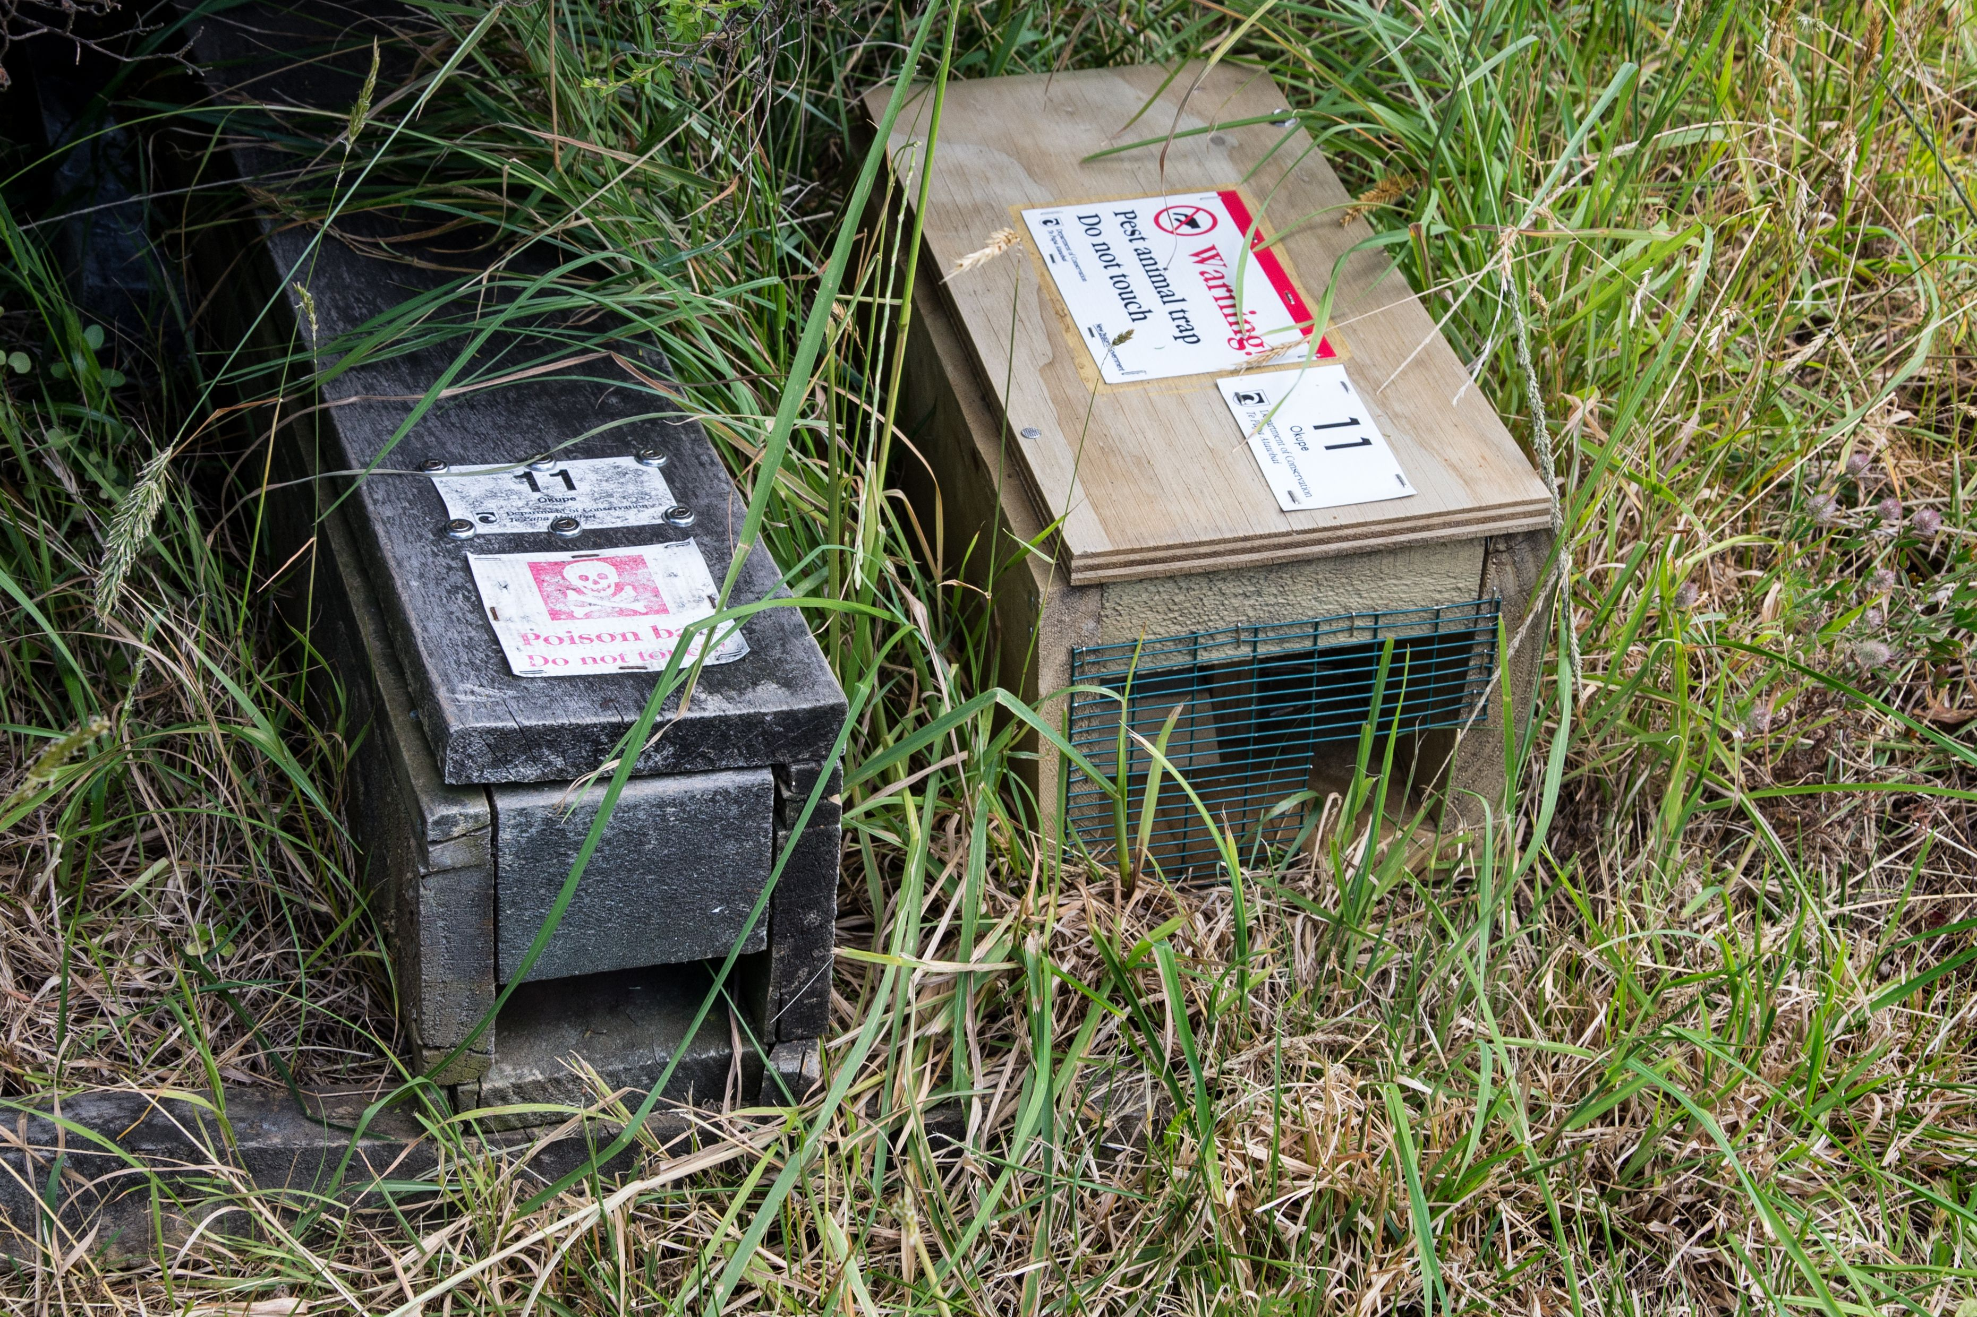
A local bird sanctuary is protected from predators by good fencing and a trapping project run by volunteers. A record is kept of all the predators caught in the traps and when the traps are sprung (by a predator that ‘got away’).

Slide 3
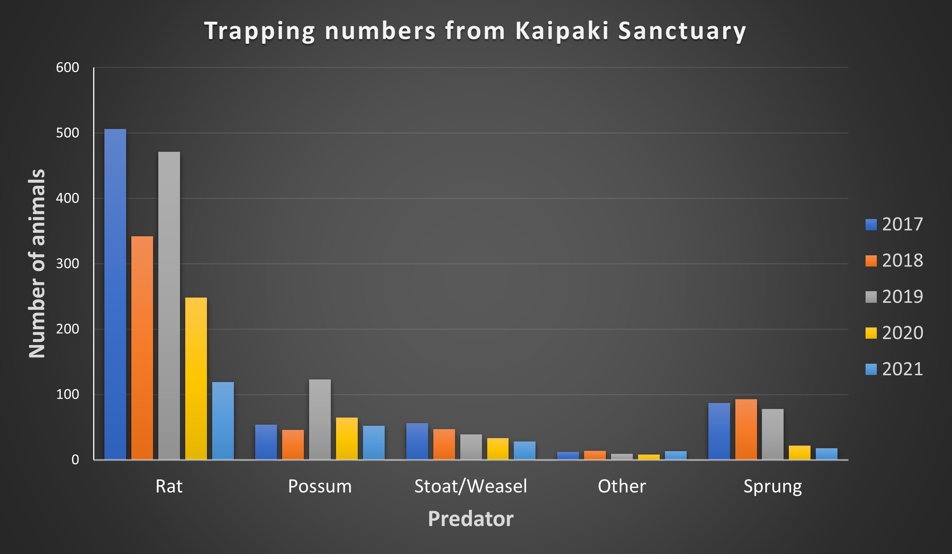

Slide 4
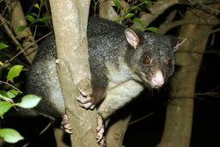
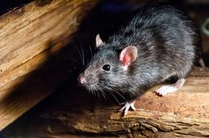

Slide 5
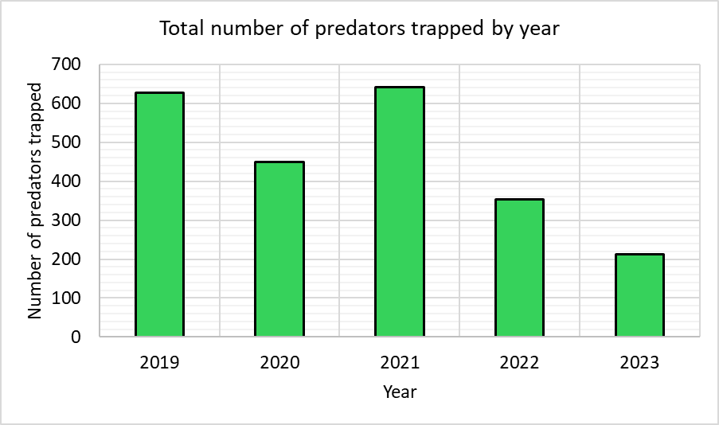

Slide 6
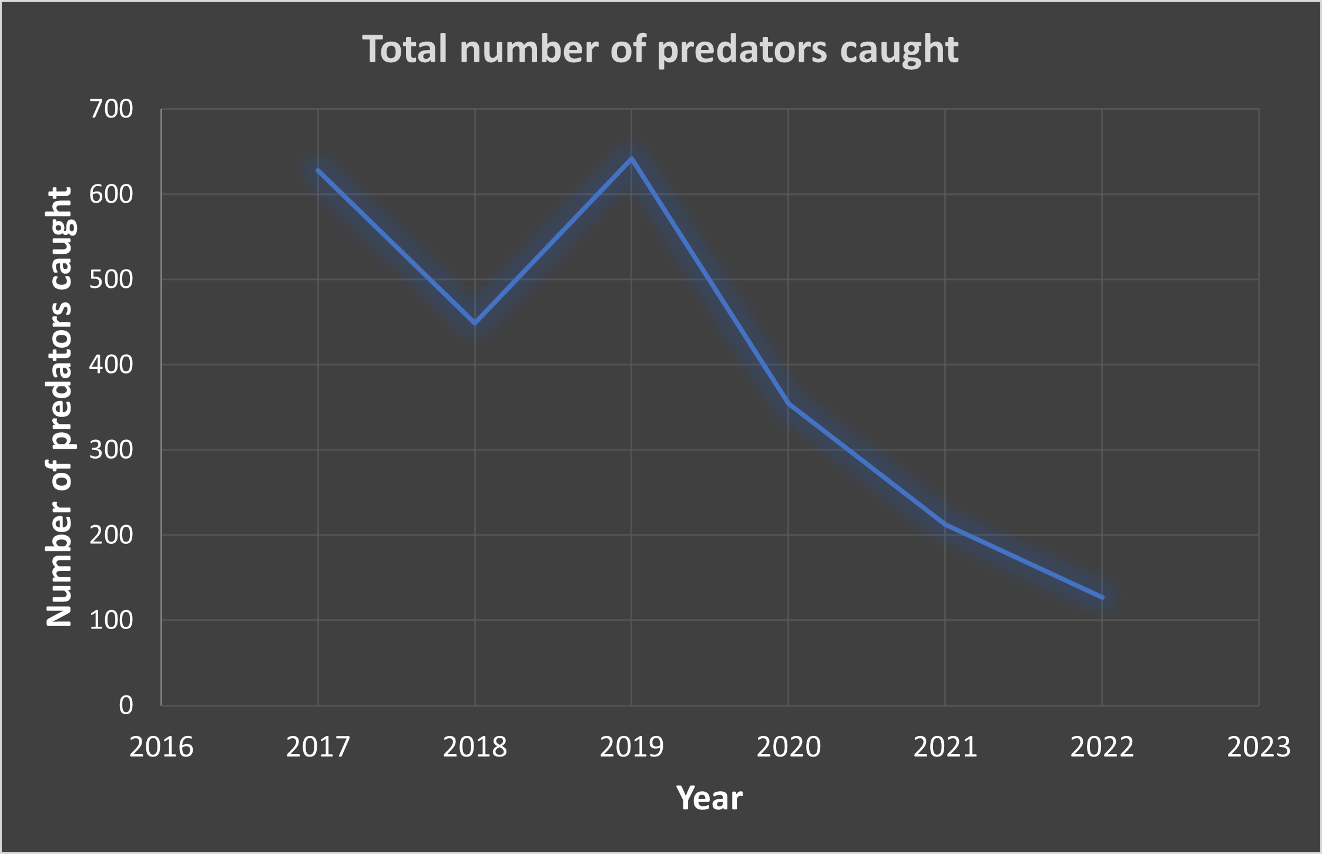

Slide 7
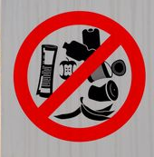
In 2024, the bird sanctuary manager decided to further reduce the rat population with better management of visitor behaviour. They did this by banning food consumption within the predator-controlled area and removing the rubbish bins (as they were no longer needed).

Slide 9
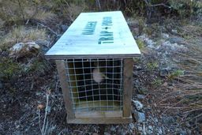
Room 7 begin a programme of pest control using proper wooden traps. There is a reserve next to the school with some bird life.
They hire 15 traps from the local council and locate the traps between the reserve and possible food sources, such as the school compost bin and rubbish skip. They also place traps beside the old hall.

Slide 11
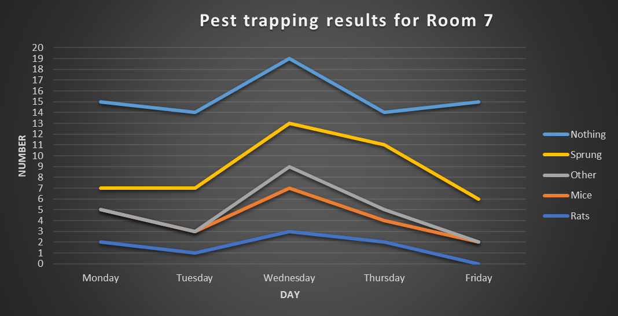

Slide 12
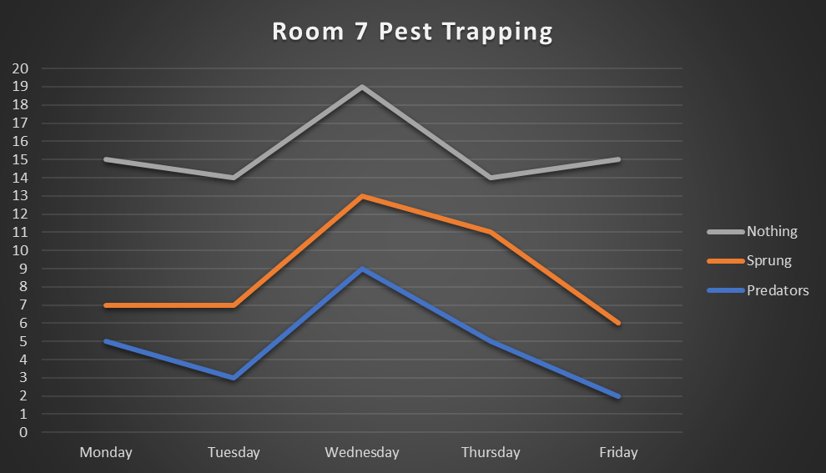

Slide 13
Room 7 students want to know if they are effective in reducing the number of wildlife predators around the school.
They collected data on the activity in their 15 predator traps.
However, the students want to find out more about any predators that had not been caught in the traps. They have prepared ink pads and plain cards for the entrance to each of the trap tunnels. The predators going near the tunnels will get ink on their paws/feet and will leave a footprint record of their visit.

Slide 14
Gecko
Weasel or Stoat
Possum
Rat
Hedgehog
Mouse
Rabbit
Cat

Slide 15
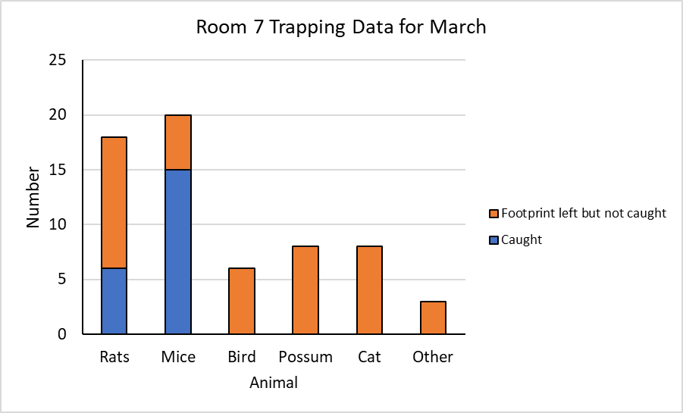

Slide 16
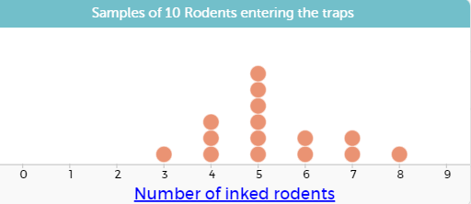

Slide 18
17 of the rodents in the population have inked feet.
During the next week 12 rodents are caught in the traps.
Three of the trapped rodents have inked feet.
Use these data to estimate the population of rodents that frequent the school grounds.
Carry out a simulation to check the accuracy of your estimate.

Slide 19
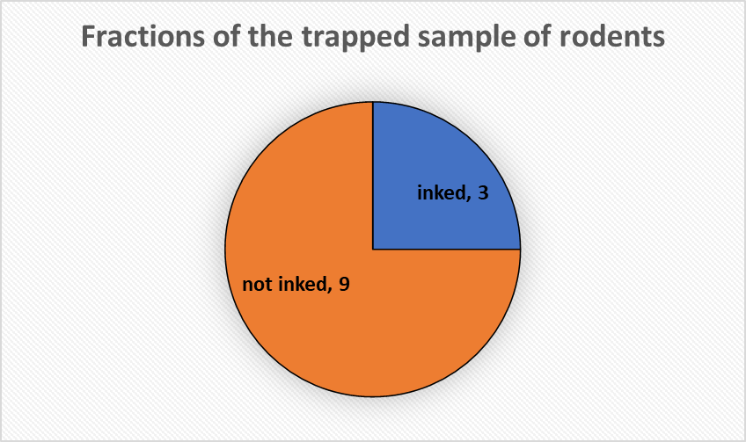
If the fractions are the same, then:
Estimate the number of rodents in the population that are not inked.
Estimate the total population of rodents.
not inked, ?

Slide 21
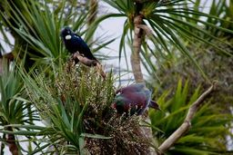
At another Waimiha School, Room 3 is also trapping possums using humane cage traps. Beside the school is a large glade of native trees and birds are beginning to return, especially kereru and tui.
Using ink pads, the students know that 9 possums escaped the traps on the first night. Those possums got ink on their feet.
On the second night 16 possums were trapped. Six of those possums had ink on their feet.
Use those data to estimate the possum population in the glade and test the reliability of your estimate with a simulation.

Slide 22
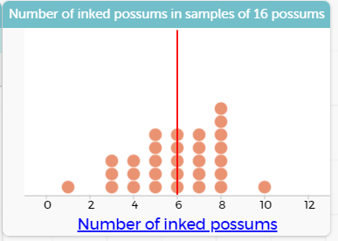
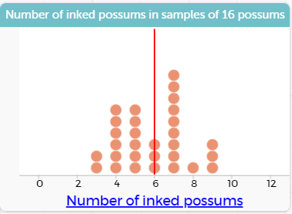
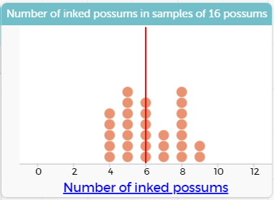
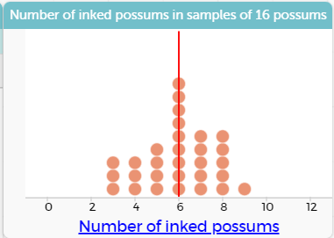
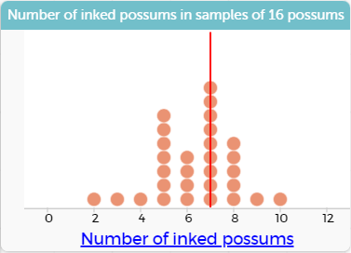
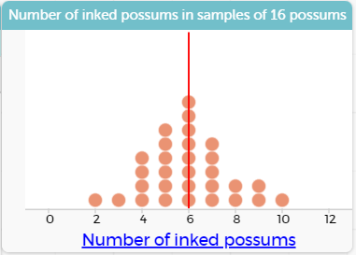

Slide 23
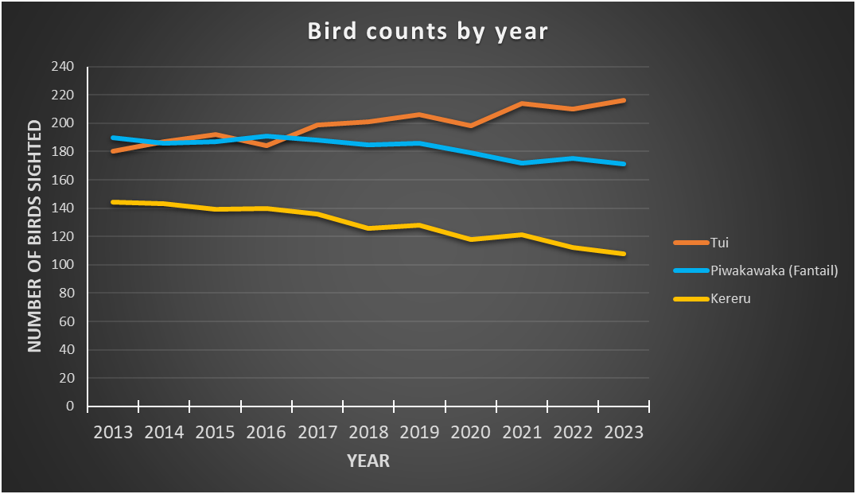
Before the year 8 class implemented a ‘predator free’ programme, it took part in Landcare New Zealand’s garden bird survey. The class were interested to learn that over the past ten years in their area, there has been an 11% increase in the tui count but a 13% decline in the fantail count and a 27% decline in the kereru count.

Slide 24
To measure the effectiveness of their predator traps on the bird population at their school, the Room 3 class have taken a bird count for one day each month, over a period of five months. The results are as follows:

Slide 25
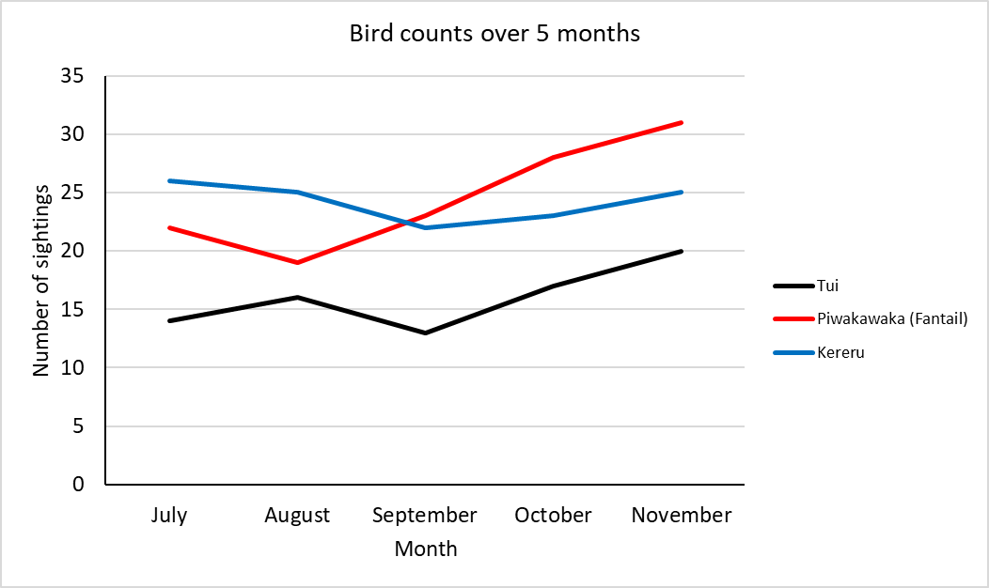

Slide 28
