Slide 1
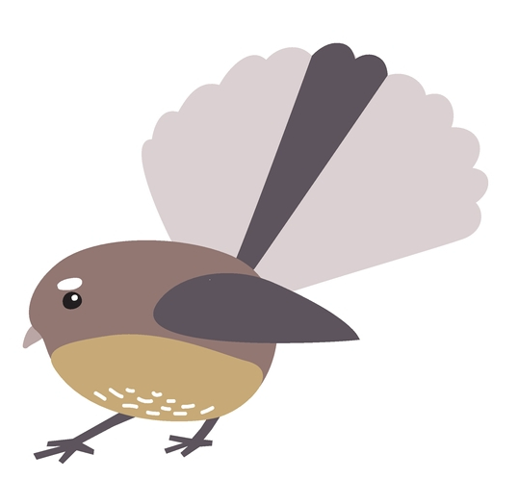
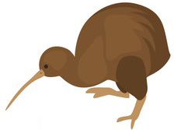
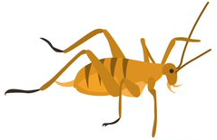
1 | 2 | 3 | 4 | 5 | 6

Slide 2
What animal is in place 7?
How do you know?
1 | 2 | 3 | 4 | 5 | 6

Slide 3
5 | 6 | 7 | 8 | 9 | 10 | 11

Slide 4
What animal is in place 15?
How do you know?
5 | 6 | 7 | 8 | 9 | 10 | 11

Slide 5
10 | 11 | 12 | 13 | 14 | 15 | 16

Slide 6
What animal is in place 18?
How do you know?
10 | 11 | 12 | 13 | 14 | 15 | 16

Slide 7
15 | 16 | 17 | 18 | 19 | 20 | 21

