Slide 1
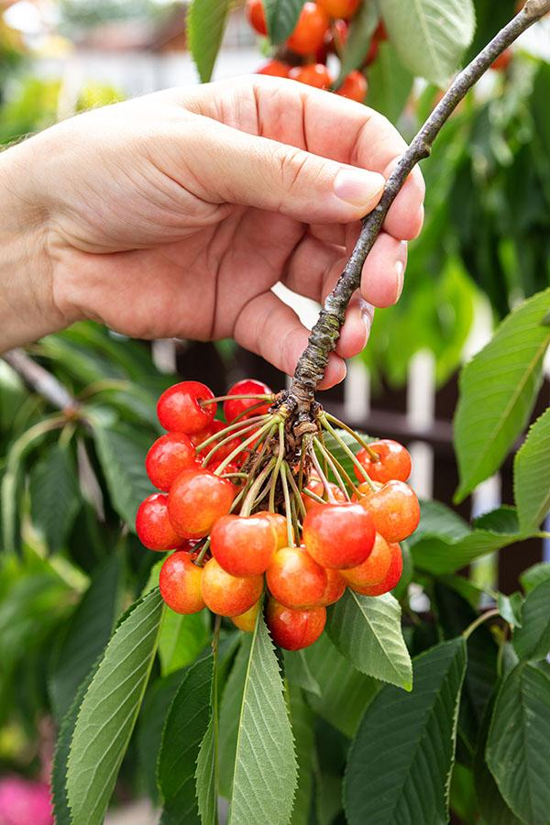
Kylie and Gary want to establish a cherry grove as a ‘money spinner.’
Irrigation during the spring will be important.
Cherry trees need deep watering every
7 to 10 days.

Slide 2
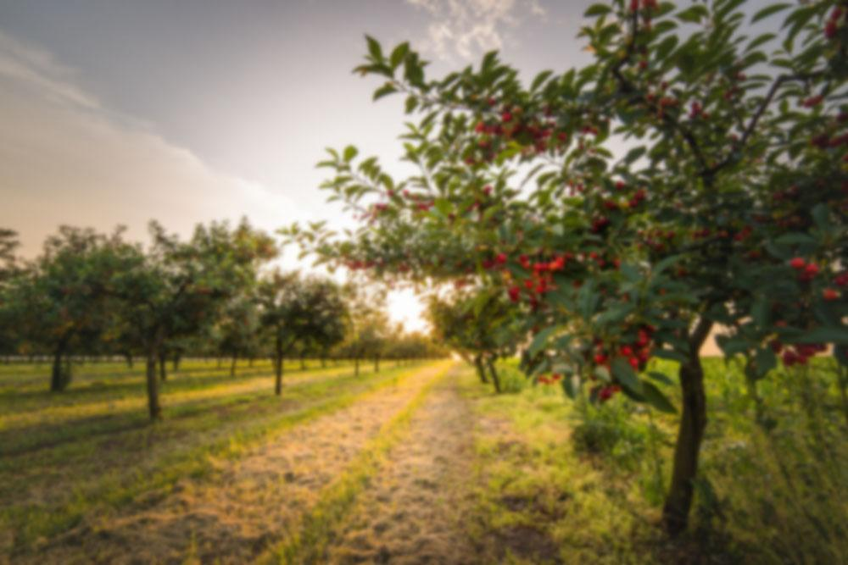
Most cherry orchards have trees arranged in rows to make mowing the grass easier. Sprayers and pruning gangs can also get to the plants easily.

Slide 3
(0,13)
(5,12)
(⁻8, 10)
10
(11,7)
(⁻12, 5)
5
(12,5)
(⁻13, 0)
⁻15
⁻10
⁻5
5
10
15
(⁻12,⁻5)
⁻5
(12,⁻5)
(10,⁻8)
(⁻8, ⁻10)
⁻10
(5,⁻12)
(0,⁻13)

Slide 4
(0, 13)
10
(11, 7)
(⁻12, 5)
13m
5
13m
13m
⁻15
⁻10
⁻5
5
10
15
⁻5
13m
⁻10
(5, ⁻12)

Slide 5
10
5
?
22.6⁰
⁻15
⁻10
⁻5
5
10
15
⁻5
⁻10

Slide 6
10
5
22.6⁰
⁻15
⁻10
⁻5
5
10
15
?
⁻5
⁻10

