Slide 1
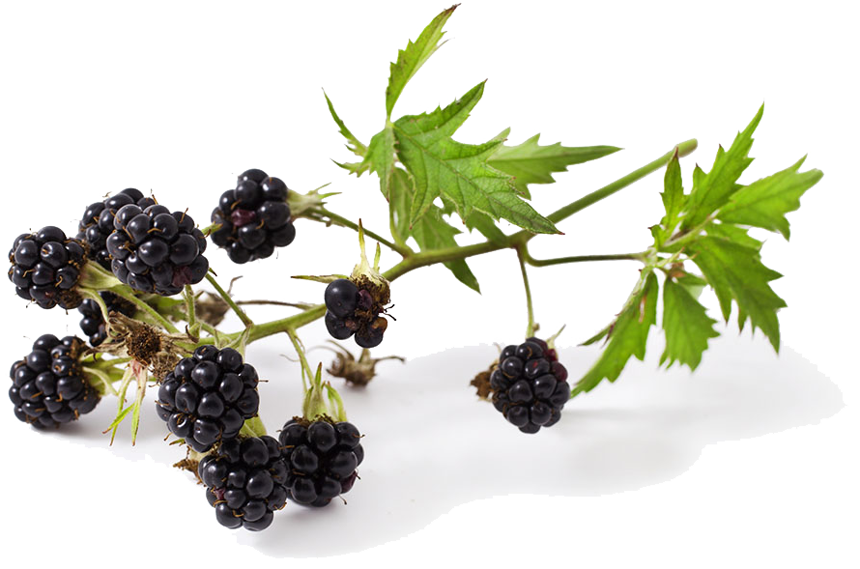
The irrigation system works well and the kōwhai trees cope well with the dry summer.
However, other plants like gorse, blackberry, and grass also grow well.
It is not long before the jets become overgrown and need to be relocated and cleared.

Slide 2
Luckily, Kylie and Gary labelled each tree and have record of the angle and distance from the tree to the irrigation jet.

Slide 3
Kōwhai H
Angle 150⁰
Distance 9m
9m
8m
7m
6m
5m
0⁰
4m
3m
2m
1m
150⁰

Slide 4
Kōwhai A
Angle 45⁰
Distance 7m
0⁰
45⁰
7m

