Slide 1

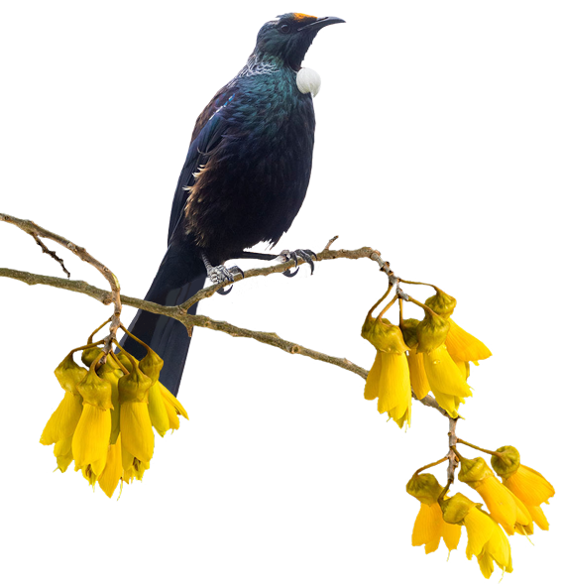
Kylie and Gary buy a lifestyle block just outside Ngāruawāhia.
They aim to create a grove of kōwhai trees to attract tūi in the spring.

Slide 2
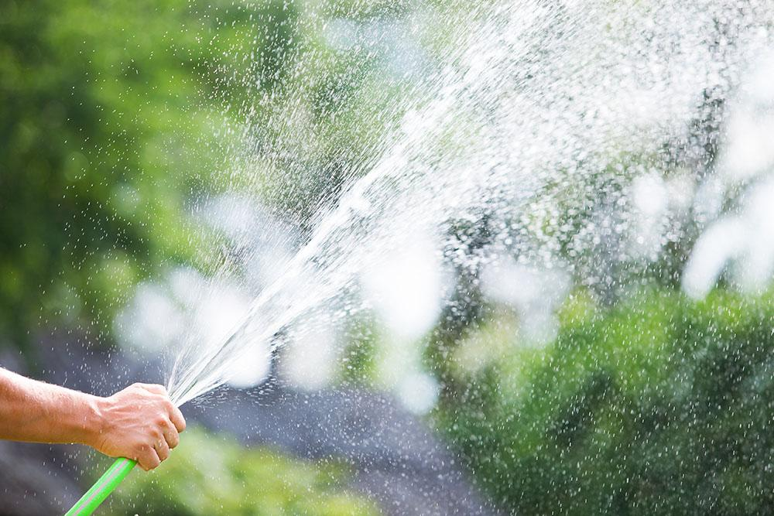
Apart from pests like rabbits and possums, the biggest challenge for Kylie and Gary is keeping the young trees watered during the dry summer months. They are on tank water that is collected from the roof of their house. Conservation of water is also very important.

Slide 3

Blanket irrigation is impractical so they investigate sprayers that send a precise jet to each individual tree.

Slide 4



Slide 5
0⁰

