Slide 1
Let’s use the brown rod as the whole.
We can copy the one rod many times to find where whole numbers are.
2
3
0
1
Where does the number one half go on this number line?

Slide 2
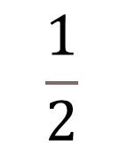
One half is here.
We use the length of one to find out where a fraction is.
2
3
0
$$\frac{1}{2}$$
1
Where does the number three quarters live on this number line?

Slide 3
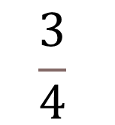
Three quarters is here, half-way between one half and one whole.
Three quarters is three copies of one quarter.
2
3
0
$$\frac{1}{2}$$
$$\frac{3}{4}$$
1
Where does the number five quarters live on this number line?

Slide 4
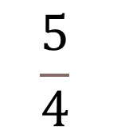
Five quarters is here, one quarter more than one whole.
Five quarters is five copies of one quarter.
2
3
0
$$\frac{1}{2}$$
$$\frac{3}{4}$$
1
$$\frac{5}{4}$$

Slide 5
Let’s use the blue rod as the whole.
0
1
2
3
Where does the number one third go on this number line?

Slide 6

One third is here.
We use the length of one to find out where a fraction is.
0
$$\frac{1}{3}$$
1
2
3
Where does the number two thirds go on this number line?

Slide 7
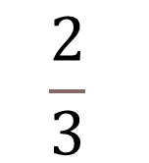
Two thirds is here.
It is two copies of one third.
0
$$\frac{1}{3}$$
$$\frac{2}{3}$$
1
2
3
Where does the number six thirds go on this number line?

Slide 8


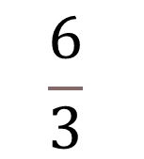
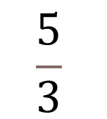

Six thirds is the same as two whole ones.
Two and six thirds are the same amount.
0
$$\frac{1}{3}$$
$$\frac{2}{3}$$
1
$$\frac{4}{3}$$
$$\frac{5}{3}$$
2
3
$$\frac{6}{3}$$
Where does the number three sixths go on this number line?

Slide 9









Three sixths is the same amount as one half.
One sixth is half of one third.
0
$$\frac{1}{6}$$
$$\frac{1}{3}$$
$$\frac{1}{2}$$
$$\frac{2}{3}$$
1
$$\frac{4}{3}$$
$$\frac{5}{3}$$
2
3
$$\frac{6}{3}$$
$$\frac{2}{6}$$
$$\frac{3}{6}$$

