Slide 1
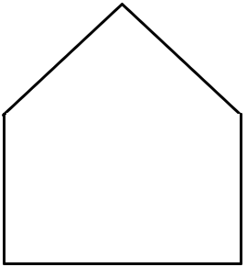
Top
Left
Front
Right

Slide 2
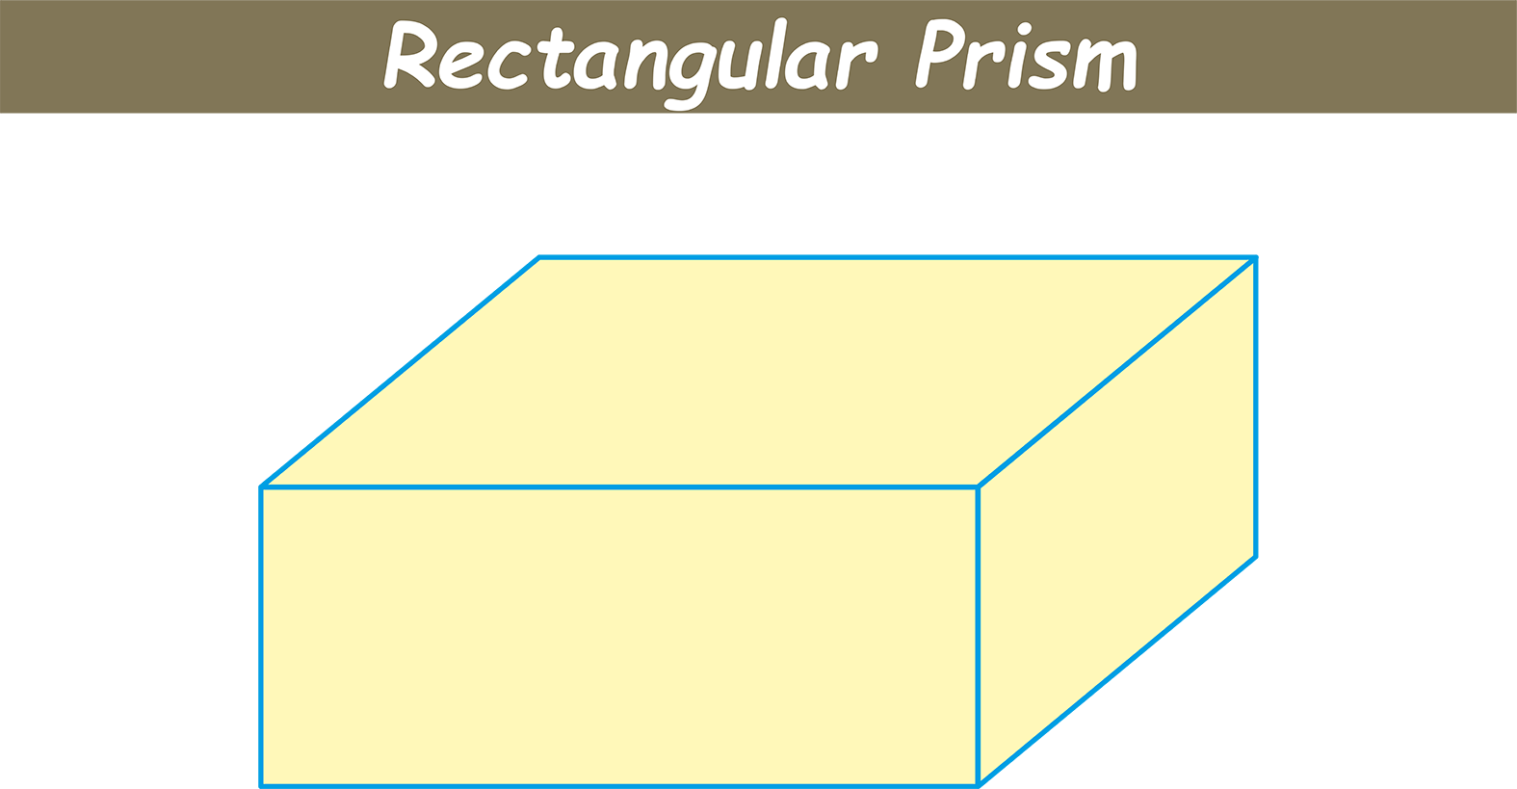

Slide 3
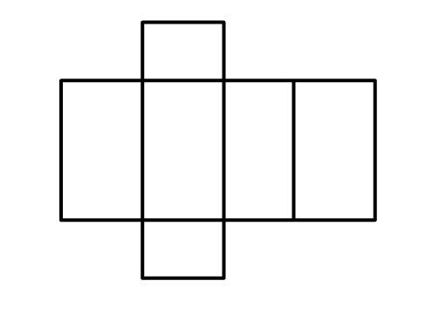


Slide 4
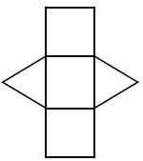


Slide 5
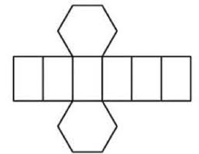
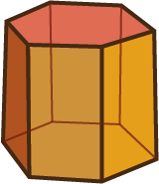

Slide 7
Top
Left
Front
Right

Slide 8
The ‘Annex’
The ‘Manor House’

Slide 9
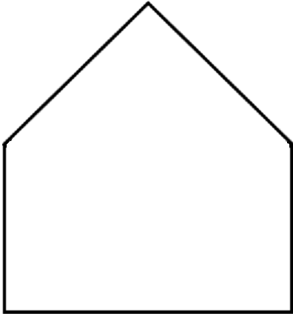
Top
Left
Front
Right

Slide 10
5 cm
Top
6 cm
Left
Front
Right

