Slide 1
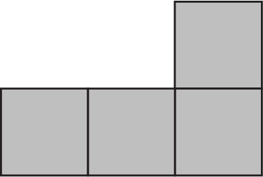
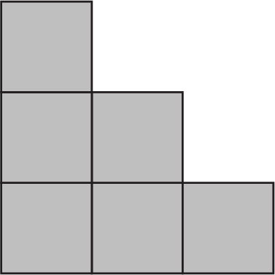
Top
Front
Right side
This model takes 7 cubes.

Slide 2
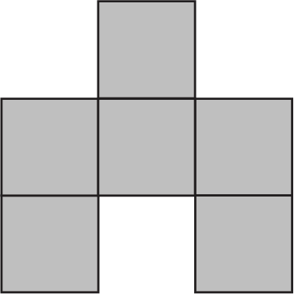
Top
Front
Right side
This model takes 8 cubes.

Slide 3
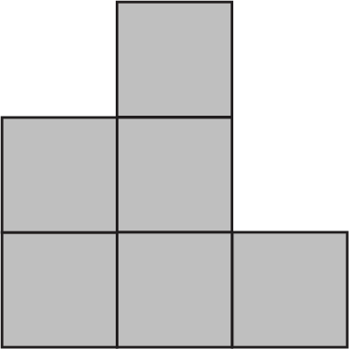
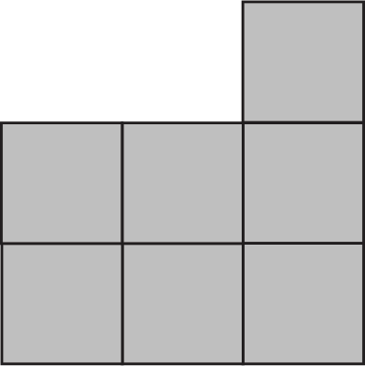
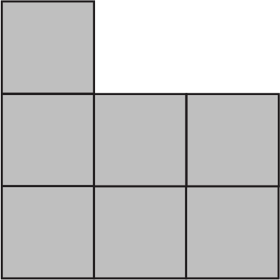
Top
Front
Right side
This model takes 10 cubes.

Slide 4
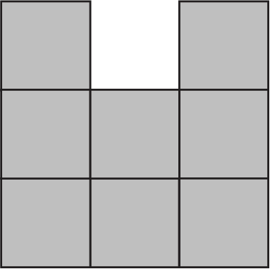
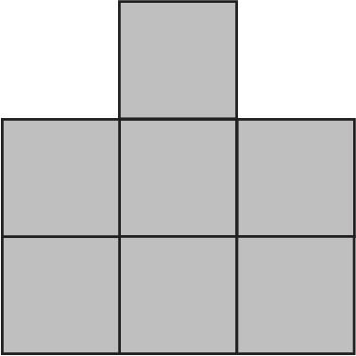
Top
Front
Right side
This model takes 15 cubes.

Slide 5
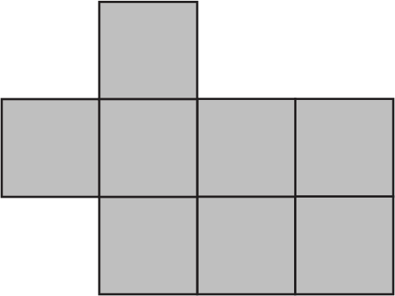
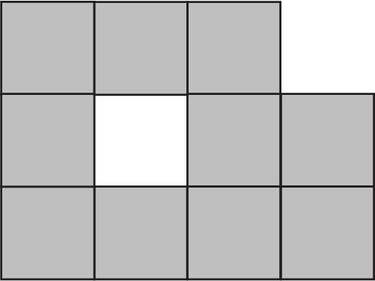
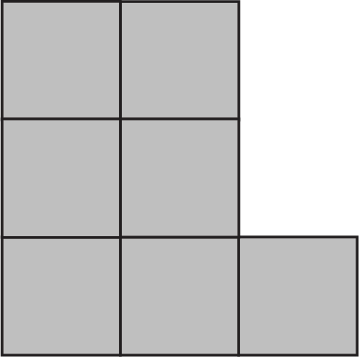
Top
Front
Right side
This model takes 15 cubes.

Slide 6
Top
Left
Front
Right

Slide 7
Top
Left
Right
Front

Slide 8
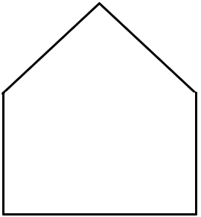
Top
Left
Front
Right

