Slide 1


Slide 2


Slide 3


Slide 4
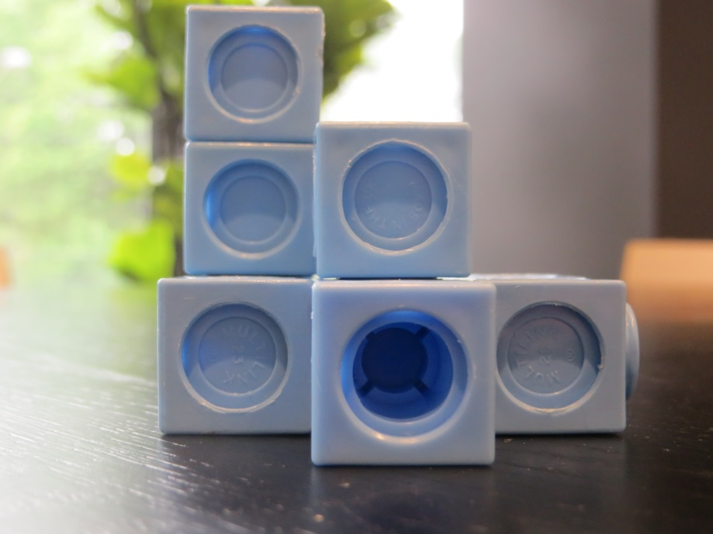
Front

Slide 5
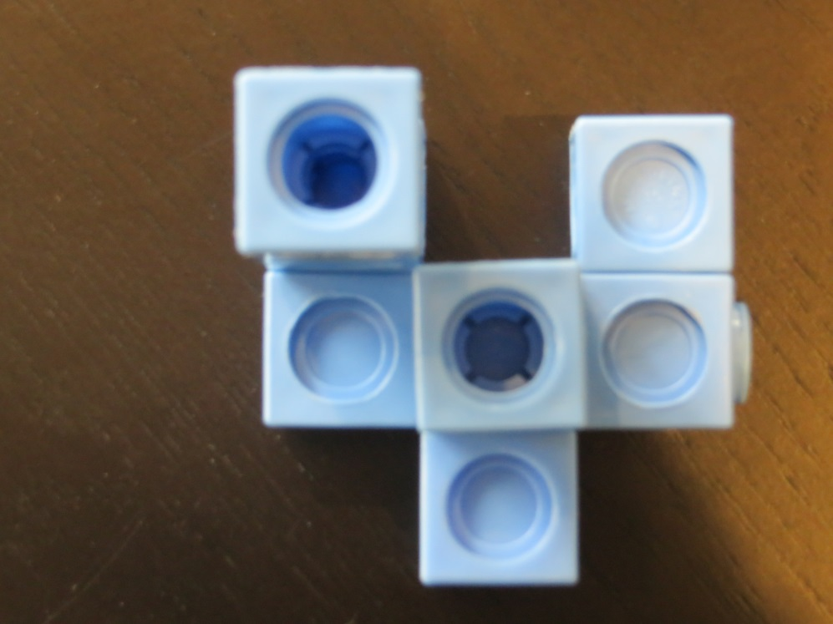
Top

Slide 6
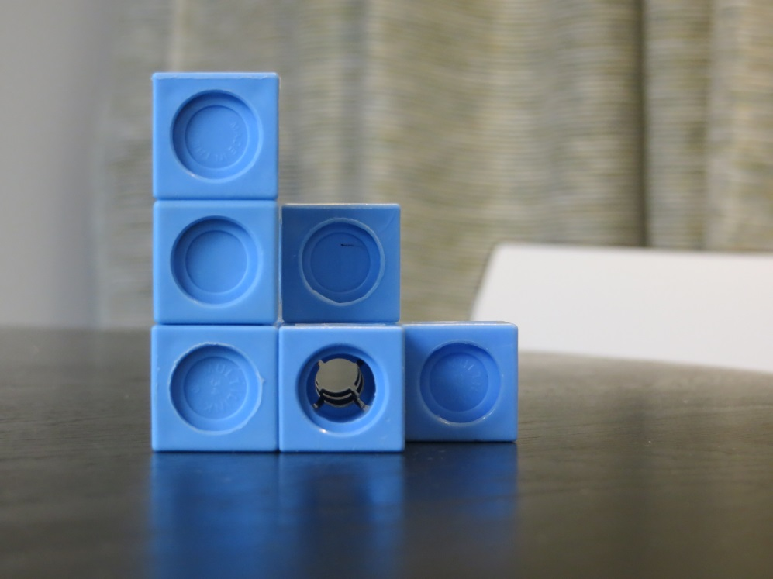
Left Side

Slide 7
Top
Left
Front

Slide 8
Top View
Front View
Right View
Can you build this using exactly 12 cubes?
Make your own building and draw the plans.
Say the number of cubes you need to make it.

