Slide 1
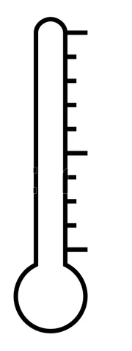

⁰C
40
30
20
10
0
Kwayera is not well.

Slide 2
2.3
Let’s count in tenths.
2.2
2.1
2
1.9
1.8
1.7
1.6
1.5
1.4
1.3
1.2
1.1
1
0.9
0.8
0.7
0.6
0.5
0.4
0.3
0.2
0.1
0

Slide 3
2.3
Let’s count in
tenths backwards.
2.2
2.1
2
1.9
1.8
1.7
1.6
1.5
1.4
1.3
1.2
1.1
1
0.9
0.8
0.7
0.6
0.5
0.4
0.3
0.2
0.1
0

Slide 4
5.3
Let’s count forward in tenths from 3.4
5.2
5.1
5
4.9
4.8
4.7
4.6
4.5
4.4
4.3
4.2
4.1
4
3.9
3.8
3.7
3.6
3.5
3.4
3.3
3.2
3.1
3

Slide 5
Let’s count in tenths backwards from 5.2
5.2
5.1
5
4.9
4.8
4.7
4.6
4.5
4.4
4.3
4.2
4.1
4
3.9
3.8
3.7
3.6

