Slide 1
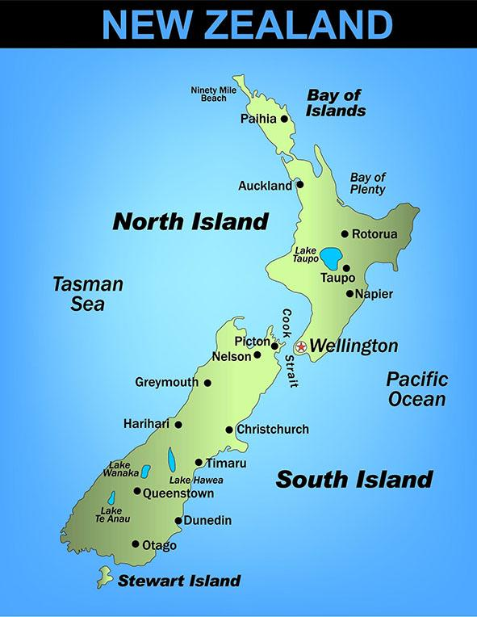
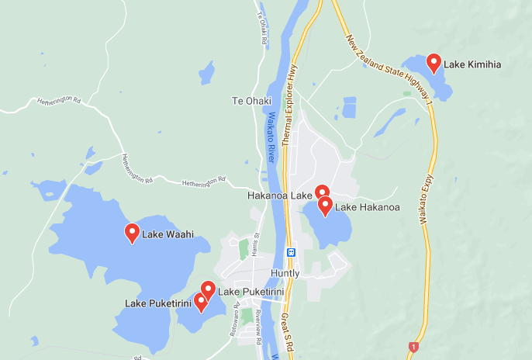
If you travel to Huntly be sure to check out the beautiful lakes around the town.
Lakes Puketirini is a favourite spot for recreational fisherman.

Slide 2
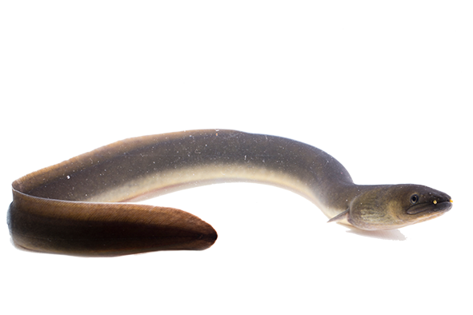
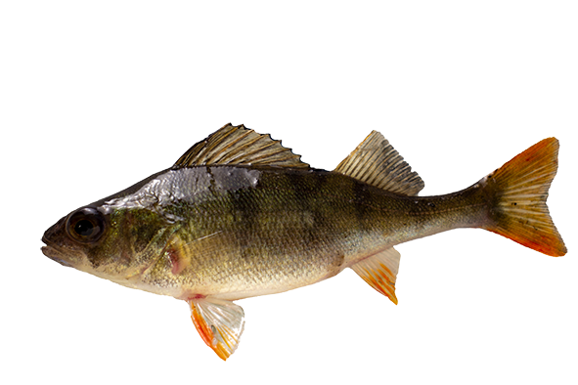
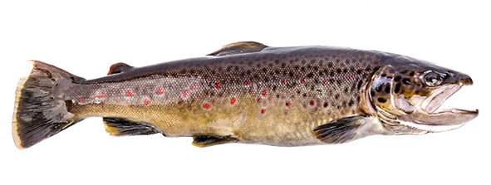
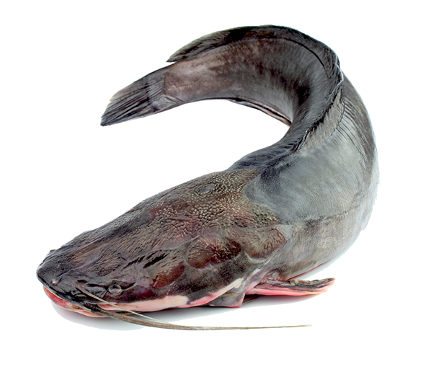
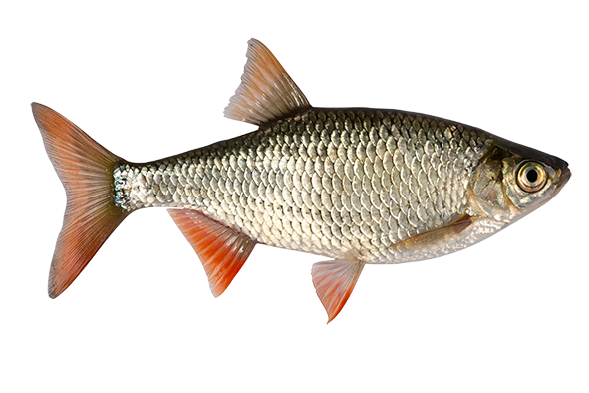
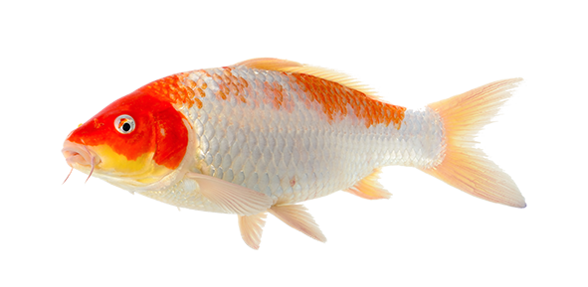
Most fish in the Lake Puketirini are introduced species though eels and whitebait inhabit it as well.
Perch
Brown Trout
Shortfin Eel
Catfish
Rudd
Koi Carp

Slide 3
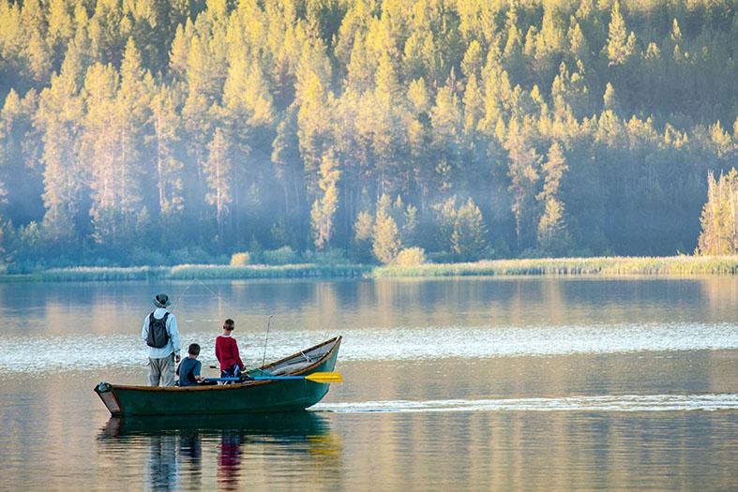
The fish stocks in the lake are monitored to ensure it does not become over-fished.
Scientists also check to see that Koi Carp numbers are not increasing. Carp tend to take over lakes if not eliminated.

Slide 4
In 2018 a sample of fish was caught and released into Lake Puketirini.
What percentage of the catch belonged to each species?
5 Perch
4 Brown Trout
5 Shortfin Eel
3 Catfish
1 Rudd
2 Koi Carp

Slide 5
In 2019 a bigger sample of fish was taken.
What percentage of the sample belonged to each species?
12 Perch
8 Brown Trout
13 Shortfin Eel
7 Catfish
2 Rudd
8 Koi Carp

Slide 6
In 2019 a bigger sample of fish was taken.
What percentage of the sample belonged to each species?
8 Perch
4 Brown Trout
10 Shortfin Eel
6 Catfish
0 Rudd
12 Koi Carp

Slide 7
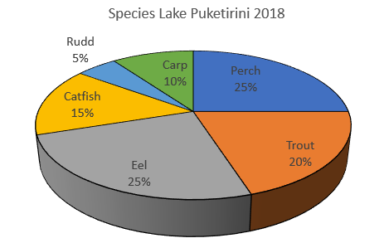
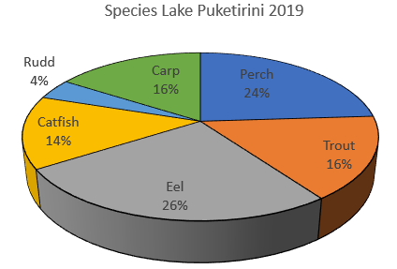
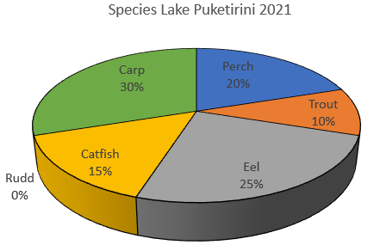
Here are pie charts representing the samples for each year.
What do you notice?
Is there a better way to display the data? How?

Slide 8
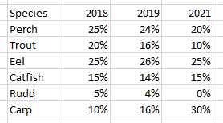
40%
30%
Percentage of sample
20%
10%
Perch
Trout
2018
2019
2020
2021
Year

