Slide 1
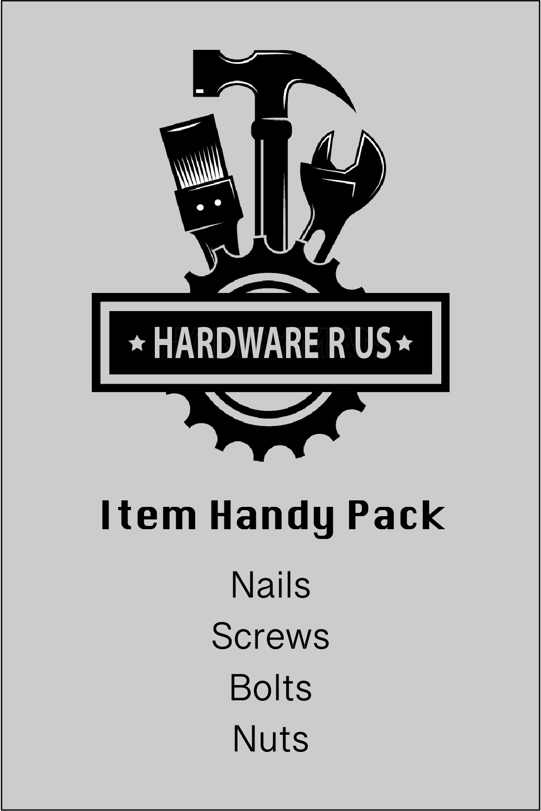
At ‘Hardware R Us’ you can buy handy packs that contain an assortment of nails, screws, nuts and bolts.
The packs are very useful for those little fixup jobs around the home.
Let’s investigate whether the same mix is used, no matter the pack size.

Slide 2
Here are the contents of a 25-item handy pack.
What percentage of the items are nails?
Find the percentages for the other items, screws, nuts, and bolts.

Slide 3
Nails
Screws
Bolts
Nuts
Percentage
16%
28%
36%
0%
100%
0 items
25 items
4
7
9
Amount

Slide 4
Here are the contents of a 50-item handy pack.
What percentage of the items are nails?
Find the percentages for the other items, screws, nuts, and bolts.

Slide 5
Here are the contents of a 40-item handy pack.
What percentage of the items are nails?
Find the percentages for the other items, screws, nuts, and bolts.

