Slide 1
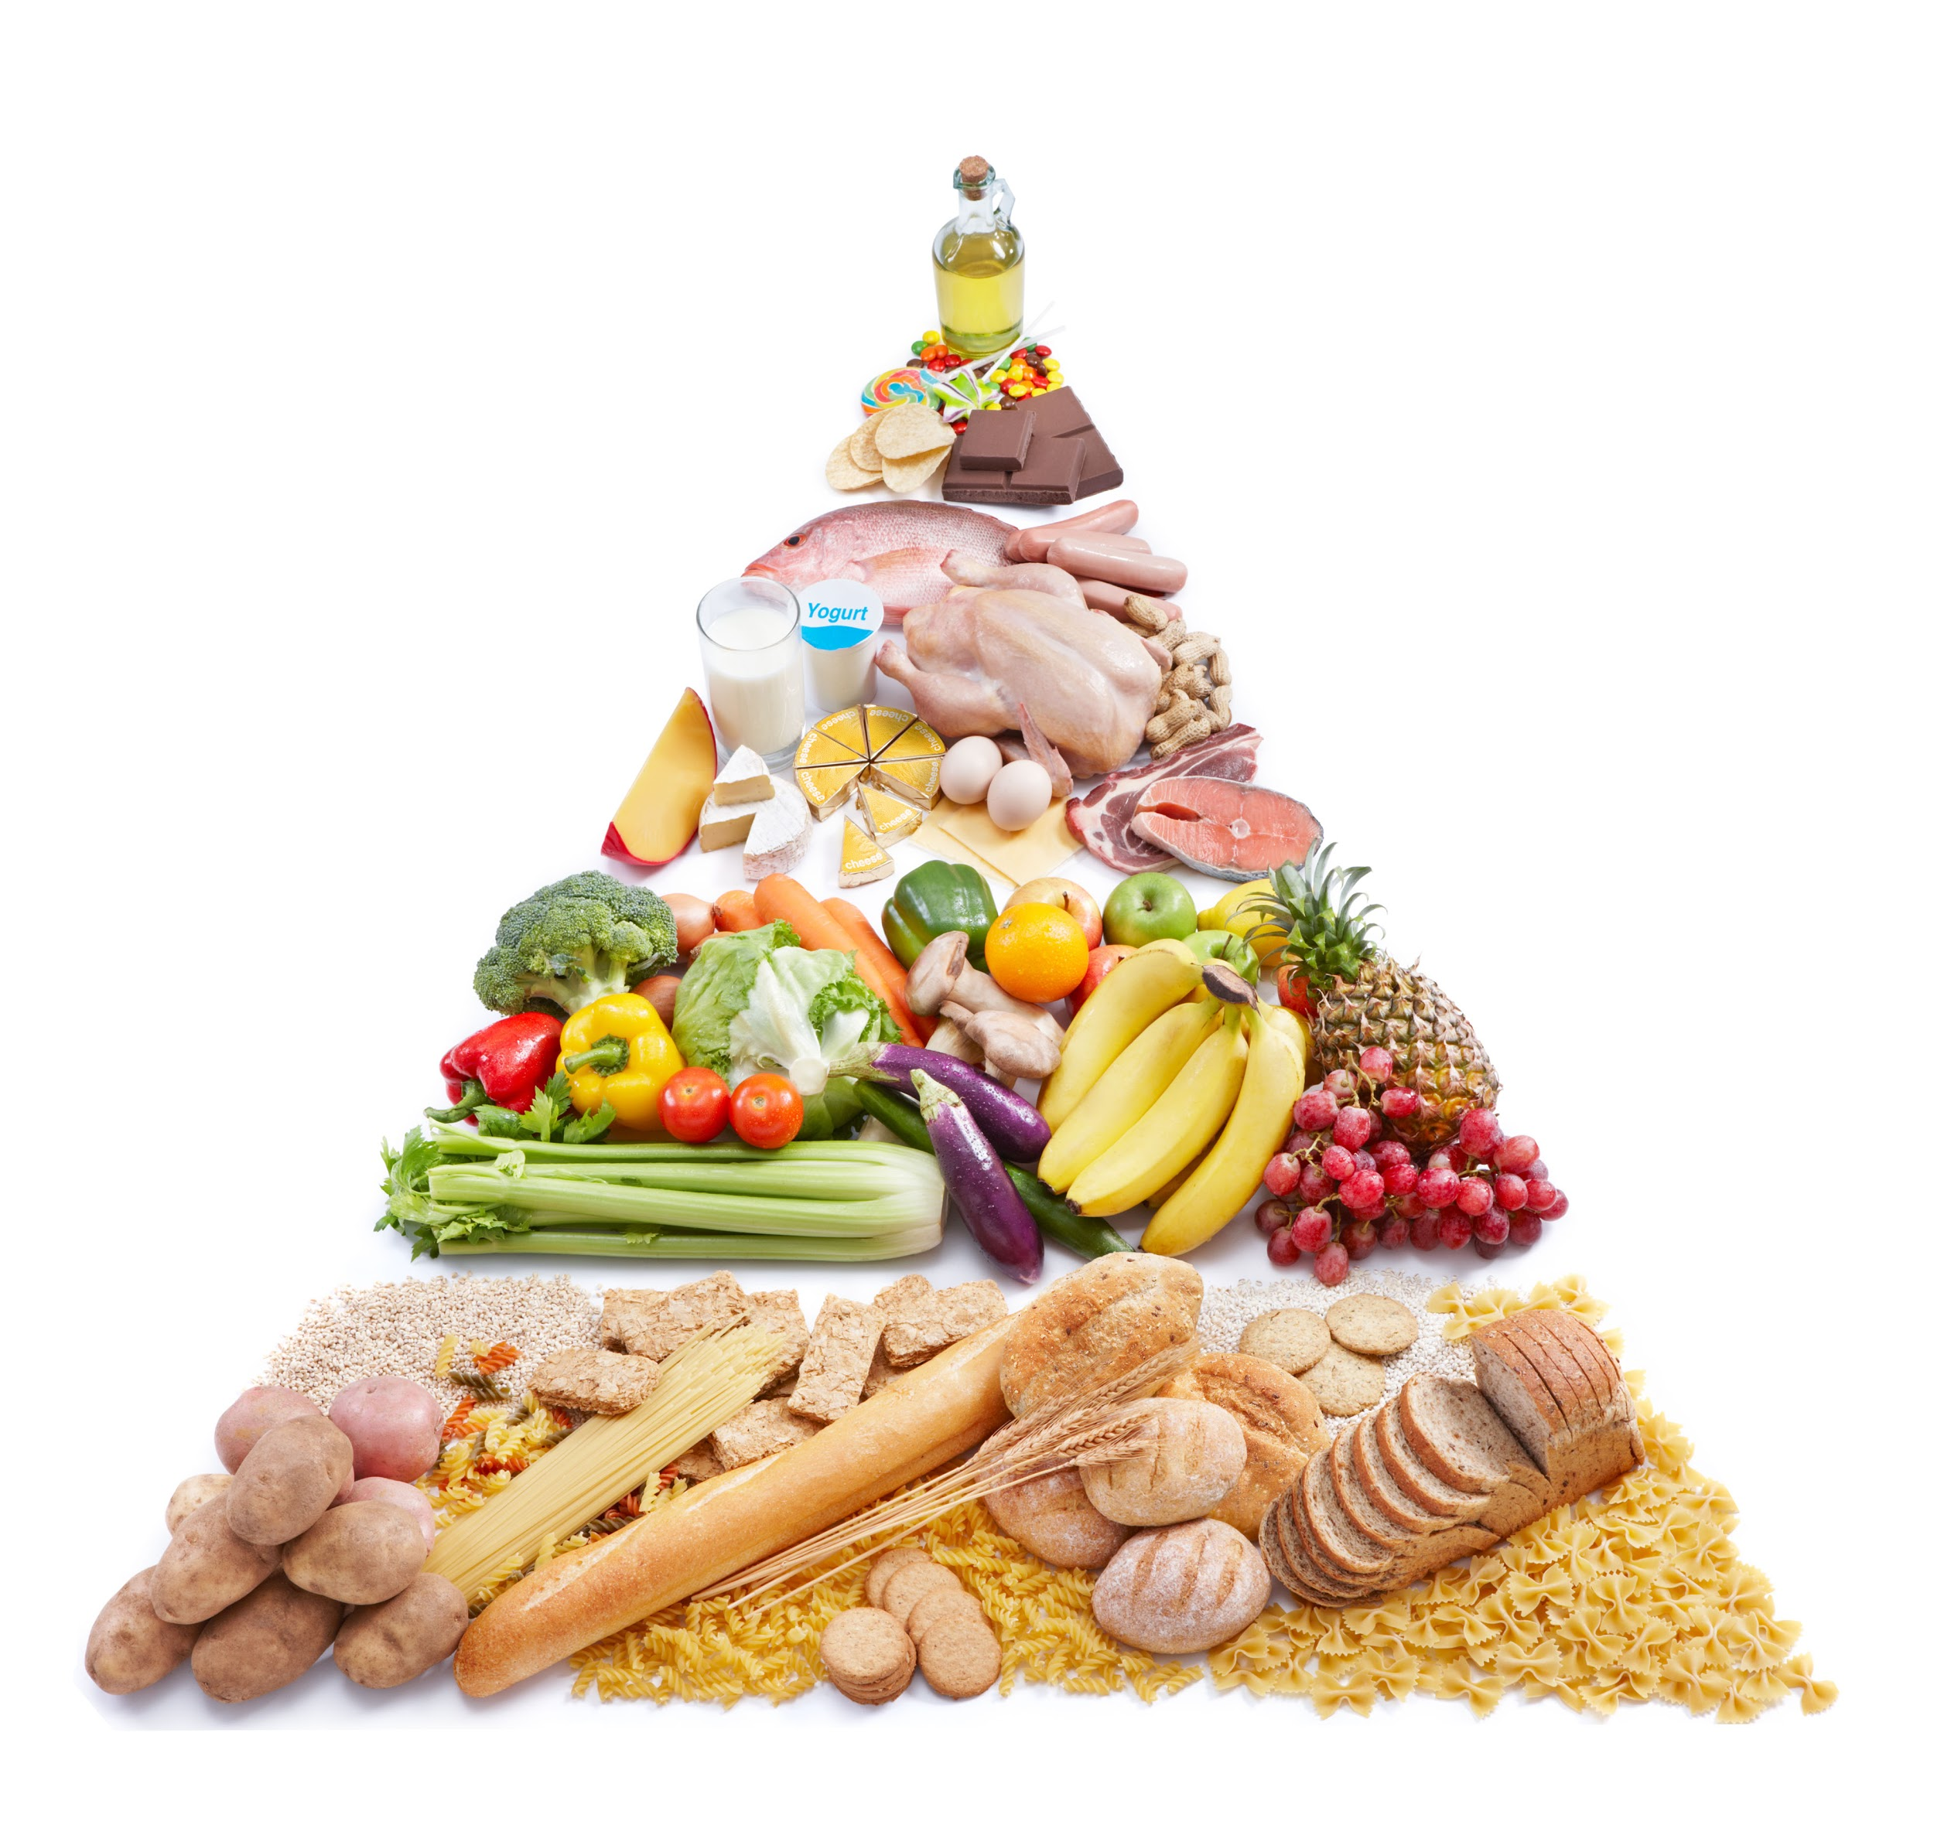
Fat, oil, sugar, sweets
10%
Meat, fish, milk, eggs
15%
Vegetables
25%
Fruit
20%
Bread, cereals, pasta
30%

Slide 2

Here are the number of kilojoules (kJ) people of your age should eat each day.
Boys
Girls
9 Years
7 700 kJ
7 200 kJ
10 Years
8 500 kJ
8 100 kJ

Slide 3
A 7 year old girl only needs to eat 6 400 kilojoules (kJ) per day.
The whole square is 100%.
How many kilojoules are 50%, 10%, 1%?
6 400 kJ

Slide 4
3 200 kJ
640 kJ
64 kJ
6 400 kJ
6 400 kJ
6 400 kJ
50% is half of 100%.
10% is one tenth of 100%.
1% is one hundredth of 100%.
Half of 6400 equals 3200 kJ.
One tenth of 6400 equals 640 kJ.
One hundredth of 6400
equals 64 kJ.

Slide 5

Using a percentage bar
Percentage
Pippa
10 years old
50%
0%
100%
0 kJ
8 100 kJ
4 050 kJ
Amount

Slide 6
Using a percentage bar
Percentage
Pippa
10 years old
10%
50%
0%
100%
0 kJ
8 100 kJ
810 kJ
4 050 kJ
Amount
Draw a percentage bar to show
1% of Pippa’s kilojoule intake.

Slide 7

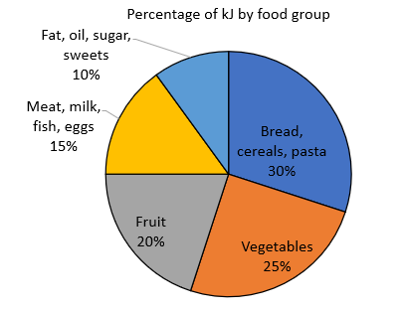
I am 8 years old so my daily intake should be 7 300 kJ per day.
How many kiloJoules of each food type should I eat in one day?
Tama

Slide 8
Using a percentage bar for Tama’s intake.
5%
Percentage
10%
20%
0%
100%
0 kJ
7 300 kJ
730 kJ
1460 kJ
365 kJ
Amount
Vegetables make up 25% of Tama’s intake.
What is 25% of 7 300 kJ?
Meat, milk, fish, and eggs make up 15% of Tama’s intake.
What is 15% of 7 300 kJ?

Slide 9
Food Group | Number of kilojoules (kJ) 9-year-old girl | Number of kilojoules (kJ) 10-year-old girl | Number of kilojoules (kJ) 9-year-old boy | Number of kilojoules (kJ) 10-year-old boy
Bread, cereals, pasta (30%) | 30% x 7 200 = 2 160 kJ | 30% x 8 100 = 3 430 kJ | 30% x 7 700 = 2 310 kJ | 30% x 8 500 = 2 550 kJ
Vegetables (25%) | 25% x 7 200 = 1 800 kJ | 25% x 8 100 = 2 025 kJ | 25% x 7 700 = 1 925 kJ | 25% x 8 500 = 2 125 kJ
Fruit (20%) | 20% x 7 200 = 1 440 kJ | 20% x 8 100 = 1 620 kJ | 20% x 7 700 = 1 540 kJ | 20% x 8 500 = 1 700 kJ
Meat, milk, fish, eggs (15%) | 15% x 7 200 = 1 080 kJ | 15% x 8 100 = 1 215 kJ | 15% x 7 700 = 1 155 kJ | 15% x 8 500 = 1 275 kJ
Fat, oil, sugar, sweets (10%) | 10% x 7 200 = 720 kJ | 10% x 8 100 = 810 kJ | 10% x 7 700 = 770 kJ | 10% x 8 500 = 850 kJ

Slide 10
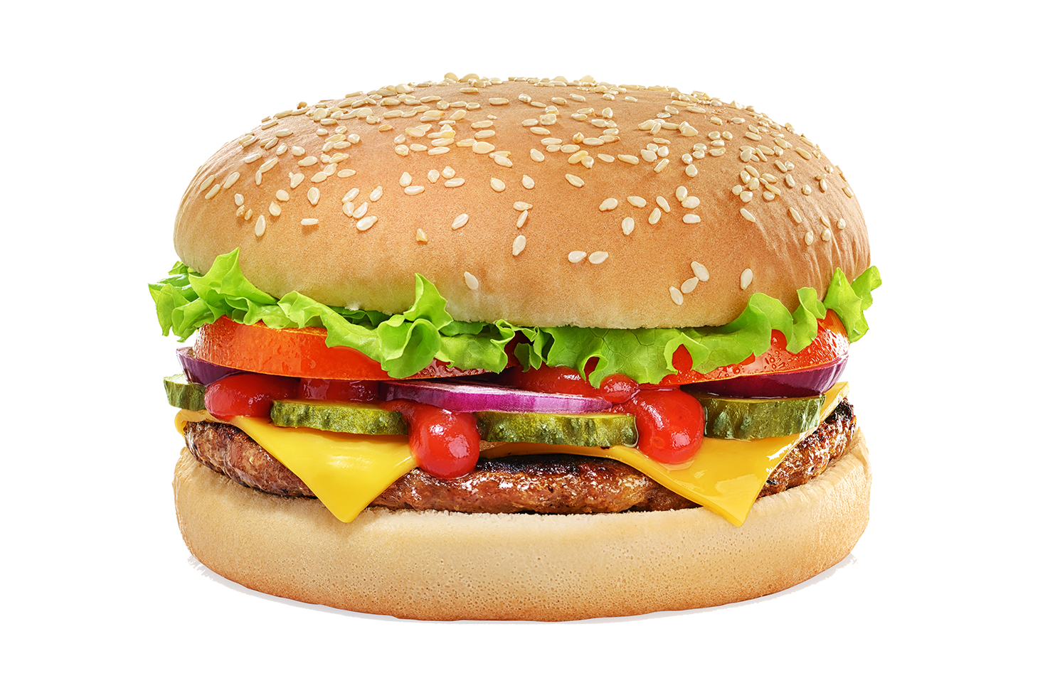
A standard cheeseburger contains 1 255 kJ of energy.
What percentage of your daily intake is that?

