Slide 1
Captain Pegleg notices that his pirate band divide the loot amicably when the shares are less than one whole bar. When there is more than one bar per pirate they tend to fight.
“There are enough missing limbs around here already,” he says.
What does amicably mean?
What does the Captain’s comment about missing limbs mean?

Slide 2
Captain Pegleg decides to plan the raids more carefully to ensure that the shares are less than one gold bar per pirate.
“I’ll start simple,” he ponders, “Let’s aim at one half of a bar per pirate. That leaves room for increasing the shares later.”

Slide 3
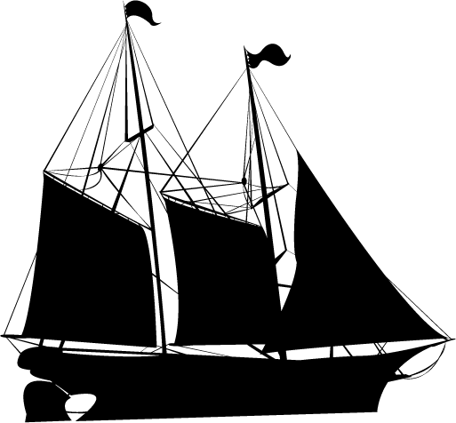
Here are some ships the crew will attack. The numbers of gold bars expected to be on board are given under the ship name.
How many pirates should attack each ship if the equal shares are to be one half?
Santa Maria
5 gold bars
Santa Katarina
7 gold bars
Santa Barbara
3 gold bars
Santa Henrietta
12 gold bars

Slide 4
Captain Pegleg decides to rethink his plan.
“There are a lot of gold-laden ships going past our shore and not being attacked,” he says, “That’s not good for business or my reputation.”
Why is the Captain’s reputation being affected?

Slide 5
He increases the share per pirate to three quarters of a bar in the hope of attacking more ships. Will that work?
Here are five ships the crew will attack. The numbers of gold bars expected to be on board are given under the ship name.
How many pirates should attack each ship if the equal shares are to be three quarters?
Santa Arabella
9 gold bars
Santa Rosa
12 gold bars
Santa Melissa
3 gold bars
Santa Aroha
6 gold bars
Santa Mika
5 gold bars

Slide 6
Here is diagram showing how Captain Pegleg worked out the number of pirates he needed to attack the Santa Aroha. That ship held six gold bars.

Slide 7
Captain Pegleg’s plan is too successful. Most ships that pass his shore are robbed.
Great! Well, that is not so great as it turns out. Captains start avoiding his shore and there are so few ships passing that his crew are getting restless.
“I’ll reduce the equal share to two thirds of a gold bar per pirate,” he thinks, “That will be less than three quarters but better than one half.”
What effect will Captain Pegleg’s plan have?

Slide 8
Here are three ships the crew will attack. The numbers of gold bars expected to be on board are given under the ship name.
How many pirates should attack each ship if the equal shares are to be two thirds?
Santa Lucia
8 gold bars
Santa Zola
6 gold bars
Santa Adriana
11 gold bars

Slide 9
Here is diagram showing how Captain Pegleg worked out the number of pirates he needed to attack the Santa Zola. That ship held six gold bars.

