Slide 1




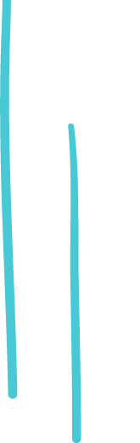
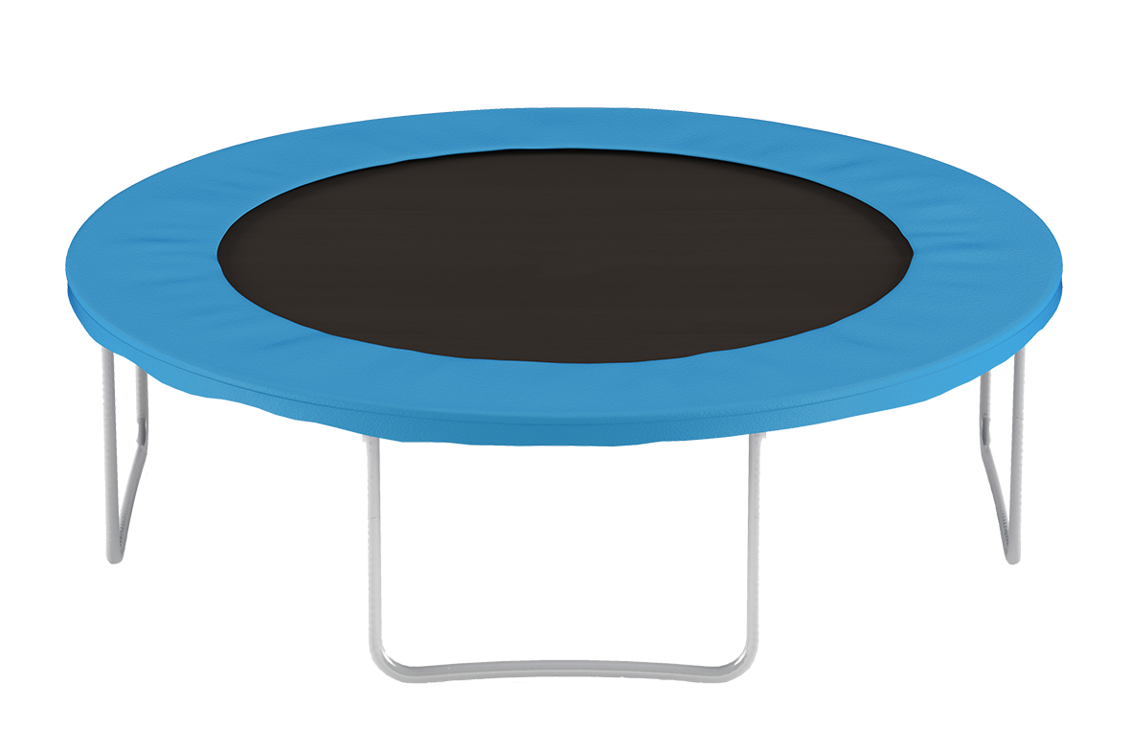
1. Three children share two hours of trampoline time equally. How much time does each child get?
2. Use the result from Question One to answer this question.
Six children share two hours of trampoline time equally. How much time does each child get?
3. Use the result from Question Two to answer this question.
Six children share four hours of trampoline time equally. How much time does each child get?

