Slide 1
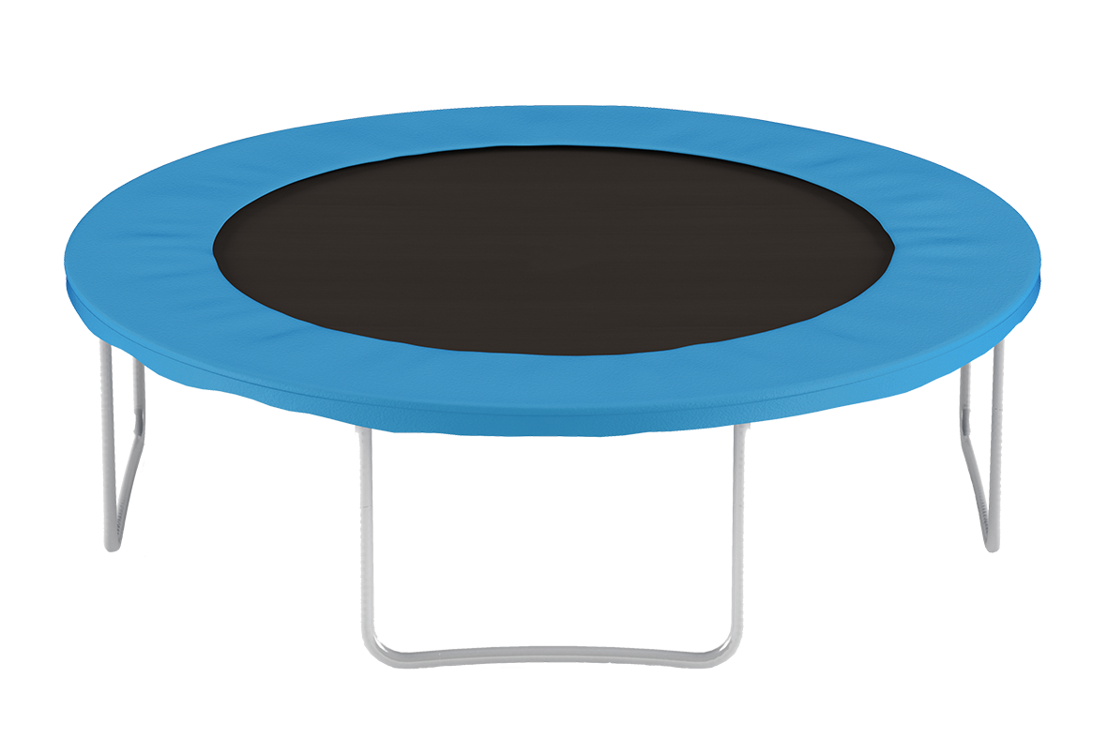
Gemma and Tai woke up one day and found that Nana and Grandpa left a little gift for them.
“We hope you enjoy this trampoline,” the card said. “There is no room for it at our new townhouse.”

Slide 2
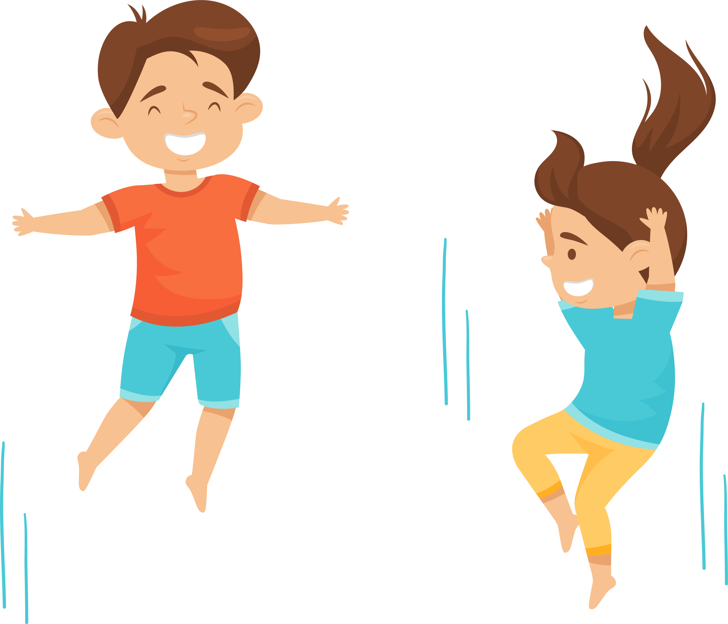
They shared the trampoline for a long time until accidents started happening. Gemma tried flipping and
Tai tried bombing at the same time. Ouch!

Slide 3
They agreed that it was good to share lots of things together but trampoline time was not one of those things. It was too dangerous, especially given they both had ambitions.
“I want to go to the Olympics as a gymnast,” said Gemma.
“I want to go as a slam dunking basketballer,” replied Tai.
Can we change around who plays which sport?

Slide 4
The best time for trampolining was straight after Tai and Gemma got home from school. There were 3 precious hours before dinner, shower time, and homework.
Gemma knew that in one hour the minute hand travels a full circle.

Slide 5
Think of one hour as a full circle.
How can Gemma and Tai share three hours of trampoline time equally between them?
1 2 3

Slide 6
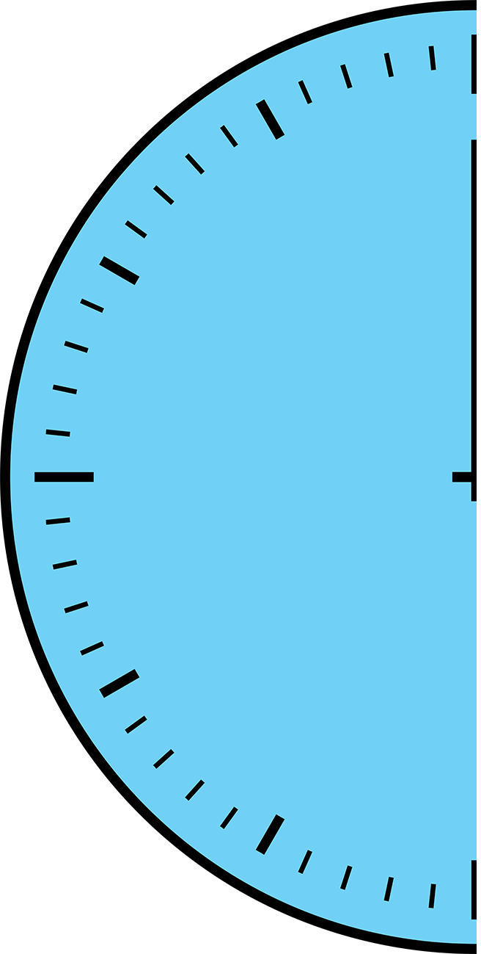

Slide 8
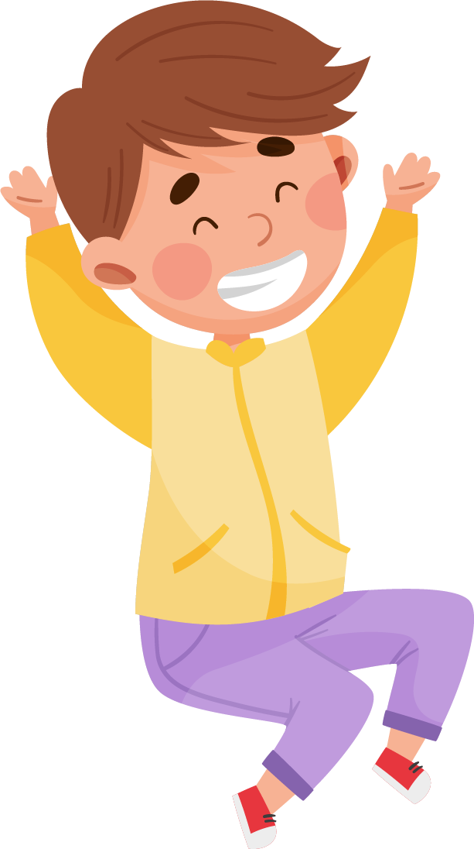
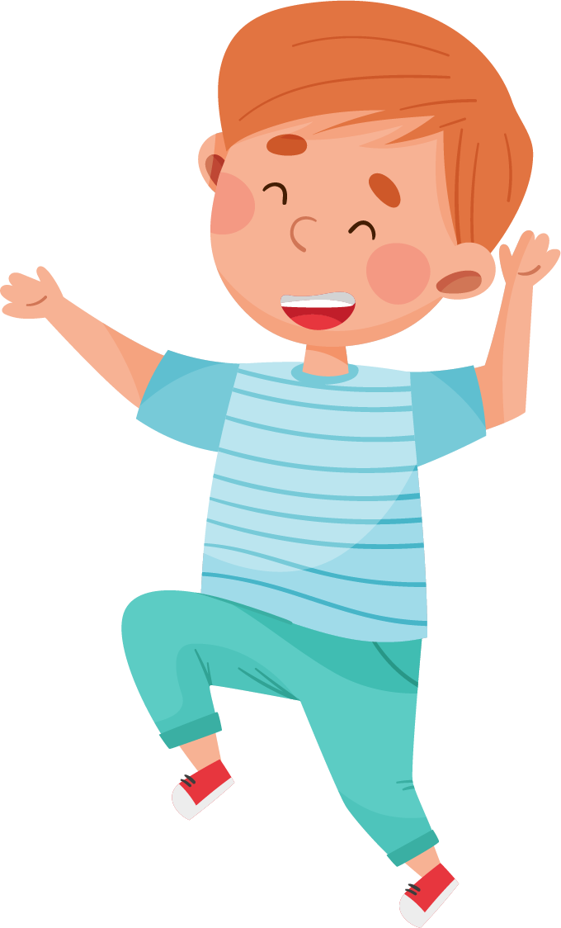
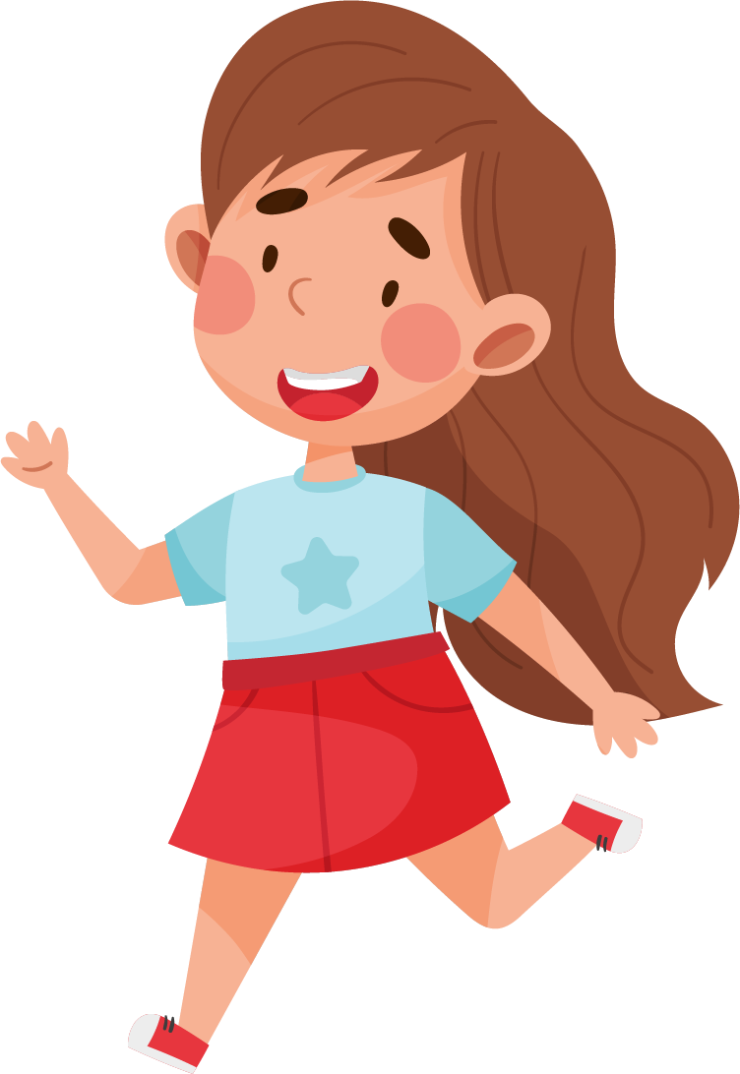
In a different family four people equally share the same amount of trampoline time, 3 hours.
How much time should each person get to bounce?

