Slide 1
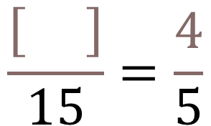
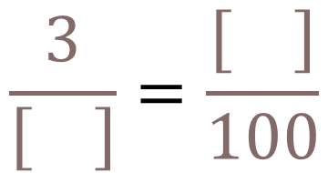
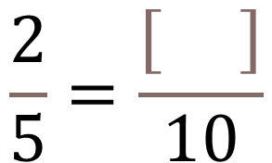
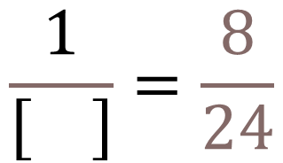
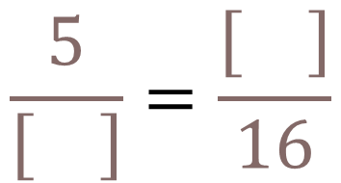
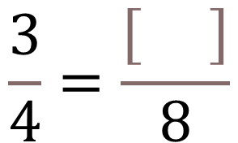
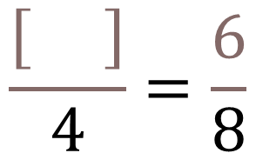
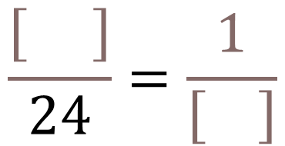
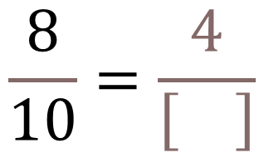
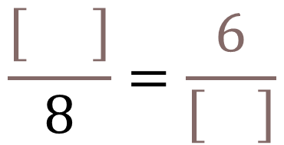
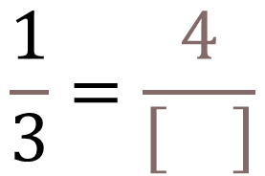
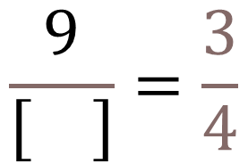
$$\frac{3}{4}=\frac{\left[ \right]}{8}$$
$$\frac{2}{5}=\frac{\left[ \right]}{10}$$
$$\frac{1}{3}=\frac{4}{\left[ \right]}$$
$$\frac{8}{10}=\frac{4}{\left[ \right]}$$
$$\frac{\left[ \right]}{4}=\frac{6}{8}$$
$$\frac{\left[ \right]}{15}=\frac{4}{5}$$
$$\frac{1}{\left[ \right]}=\frac{8}{24}$$
$$\frac{9}{\left[ \right]}=\frac{3}{4}$$
$$\frac{\left[ \right]}{8}=\frac{6}{\left[ \right]}$$
$$\frac{\left[ \right]}{24}=\frac{1}{\left[ \right]}$$
$$\frac{5}{\left[ \right]}=\frac{\left[ \right]}{16}$$
$$\frac{3}{\left[ \right]}=\frac{\left[ \right]}{100}$$

Slide 2
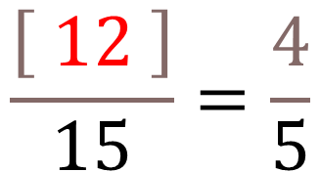
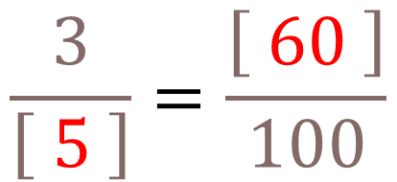
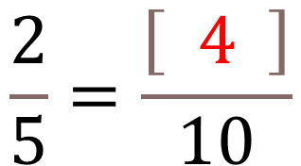
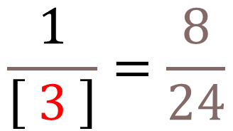
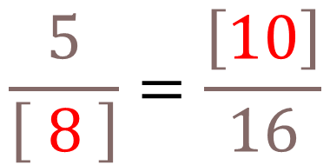
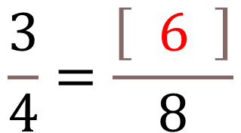
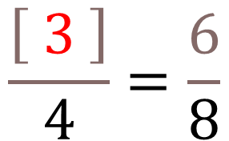
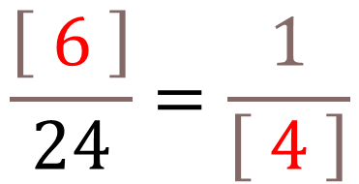
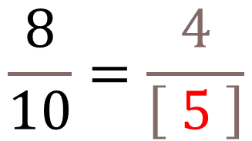
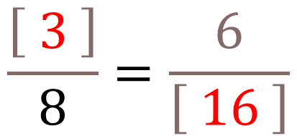
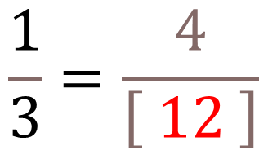
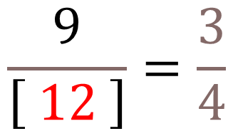
$$\frac{3}{4}=\frac{\left[ 6 \right]}{8}$$
$$\frac{2}{5}=\frac{\left[ 4 \right]}{10}$$
$$\frac{1}{3}=\frac{4}{\left[ 12 \right]}$$
$$\frac{8}{10}=\frac{4}{\left[ 5 \right]}$$
$$\frac{\left[ 3 \right]}{4}=\frac{6}{8}$$
$$\frac{\left[ 12 \right]}{15}=\frac{4}{5}$$
$$\frac{1}{\left[ 3 \right]}=\frac{8}{24}$$
$$\frac{9}{\left[ 12 \right]}=\frac{3}{4}$$
$$\frac{\left[ 3 \right]}{8}=\frac{6}{\left[ 16 \right]}$$
$$\frac{\left[ 6 \right]}{24}=\frac{1}{\left[ 4 \right]}$$
$$\frac{5}{\left[ 8 \right]}=\frac{\left[10\right]}{16}$$
$$\frac{3}{\left[ 5 \right]}=\frac{\left[ 60 \right]}{100}$$

Slide 3
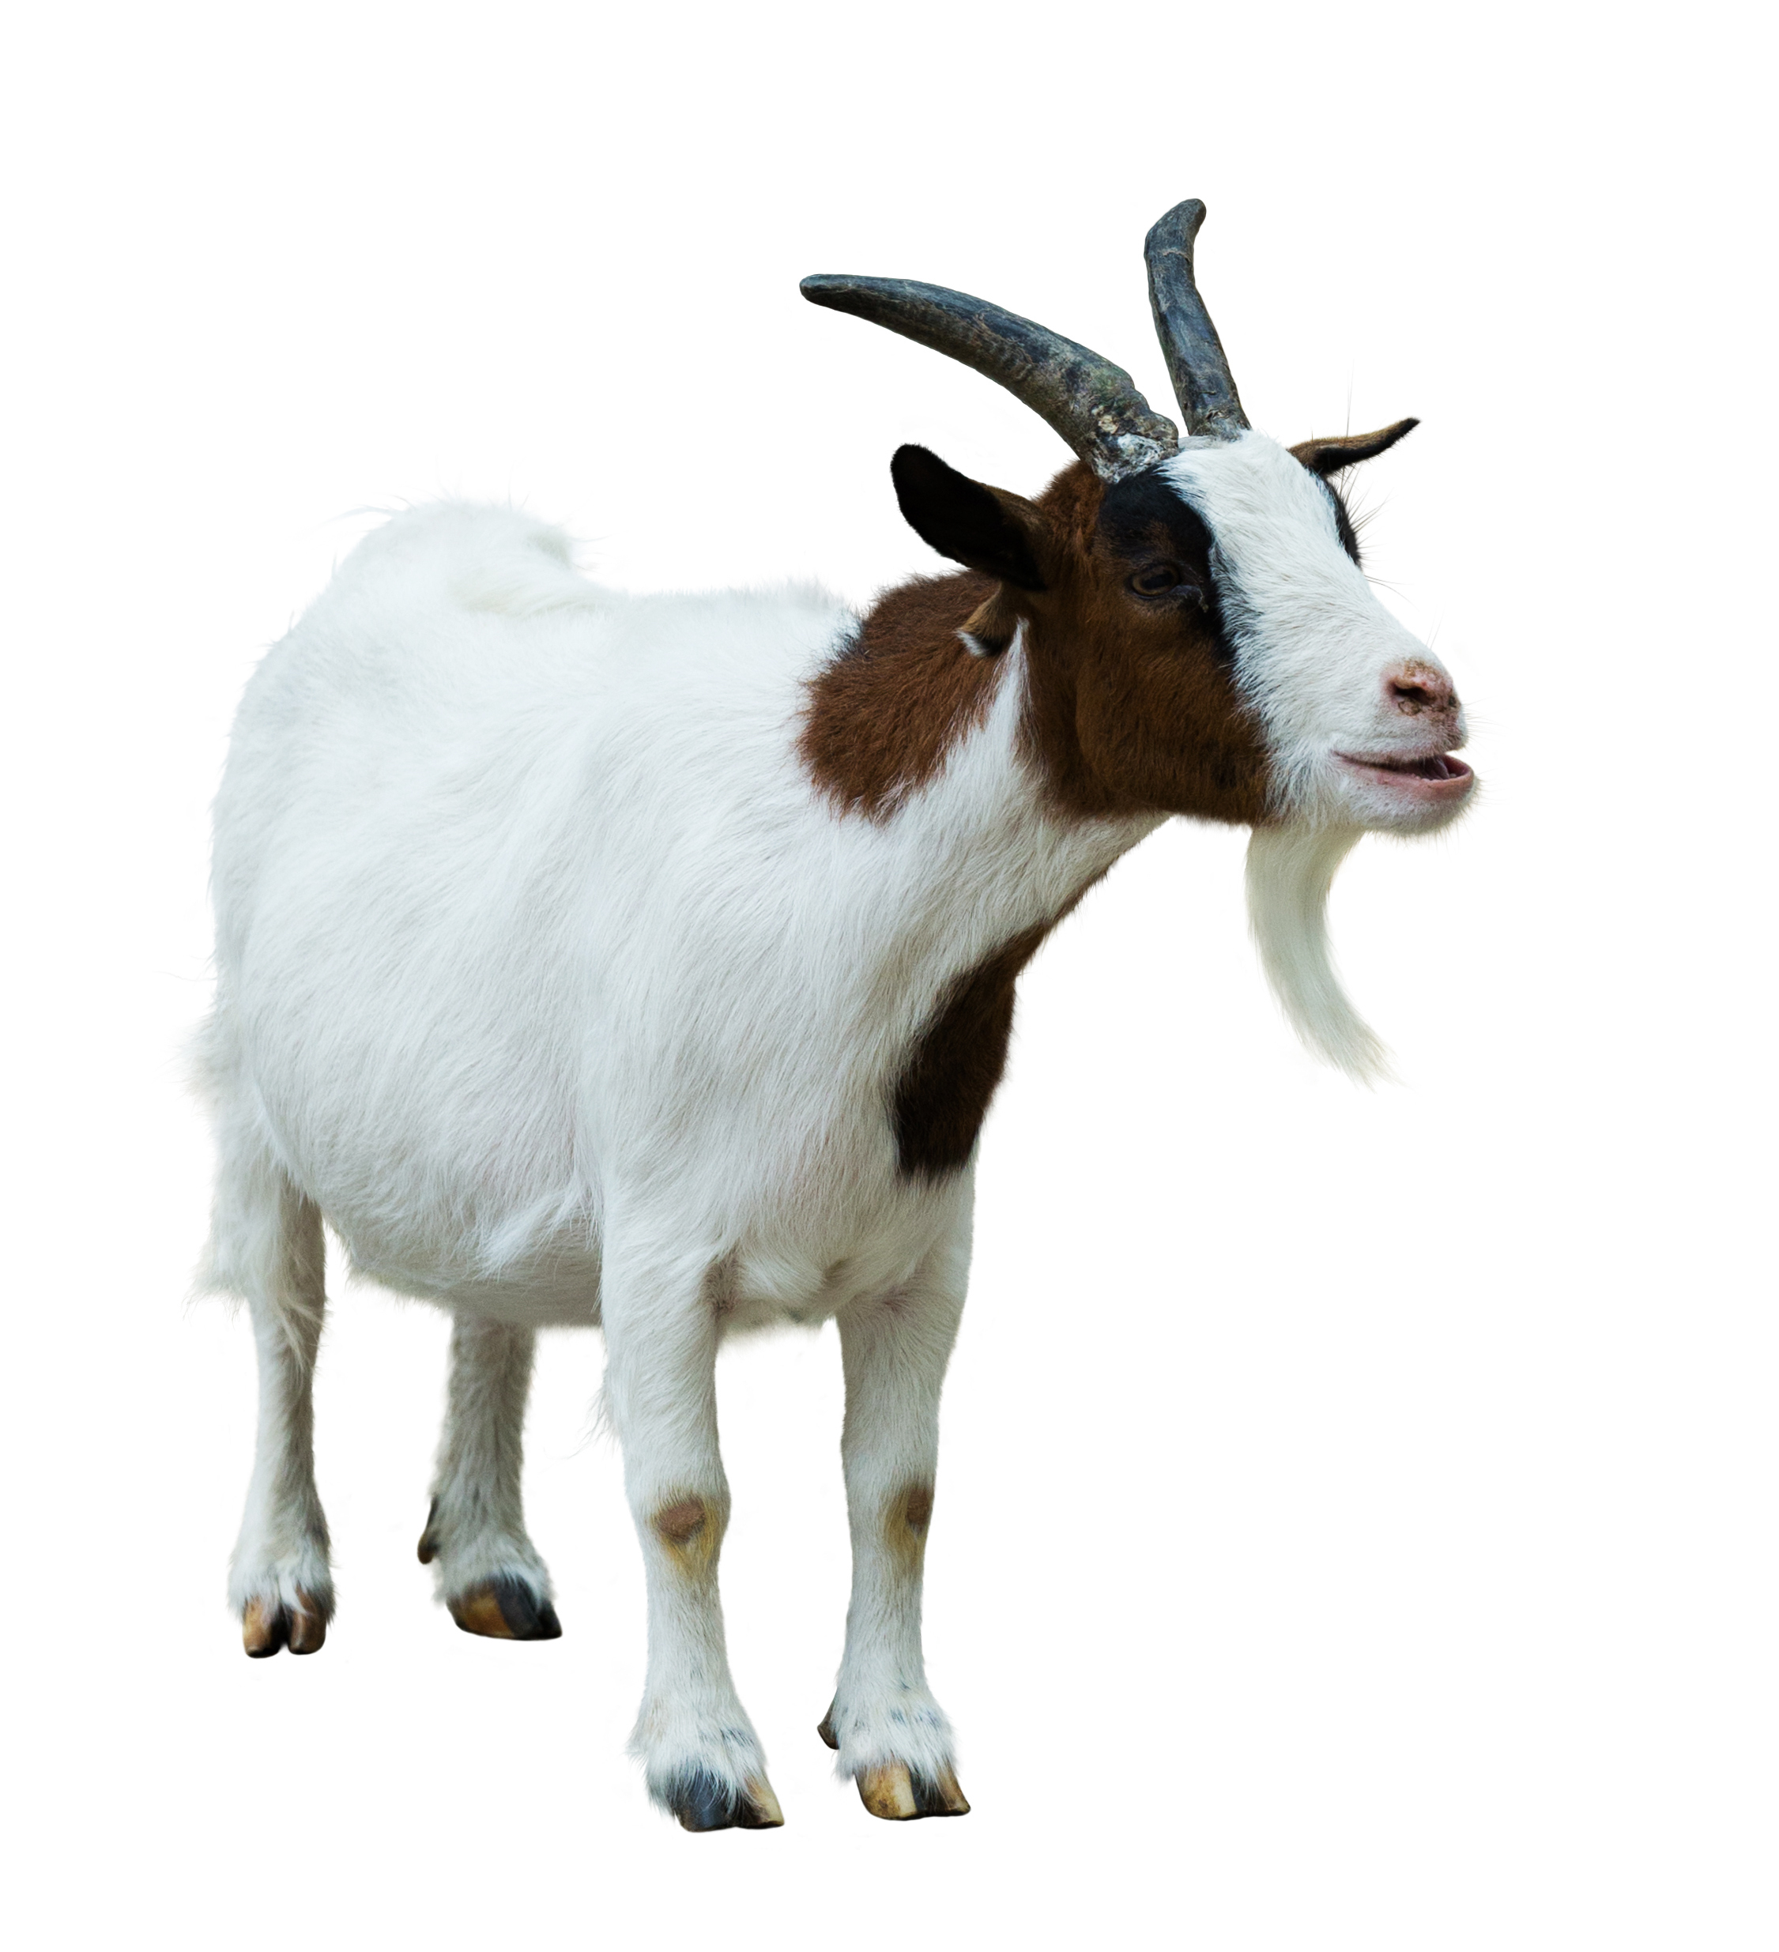
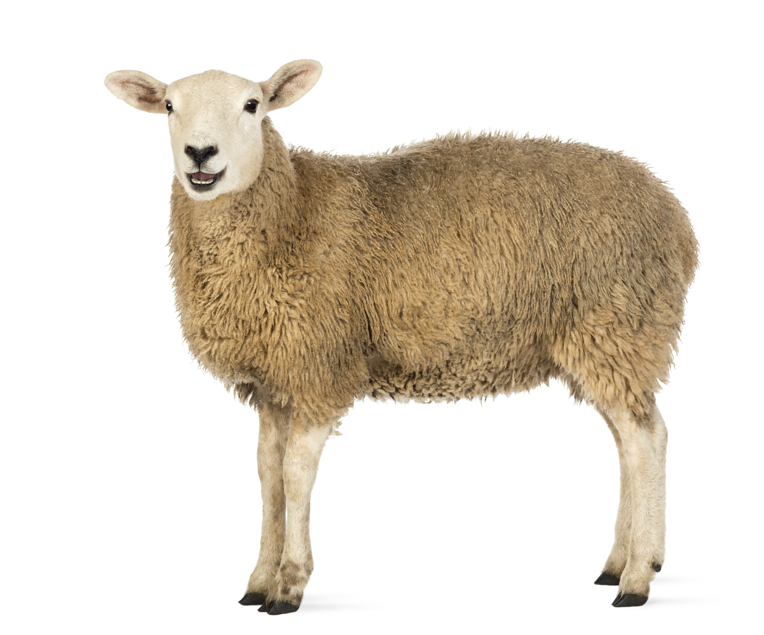
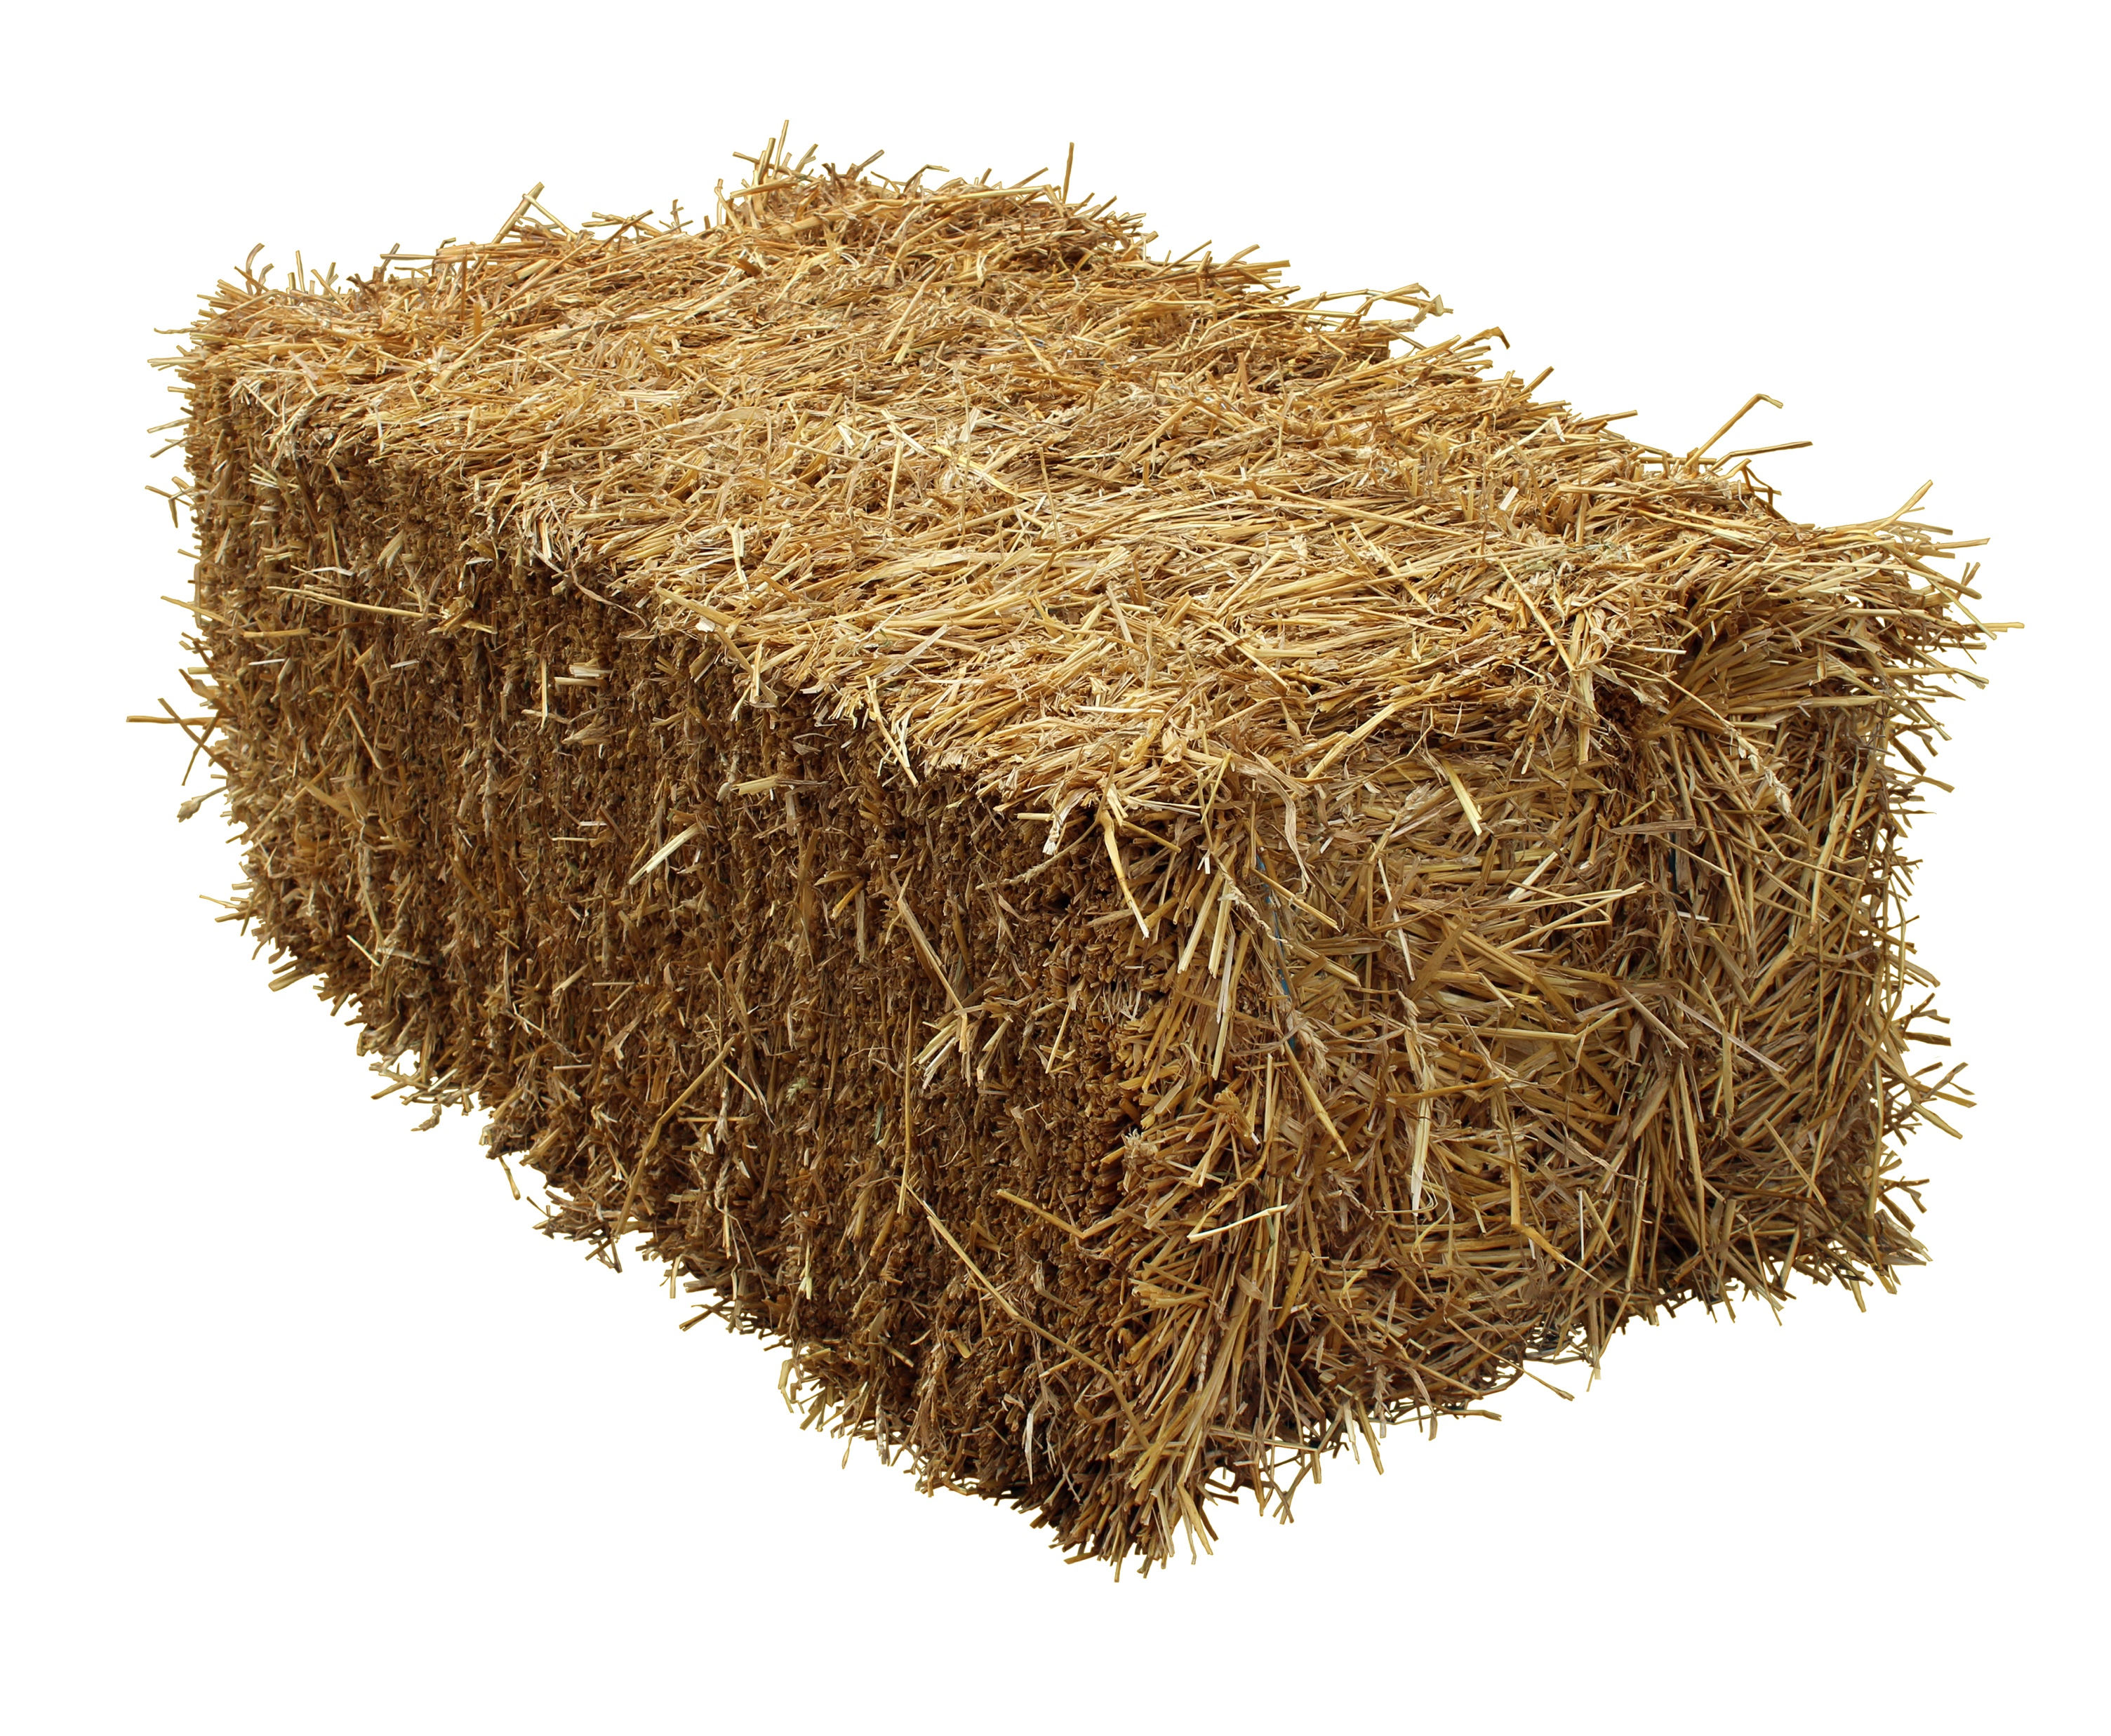
Three goats share two hay bales equally. Each goat gets the same amount.
Six sheep share four hay bales equally.
Which animal gets more hay, a goat or a sheep?

Slide 4
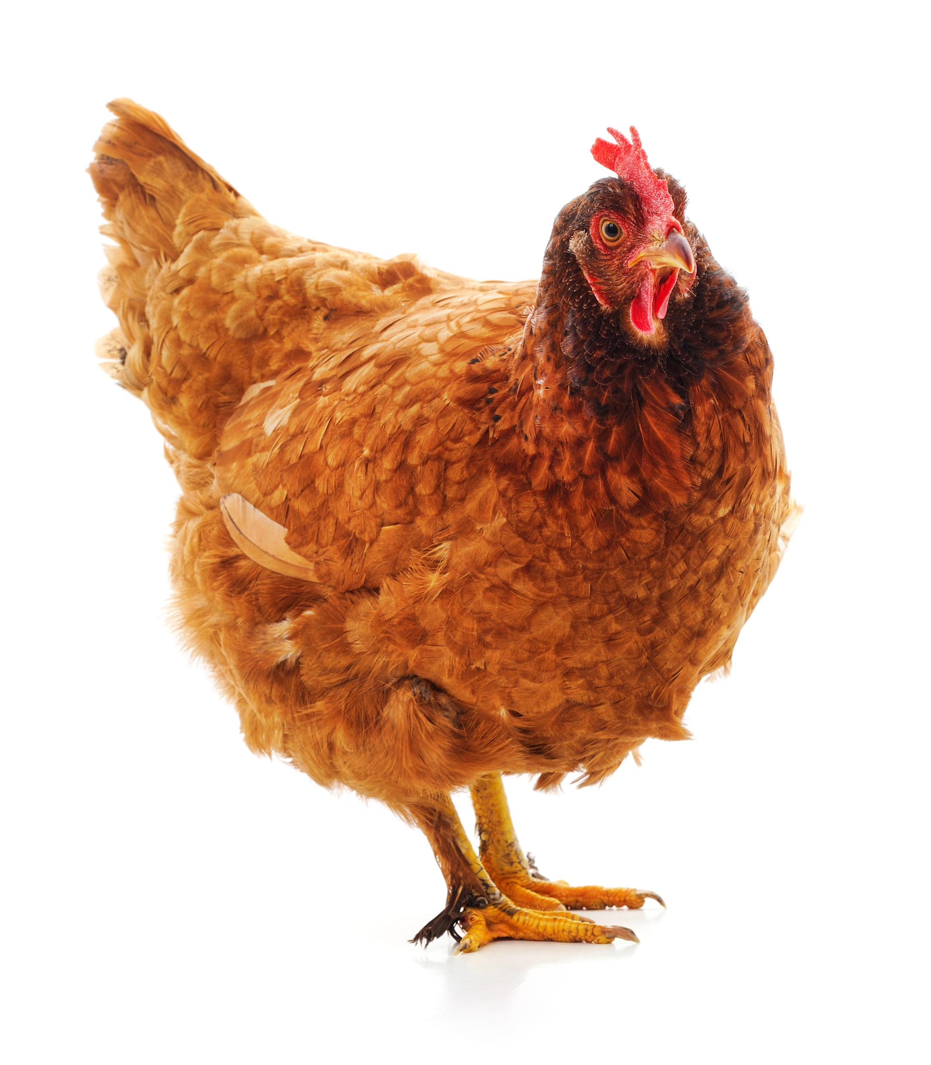
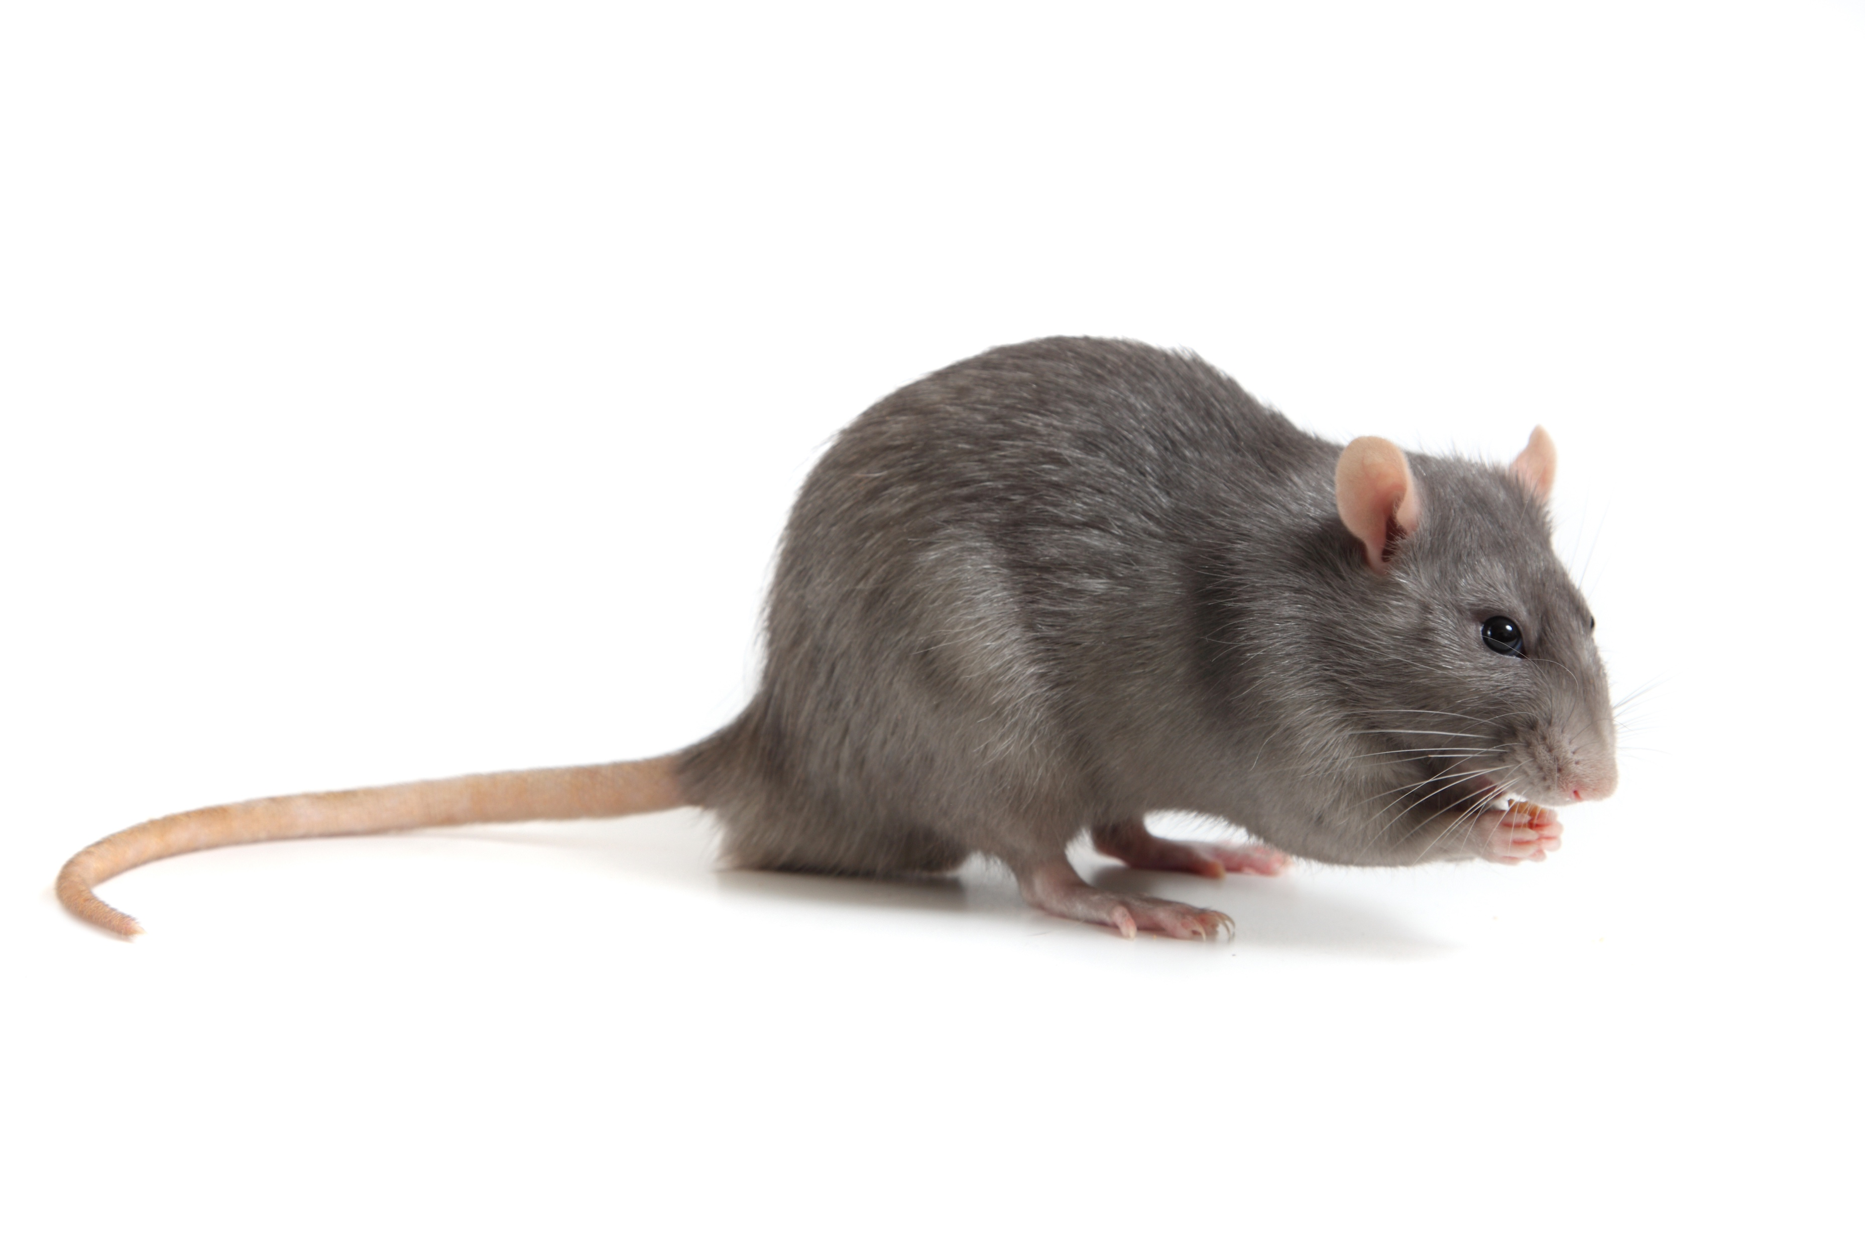
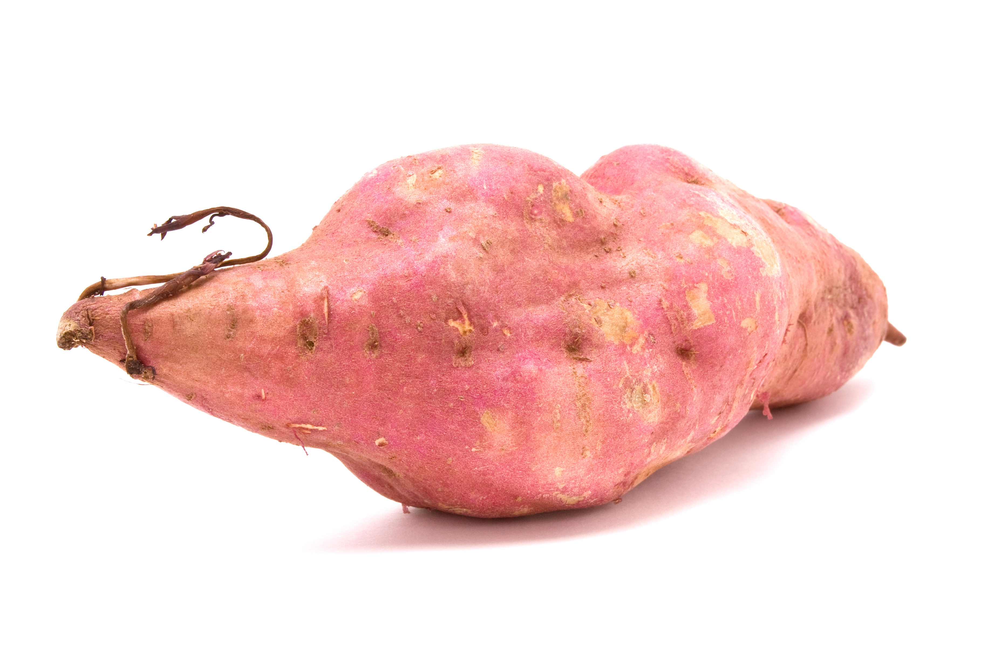
Three kiore share four kumara equally. Each rat gets the same amount.
Nine heihei share twelve kumara equally.
Which animal gets more kumara, a rat or a hen?

Slide 5
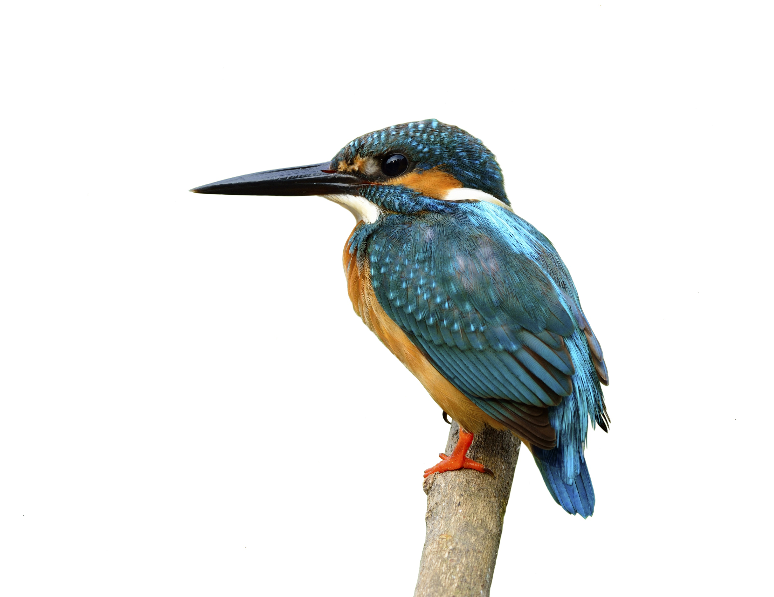
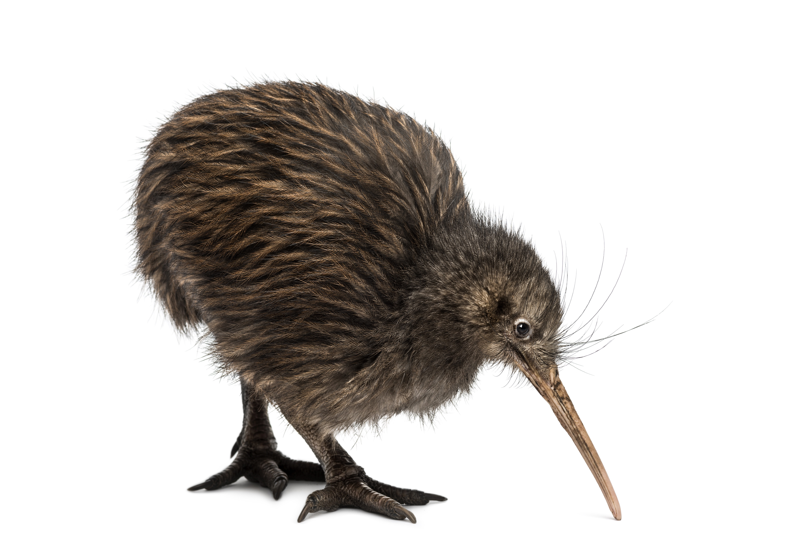
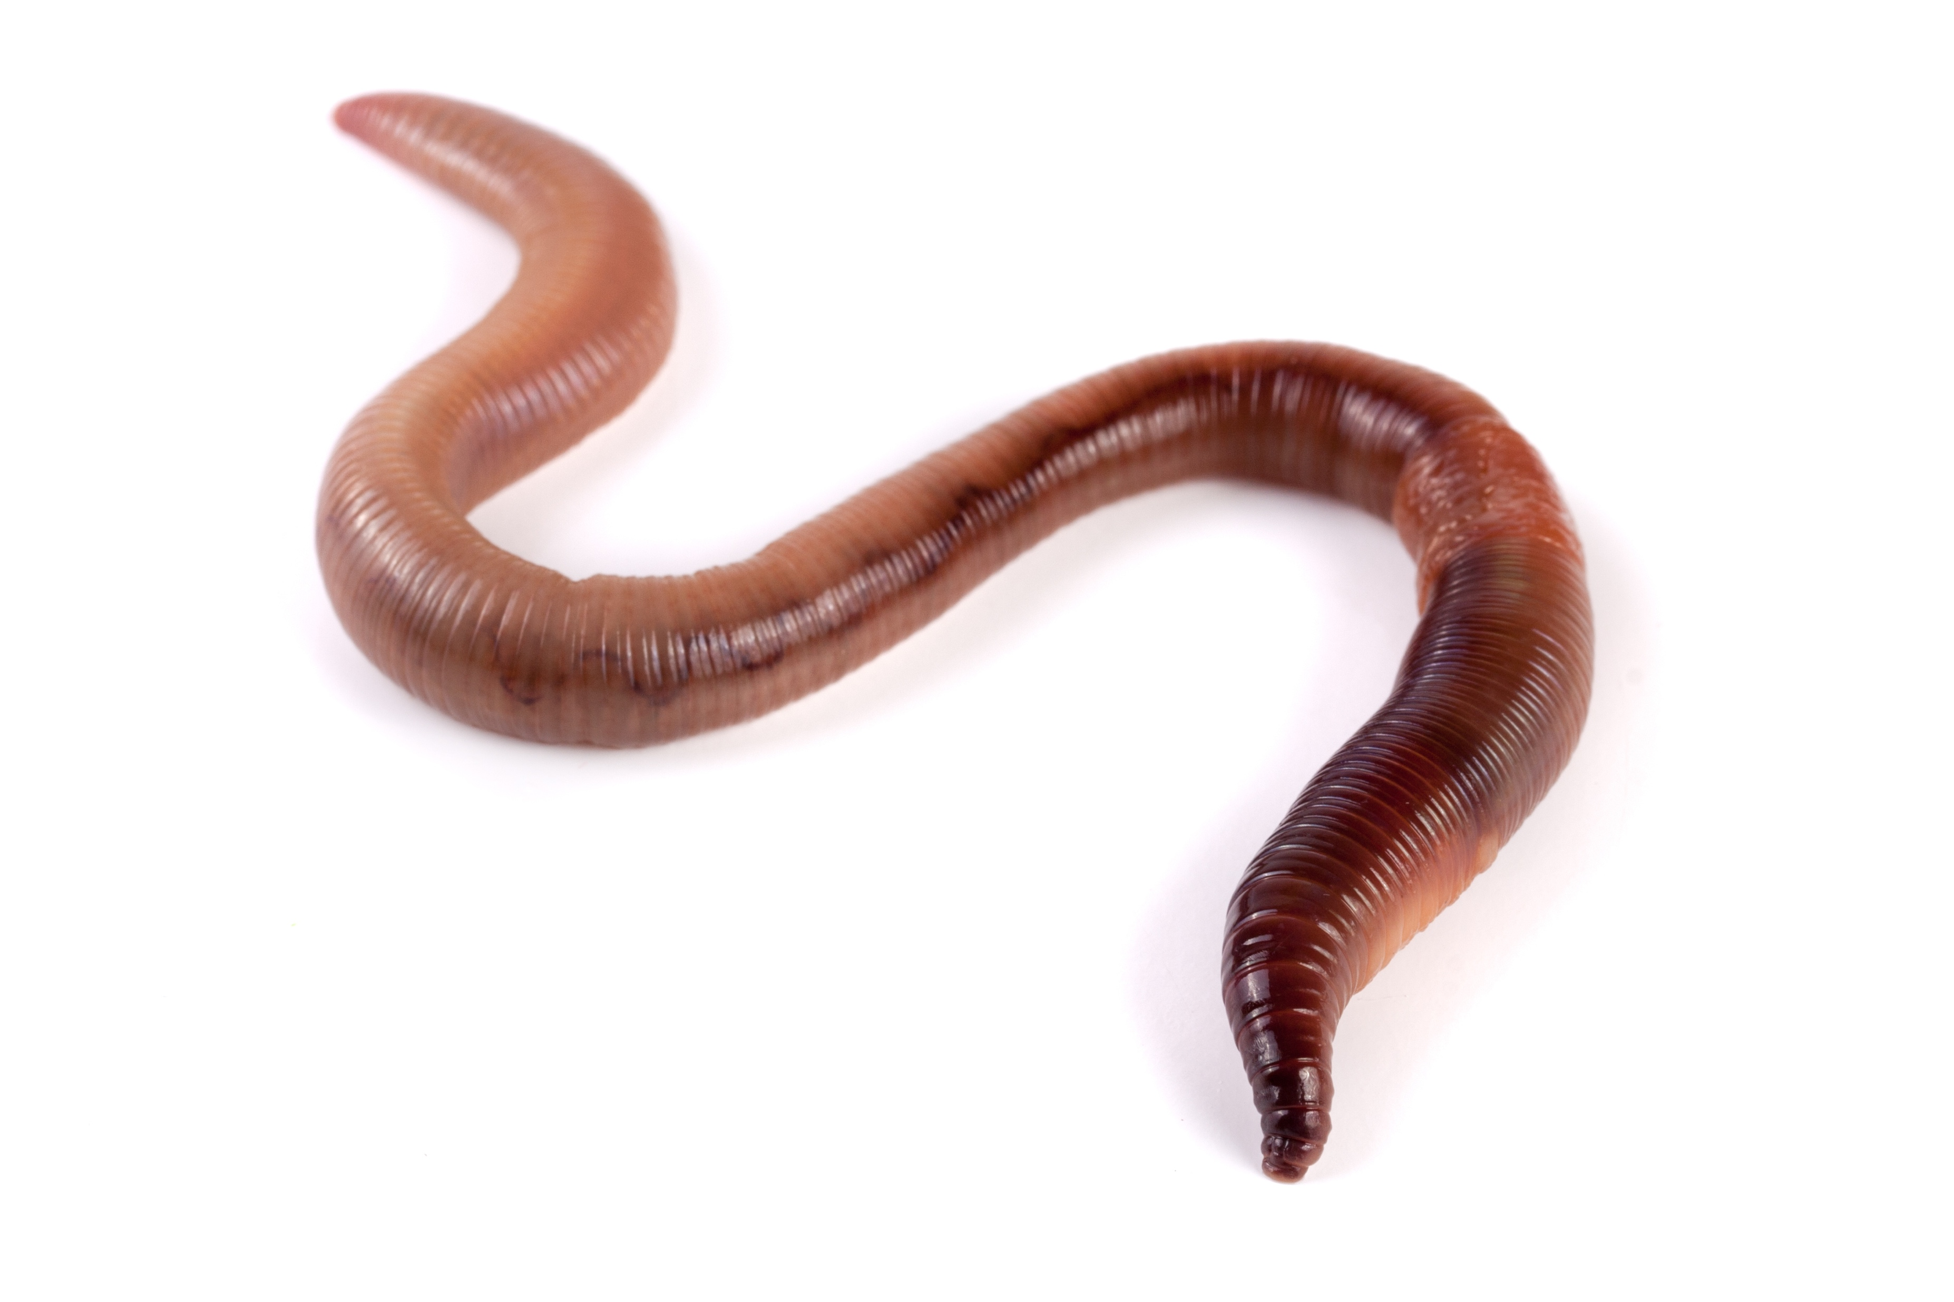
Five kotare share four worms equally. Each bird gets the same amount.
Ten kiwi share nine worms equally.
Which animal gets more worm, a kotare or a kiwi?

