Slide 1
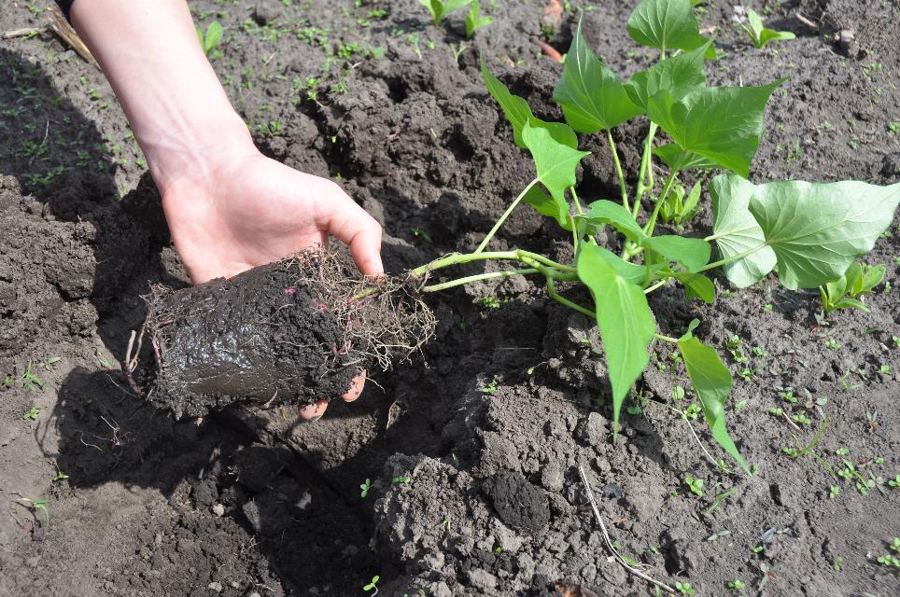
Mere has 60 kumara seedlings to plant.
She wants to space them out in tidy rows.
How many rows can she make?
How many seedlings will go in each row?

Slide 2
After Mere has planted her 60 seedlings Uncle Rewa gives her 12 more.
“That works out okay,” she says, “I’ll just put more plants in each row.”

Slide 3
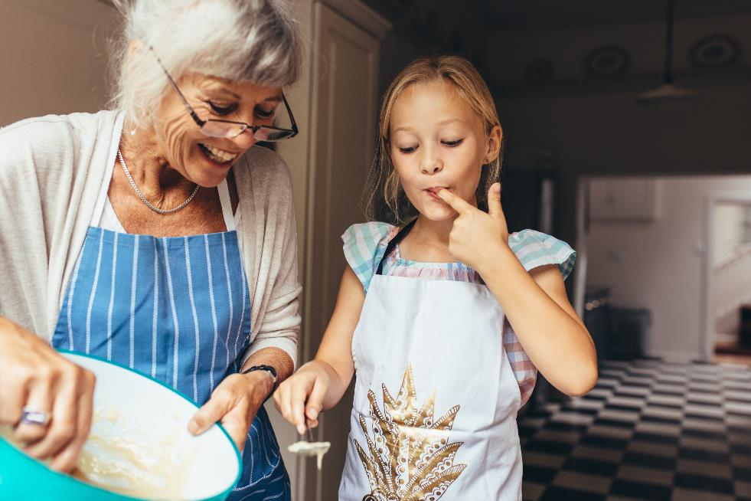
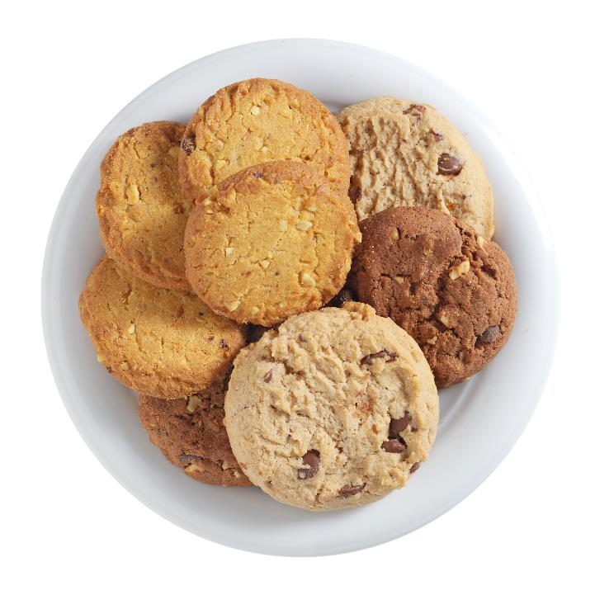
Arohia and her Kuia bake for the Kohunga Reo fundraiser.
They cook 24 raisin cookies, 48 oatmeal cookies, and 36 chocolate chip cookies.
Next, Arohia and kuia make up paper plates, and cover the biscuits with clingwrap.
How many of each type of biscuit should they put a plate?
All plates must be the same and all the biscuits must be used up.
No snacking, Arohia!

Slide 4
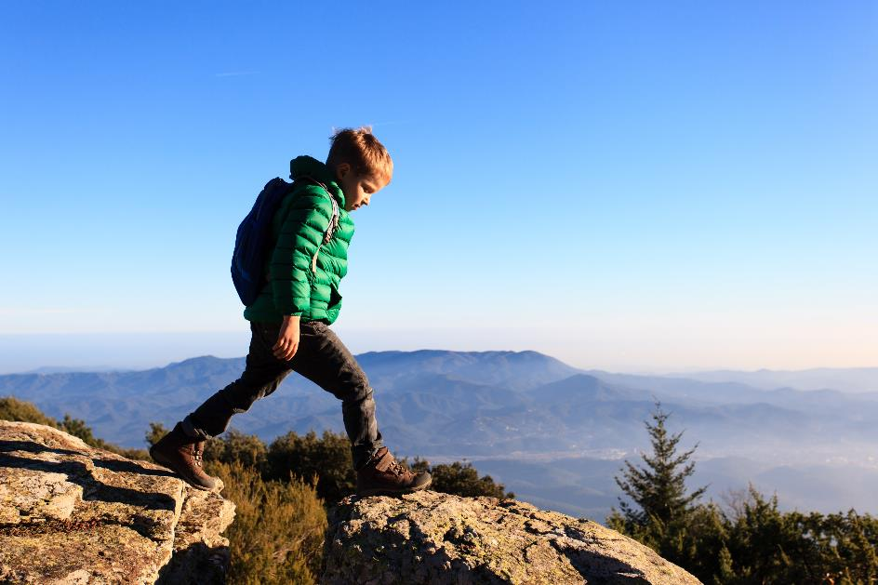
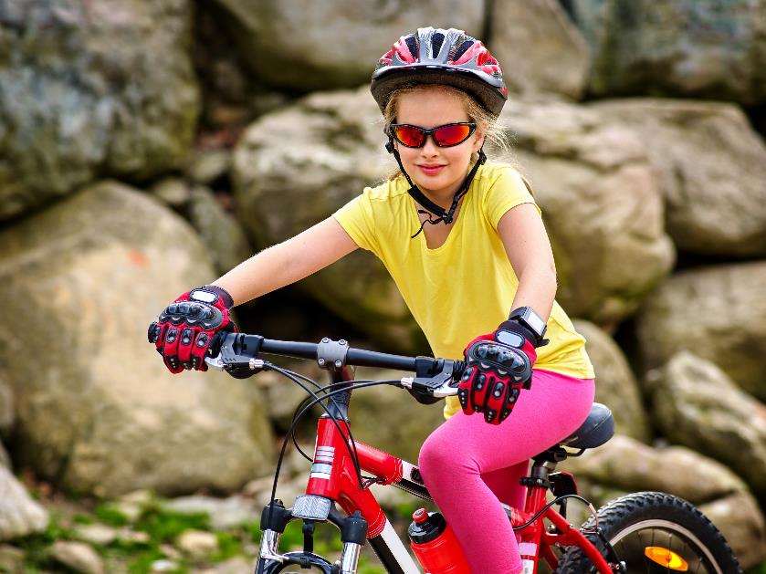
Niko is hiking a 25 kilometre track.
He can walk at about 3 kilometres per hour, including rest stops.
Kat is cycling a 58 kilometre trail .
She rides at about 7 kilometres per hour, including rest stops.
If they both start at 7:00am, who will finish their journey first?

Slide 5
Dicey Times
Roll the dice.
40
24
33
18
Maybe 2 comes up.
36
20
11
15
19
16
35
21
Write the number in a circle.
12
10
23
25
Roll the dice again.
2
5

Slide 6
Dicey Times
Score your game.
40
24
33
18
6
2
24 and 18 are both multiples of six.
36 and 15 are both multiples of three.
36
20
11
15
3
2
19
16
35
21
Add the numbers to get your total score: 25
5
1
12
10
23
25
2
2
4
2
1
3
5
40, 20, 35 and 25 are all multiples of five.
3
4
4
3
4

Slide 7
Dicey Times
23
25
20
12
5
16
17
18
15
3
36
10
24
14
2
48
30
28
29
4
6
5
4
3
1

Slide 8
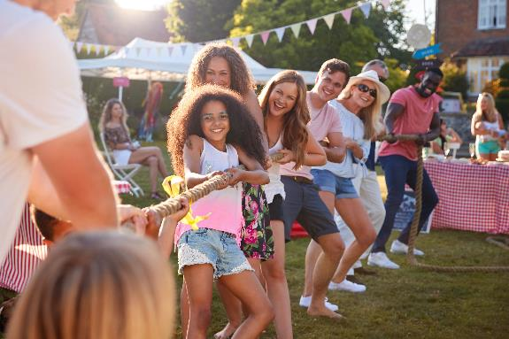
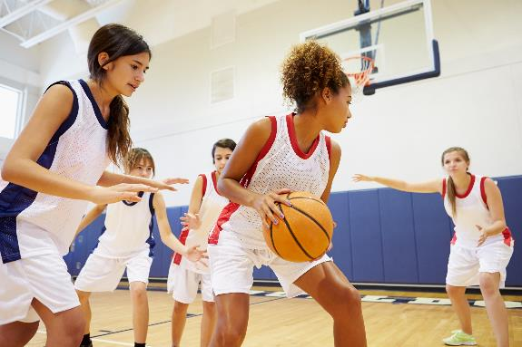
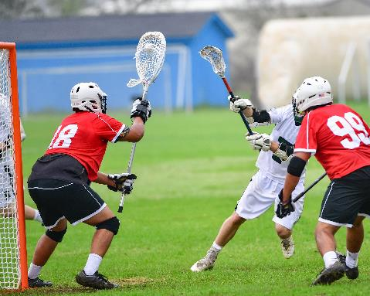
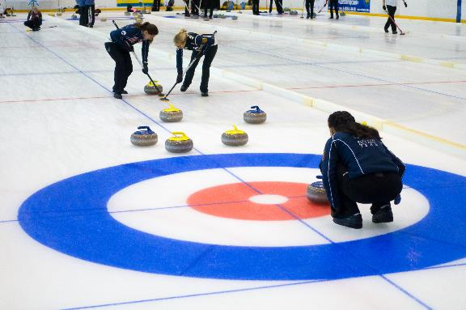
Tug of war
8 players per team
Basketball
5 players per team
Lacrosse
10 players per team
Curling
4 players per team

Slide 9
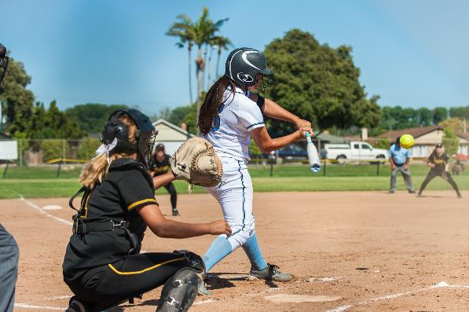
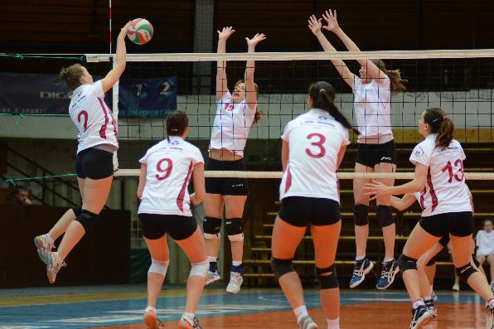
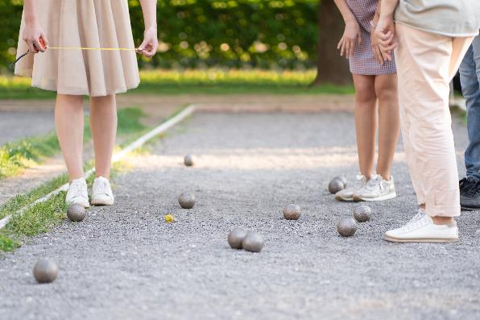
Softball
9 players per team
Volleyball
6 players per team
Petanque
3 players per team

