Slide 1
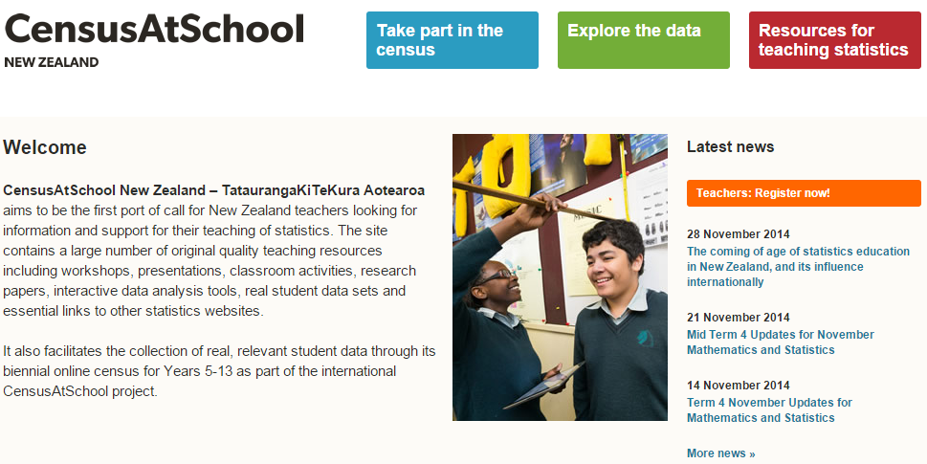
Preparing for CensusAtSchool 2015
Insert a pic here.

Slide 2
CensusAtSchool Purpose
Provide an online survey for students to participate in from Years 5 to 13.
Produce relevant REAL data to enhance statistical learning in the classroom.
Improve awareness of the uses of the last national Census on the 5th of March 2013.
Contribute to the database of CensusAtSchool International. http://www.censusatschool.org.uk/international-projects

Slide 3
About CensusAtSchool NZ
CensusAtSchool NZ gathers data from approximately 30 000 students from Okaihau School to Waianiwa School.
Is anonymous as no names or numbers are attached to individual participants.
Has been going in NZ since 2003.
NZ is one of several countries around the world including Australia, United Kingdom, USA, Japan, Korea, Canada & Ireland.
Is endorsed by Statistics NZ, the University of Auckland Statistics Department and the Ministry of Education.

Slide 4
Q19 Opinions about bullying
How can our class make sure bullying is understood to ensure consistency in our responses in the census?
Consider things such as this definition of bullying:
“A student is being bullied or victimised when he or she is exposed, repeatedly and over time, to negative actions on the part of one or more students” (Olweus, 1999, p. 10).
This definition should be discussed as a class to see what ideas students might have about the meaning of bullying.

Slide 5
Questions about bullying
Question 19 on the survey will require you to mark on a scale how much of a problem four types of bullying are at your school. Ensure you understand what the following mean:
Physical: Being physically aggressive towards others (i.e., hitting, kicking, pushing, damaging or stealing someone’s property).
Verbal: Being verbally aggressive towards others (i.e., hurtful, teasing, insulting, humiliating or threatening someone).
Social/Relational: Being socially aggressive towards others (i.e., deliberate exclusion of someone from ‘the group’ or from an activity, spreading rumours about someone).
Cyber: The use of technology to support deliberate hostile behaviour by an individual or group, that is intended to harm others.

Slide 6
Bullying is a sensitive subject: Be the change
If students are experiencing bullying behaviour or want help to stop bullying others. They can access support by talking to:
Parents
Teachers
School Councillors
Head teachers/Deans/Principals
Online help: http://www.bethechange.co.nz/

Slide 7
Thank you for participating in CensusAtSchool 2015
Data will be available for sampling and viewing after May 29th at censusatschool.org.nz

