Slide 2
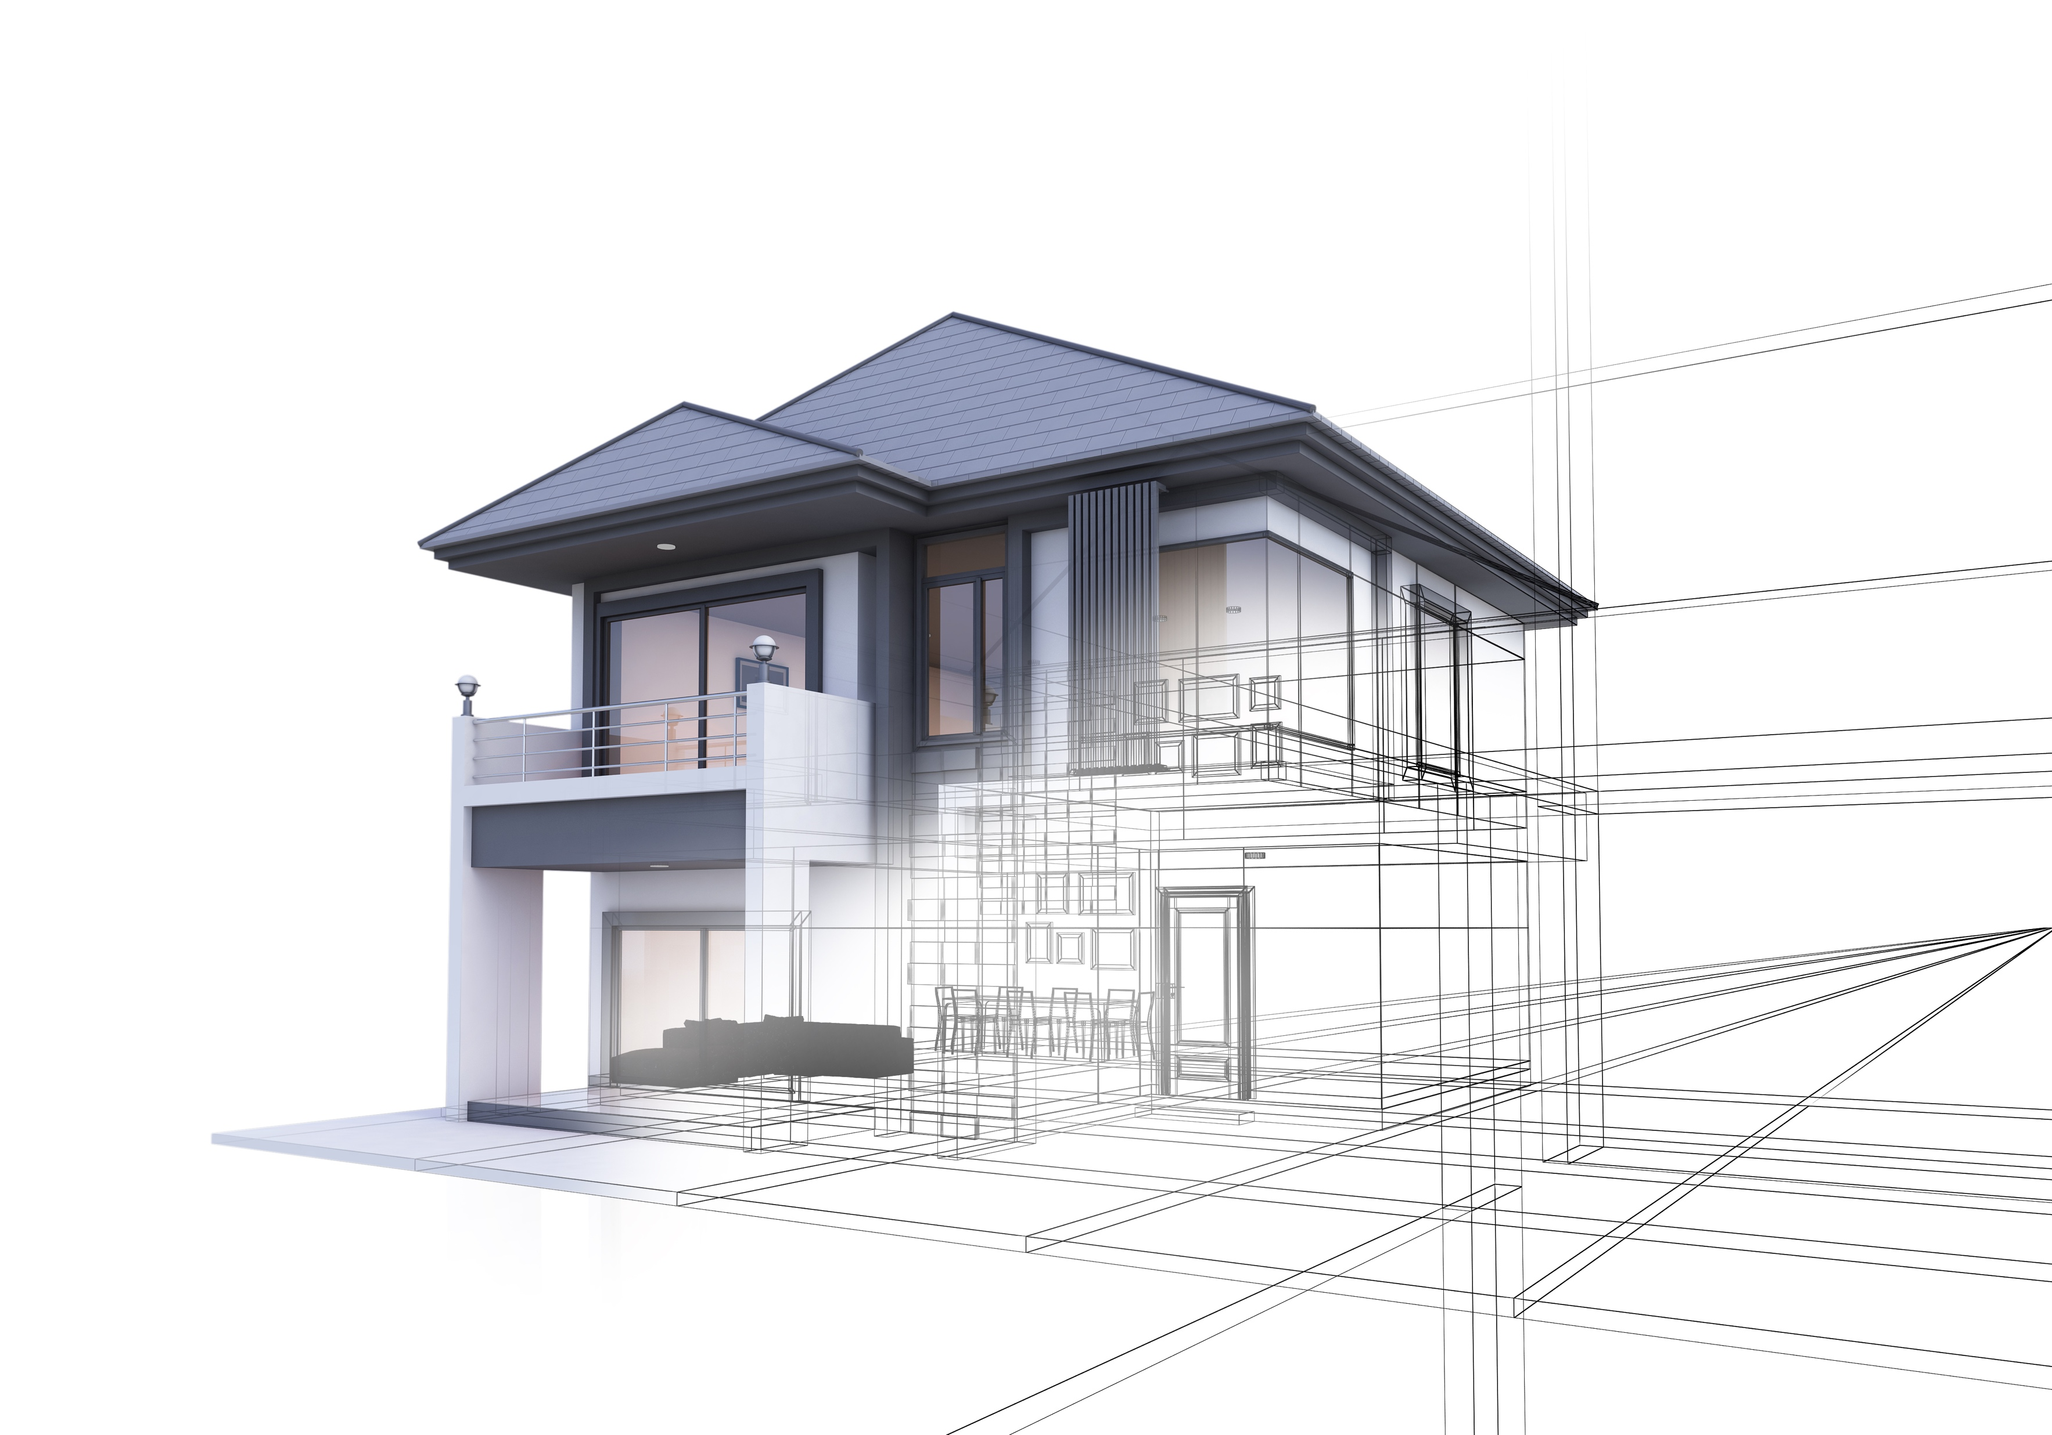
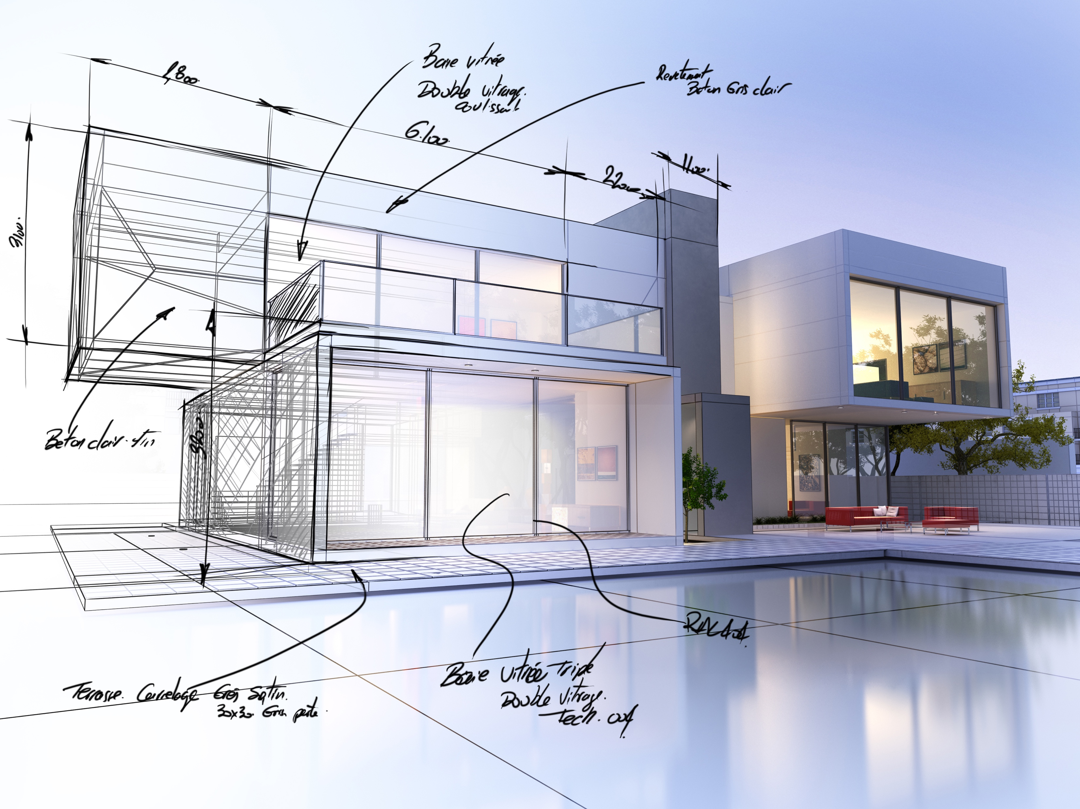

Slide 3
2
2
1
1
3
Top
Front
Right

Slide 4
3
1
3
1
4
3
2
Top
Front
Right

Slide 5
3
3
2
2
2
1
1
Top
Front
Right

