Slide 1


6
3
Hundreds | Tens | Ones
7
1
63+8
Add eight
Ten ones
answer

Slide 2
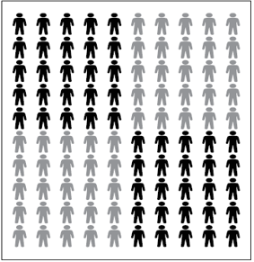

0
Hundreds | Tens | Ones
6
7
1
3
63+8
Add eight
Ten ones
answer

Slide 3
5
Hundreds | Tens | Ones
8
2
7
63+8
Ten ones
Subtract seven
answer

Slide 4
Hundreds | Tens | Ones
7
8
2
0
5
63+8
Ten ones
Subtract seven
answer

