Slide 1
Lucy and her dog Blaise are fascinated by number patterns.
“I think there must be a pattern when you multiply a number by eleven,” she says.
“Woof! Woof!” adds Blaise looking at the two digits in eleven.

Slide 2
Watch the video to show the calculation of 11 x 45.
Can you see any pattern in the digits of the answer?
11 x 45 = 495

Slide 3
Watch the video to show the calculation of 11 x 18.
Can you see any pattern in the digits of the answer?
11 x 18 = 198

Slide 4
Watch the video to show the calculation of 11 x 36.
Can you see any pattern in the digits of the answer?
11 x 36 = 396

Slide 5
Predict the answers to the next three 11 x facts.
Predict first then play the video to check your answer.
11 x 32 = ?

Slide 6
Predict first then play the video to check your answer.
11 x 44 = ?

Slide 7
Predict first then play the video to check your answer.
11 x 57 = ?

Slide 8
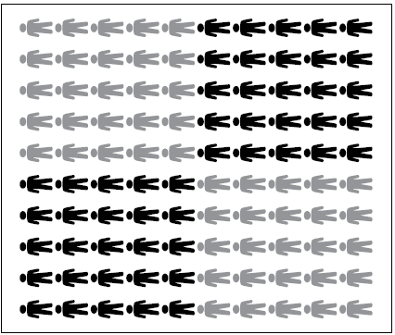
Hundreds | Tens | Ones
11x27
11x27

Slide 9
2 7
×
1
1
2 7
2 7 0
2 9 7

Slide 10
7 9
×
1
1
1
7 9
7 9 0
8
6
9

